Slide 1
Antibody Drug Conjugates: due generazioni a confronto
Marzia Del Re
UO Farmacologia clinica e Farmacogenetica
Università di Pisa

Slide 2
Ideal characteristics in each component of ADC design.
Marks and Naiido Lung Cancer 2022

Slide 3
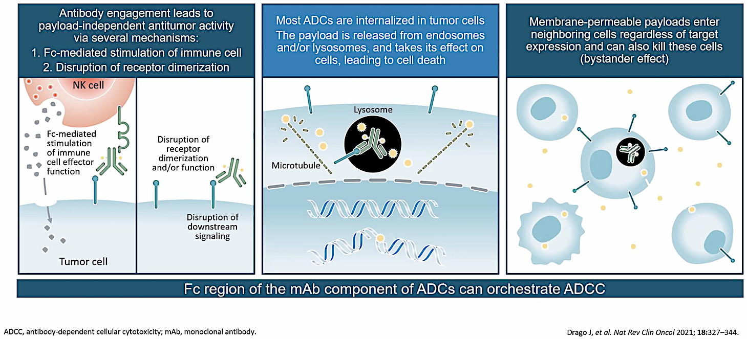
ADC mechanism of action

Slide 4
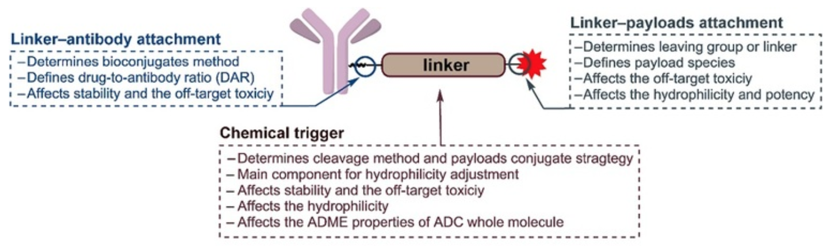
The linker connects the antibody and the cytotoxic payload and is a key component in the function of ADCs
Su Z, et al. Acta Pharmaceutica Sinica B https://doi.org/10.1016/j.apsb.2021.03.042

Slide 5
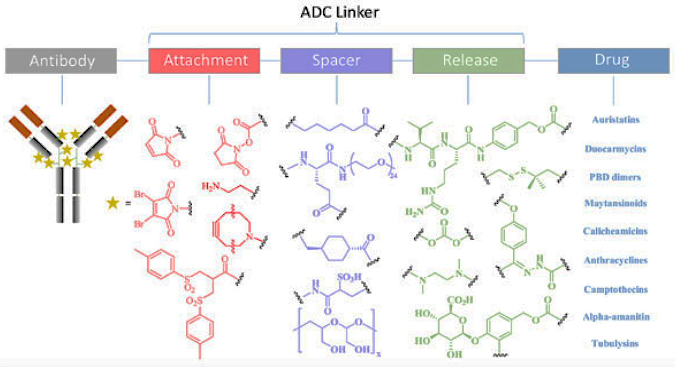
Design and Synthesis of Linkers for ADCs
Frigerio M, Kyle AF. Curr Top Med Chem. 2017;17(32):3393-3424.

Slide 6
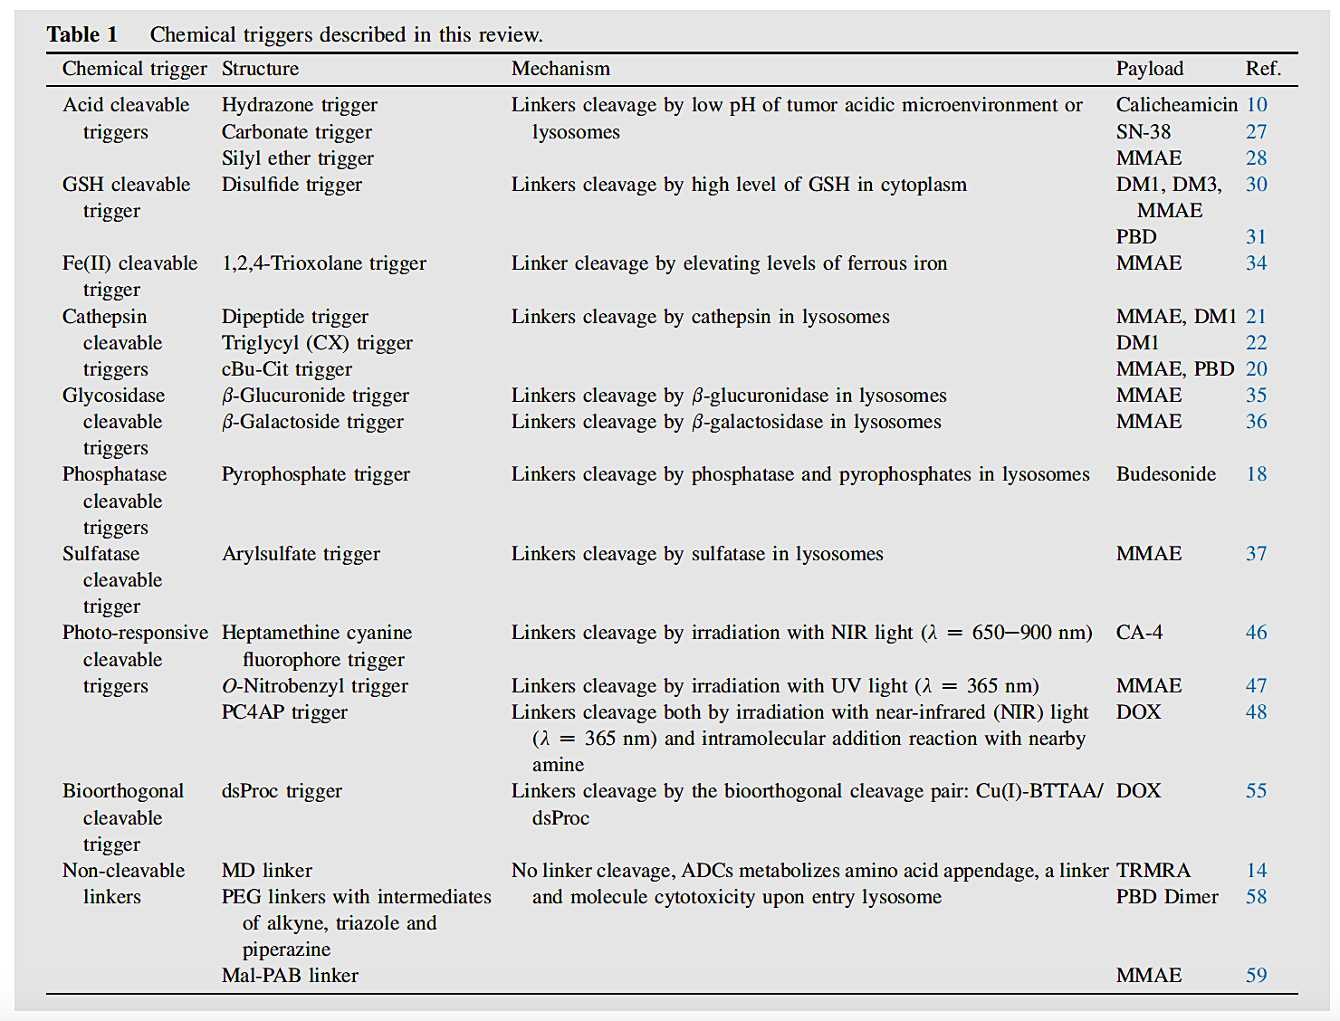
Linker Technologies (II)
Su Z, et al. Acta Pharmaceutica Sinica B https://doi.org/10.1016/j.apsb.2021.03.042

Slide 7
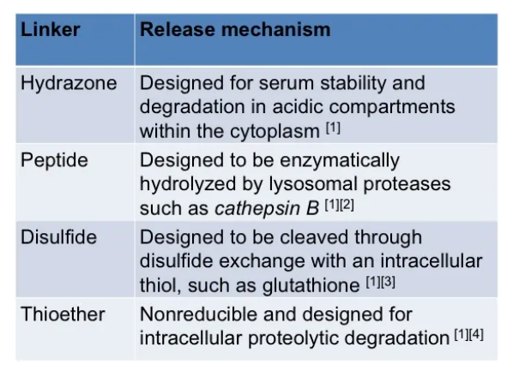
Linker Technologies
Chemically Labile Linkers
Acid-Cleavable Linkers
Reducible Linkers
- Peptide-Based Linkers (easy release of the cytotoxic drugs upon cleavage by specific intracellular proteases, such as cathepsin B)
- β-Glucuronide Linkers (cleavage by β-glucuronidase, an enzyme present in lysosomes or the tumor interstitium abundantly presenting in lysosomes, and is overexpressed in some tumors)
https://www.adcreview.com/the-review/what-are-stable-linkers/

Slide 8
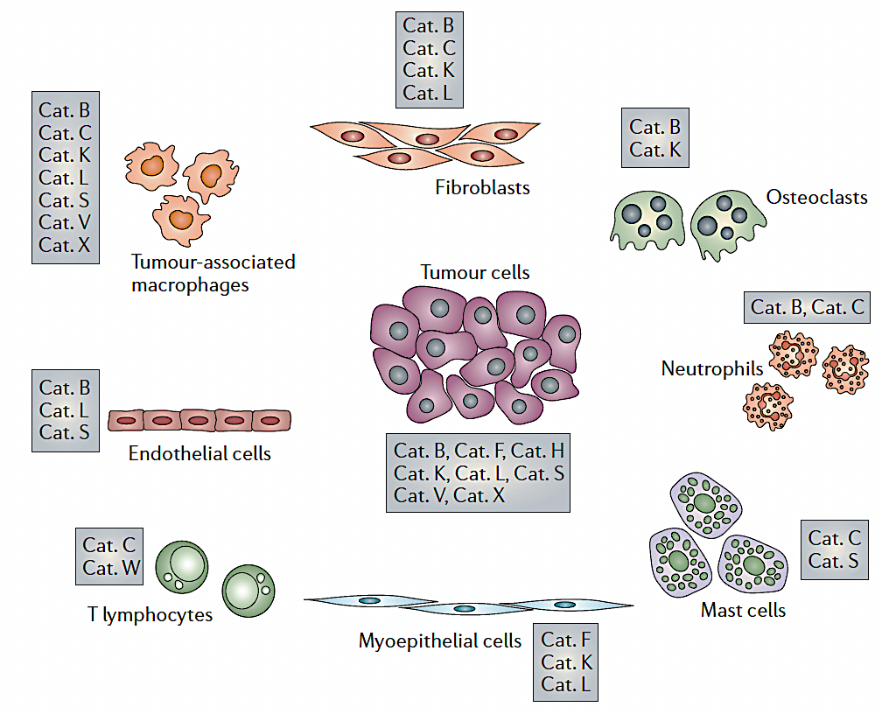
The cysteine cathepsins that are known to be expressed in tumour cells and tumour-associated cells, and have been identified as contributing to neoplastic progression
Mona Mostafa Mohamed and Bonnie F. Sloane. NATURE REVIEWS CANCER 6 (2006) 765

Slide 9
Optimised linker design maintains ADC stability in circulation while allowing payload release in tumour cell
ADCs with a non-cleavable linker must be internalised by the target cell to be degraded before release of the drug.
No efficient bystander effect because of less quantity of payload released.
Non-cleavable ADCs are primarily effective against the target antigen-expressing cell after internalisation and are best suited to treat cancers that have high and homogenous expression of the target antigen.
ADCs with a cleavable linker can be cleaved at a defined pH range or by specific proteases to release the free drug.
The resulting free drug can directly kill the target cell and can diffuse out of the target cell to cause bystander killing.
Depending on the linker type and drug combination, non-internalising ADCs may have additional advantages by exploiting features of the tumor microenvironment such as hypoxia, acidity, abundance of both active extracellular proteases and protease-rich tumour-infiltrating myeloid cells.
Payload
Antibody
Linker
Non-cleavable linkers
Increase ADC stability
Reduced payload membrane permeability
→ No bystander effect
Cleavable linkers
Allows tumour-specific enzymatic cleavage
Increased payload membrane permeability
→ Facilitate the bystander effect
Díaz-Rodríguez E, et al. Cancers. 2022;14:154
Su , et al. Acta Pharmaceutica Sinica. 2021;11(12):3889–3907

Slide 10
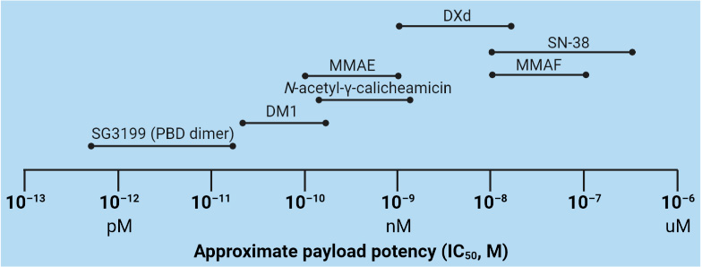
Comparison of approximate payload potency ranges
Tong JTW et al. Molecules 2021, 26, 5847

Slide 11
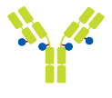

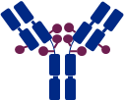

Examples of ADCs: differ following payload release
STEP 1: Binding
recognition of the target on the cell surface
STEP 2: Internalisation
ADC–Target complex is internalised via
receptor-mediated endocytosis
Internalisation
endosome
Apoptosis
Mitotic catastrophe
DNA replication block
Cell death
STEP 3: Lysosomal degradation
ADC degradation by proteases releases the active cytotoxic metabolite
microtubules
Topoisomerase I
lysosome
lysosome
STEP 4: Cytotoxic release
Cytotoxic agent interferes with DNA replication or microtubule assembly, resulting in cell death
Bystander effect
A membrane-permeable payload can exert bystander anti-tumour activity
Díaz-Rodríguez E, et al. Cancers. 2022;14:154.

Slide 12
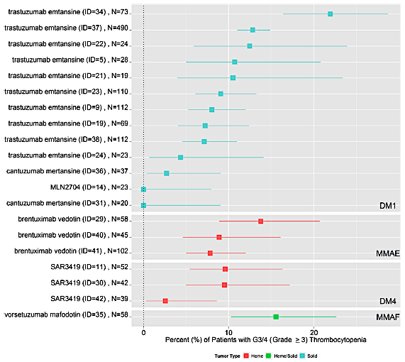
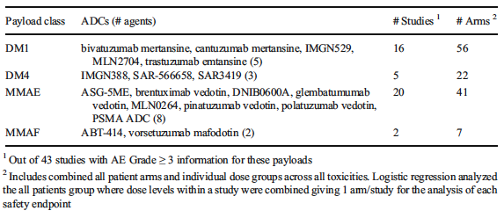
ADC-induced hematological toxicity
DM1 emtansine
DM4 ravtansine
MMAE monomethyl auristatin F
MMAF monomethyl auristatin F
Masters, J.C., et al. Invest New Drugs 36, 121–135 (2018)

Slide 13
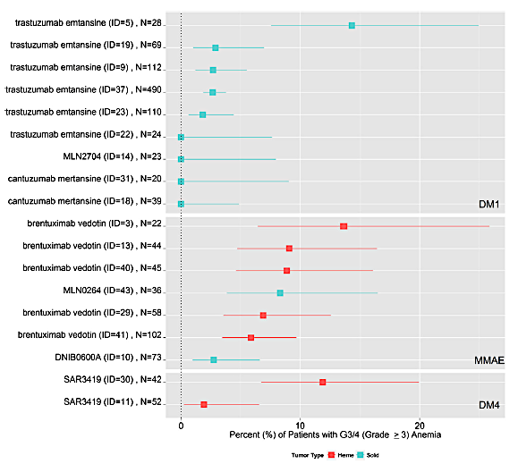
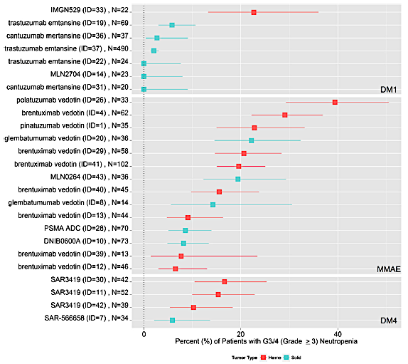
ADC-induced hematological toxicity
Masters, J.C., et al. Invest New Drugs 36, 121–135 (2018)

Slide 14
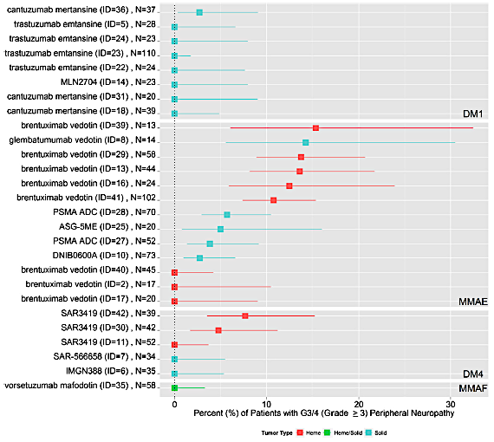
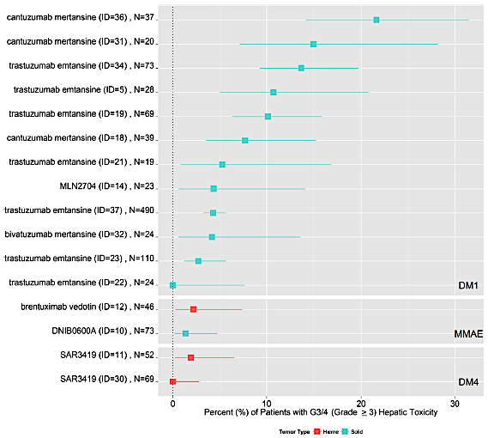
ADC-induced neuropaty and hepatic toxicity
Masters, J.C., et al. Invest New Drugs 36, 121–135 (2018)

Slide 15
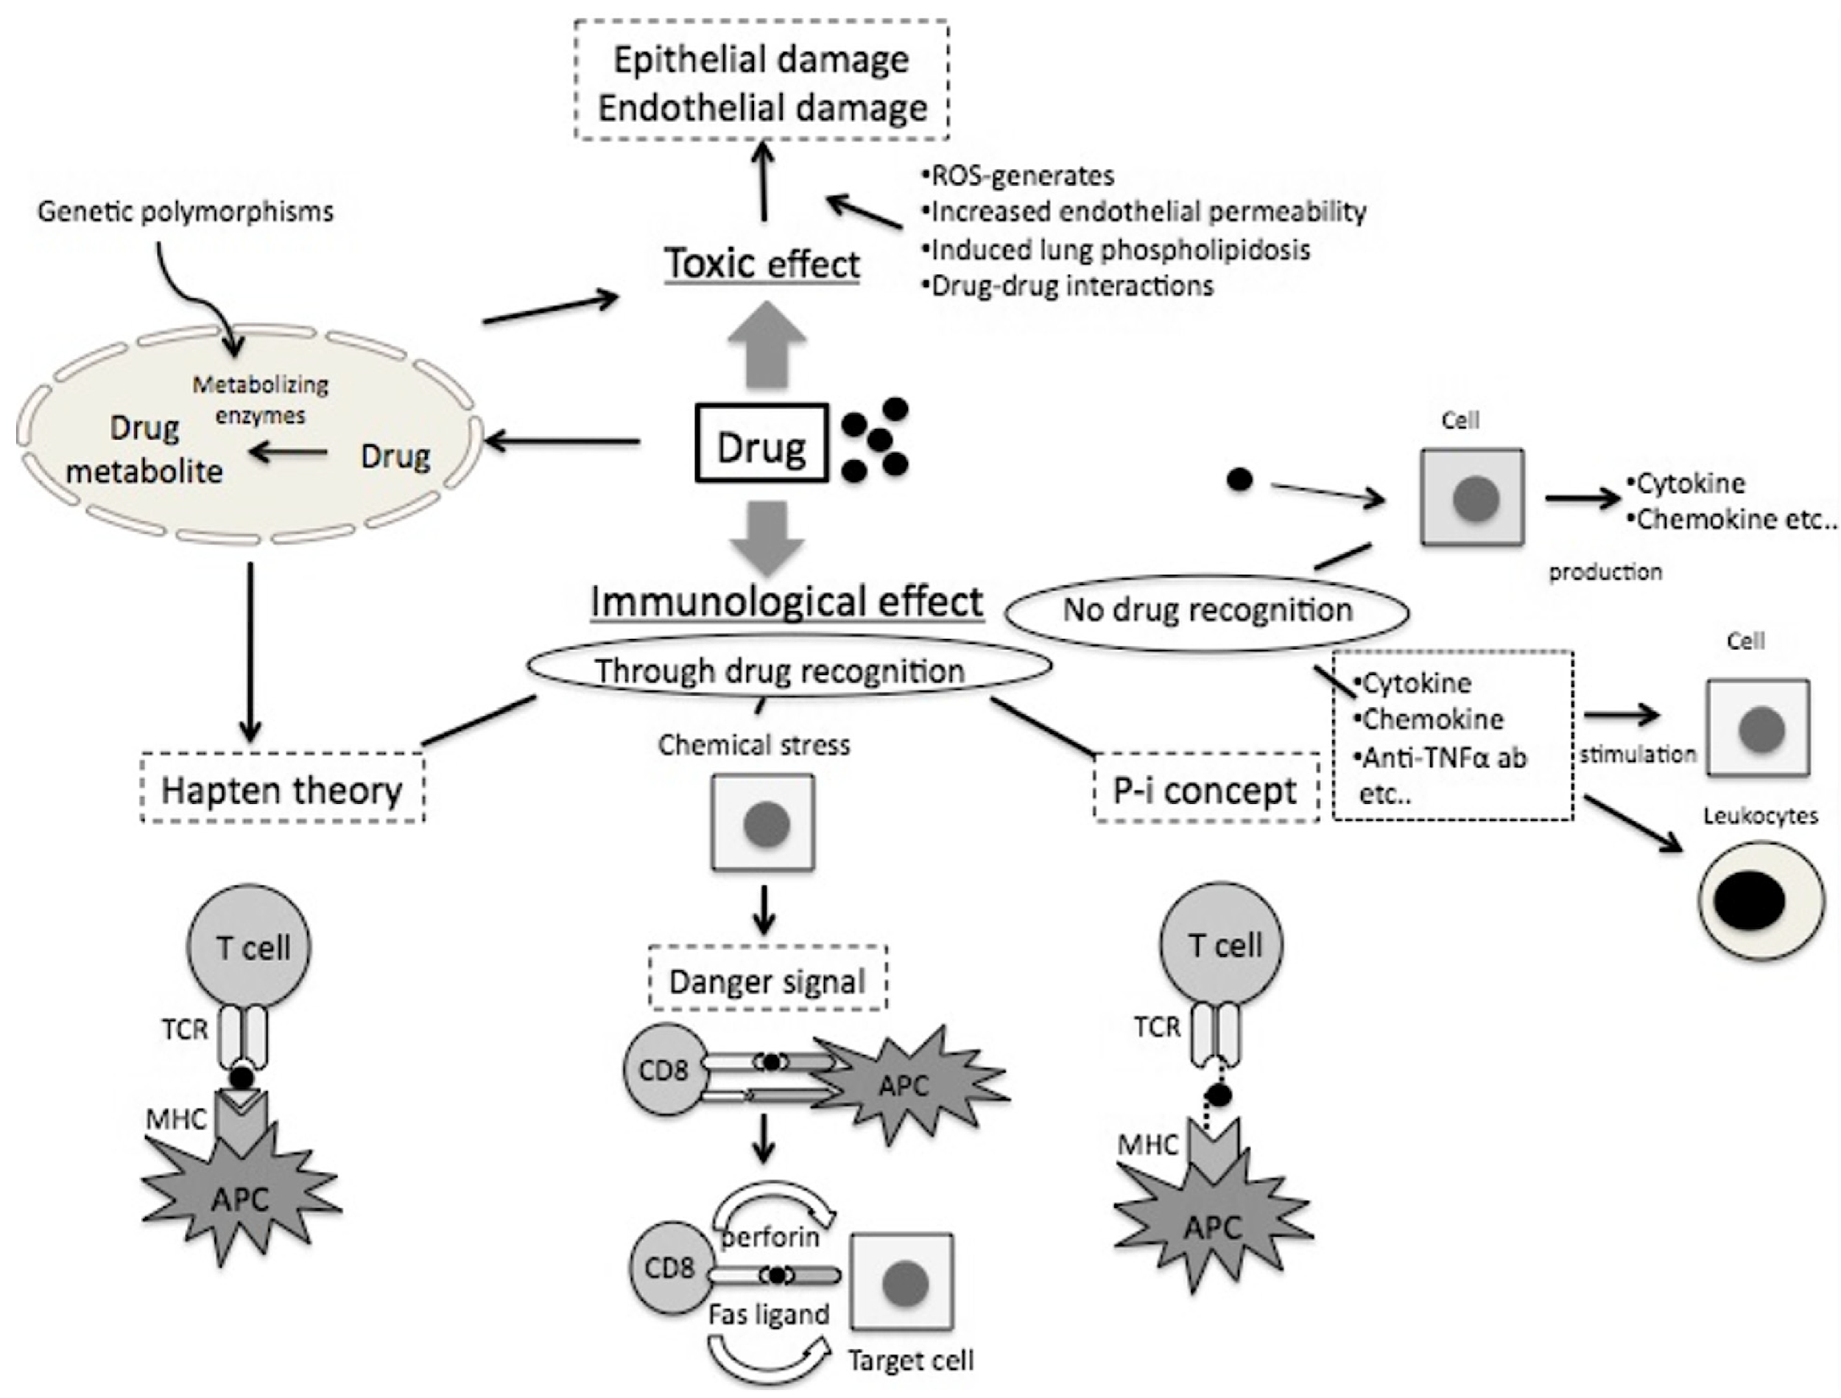
Mechanisms of drug-induced pulmonary toxicity
15
Matsuno A. Respiratory Research 2012, 13:39

Slide 16
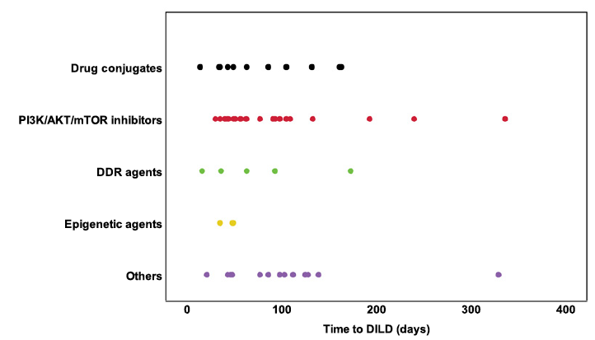
Timing of onset of DILD with each drug class
74 d (median)
63 d (median)
63 d (median)
41 d (median)
16
Terbuch A et al. Clin Cancer Res 2020;26:4805-4813

Slide 17
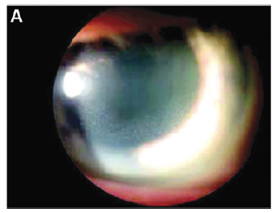
ADC-induced ocular toxicity (keratopathy)
There is a clear payload association, with ocular toxicity typically induced by ADCs that include DM4 and MMAF. Both tend to utilize a stable linker: a stable cleavable disulfide link in the case of SPDB-DM4, and an uncleavable link in the case of mc-MMAF.
The mc-MMAF produces cysteine-mc-MMAF as the charged active metabolite within the cell.
It is unclear why the eye is particularly sensitive to toxicities with these payloads, but, for MMAF-conjugated ADC, the toxicity may be related to accumulation of the drug within cells.
Donaghy H, MABS 2016;8:659–671

Slide 18
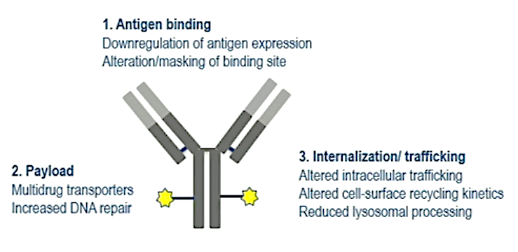
ADCs: development of resistance
Erika P. Hamilton @ASCO2023

Slide 19
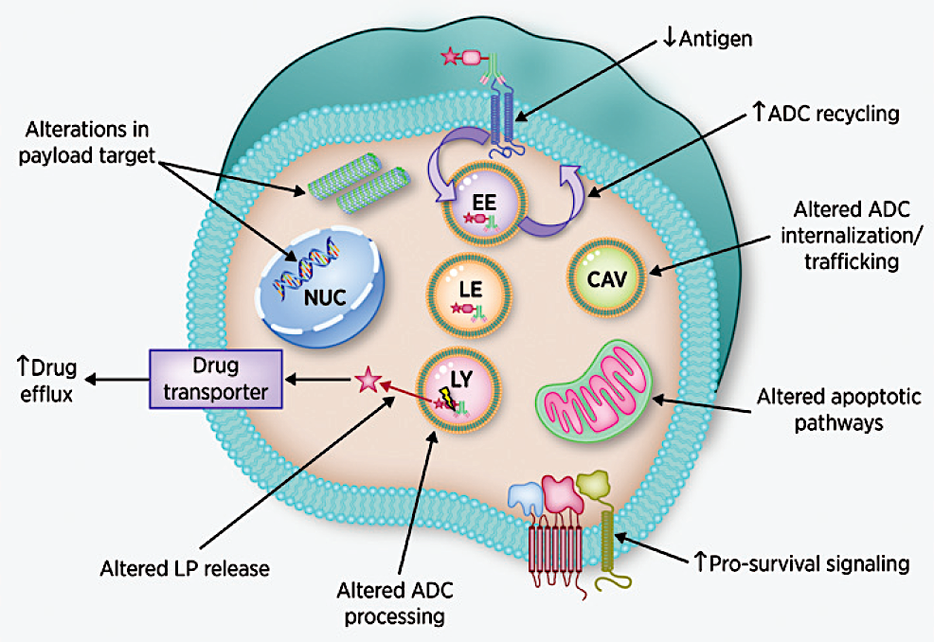
Emerging mechanisms of ADC resistance
Frank Loganzo et al. Mol Cancer Ther; 15(12) December 2016

Slide 20
Final summary
Gli ADCs sono caratterizzati da un triplo meccanismo di azione: 1) inibizione del target, 2) citotossicità diretta, 3) effetto bystender
La chimica del linker determina un significativo impatto sull’effetto bystander, dipendente anche in parte dall’eterogeneità spazio-temporale dell’espressione del target
Le tossicità degli ADC sono quelle note legate all’anticorpo ed al citotossico
Meccanismi di resistenza agli ADC possono essere target-dipendenti o indipendenti, aprendo nuovi scenari di sequenze terapeutiche

