Slide 1


Dott.ssa Silvia Taroni
Medico Diabetologo presso l’Azienda Usl della Romagna, unità operativa Endocrinologia di Forlì-Cesena. Esperienza pluriennale nella gestione delle terapie farmacologiche e dei dispositivi medici ad alta tecnologia per i pazienti diabetici.

Slide 2
NUOVI SCENARI CLINICI E TERAPEUTICI DELLA PATOLOGIA DIABETICA E “DIABETE TECNOLOGICO”: LA TECNOLOGIA GIUSTA AL PAZIENTE GIUSTO, VALUTAZIONI CLINICHE E TECNOLOGICHE
Silvia Taroni
UOC Endocrinologia e Malattie Metaboliche Romagna
AUSL della Romagna
Ambito di Forlì
Direttore Dott. Maurizio Nizzoli

Slide 3
Dichiarazione dei conflitti d’interesse
Ai sensi dell’art. 4.5 su “Docenti e moderatori dell’evento”, pag. 8 del Manuale Nazionale di Accreditamento per l’erogazione di eventi ECM del 06/12/2018, dichiaro che nell’ultimo biennio NON ho avuto fonti di finanziamento e rapporti con i seguenti soggetti portatori di interessi commerciali in ambito sanitario.

Slide 4


Metformina, Pioglitazone, Gliclazide RM, Repaglinide, Glimepiride
aGLP-1
iSGLT-2

Slide 5
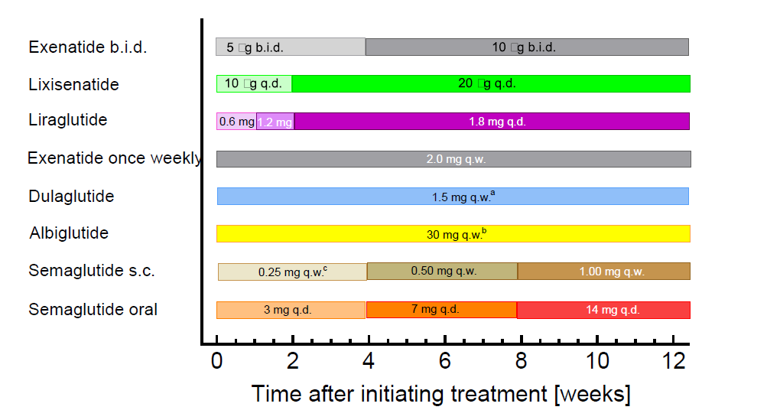
aGLP-1: quali sono e come somministrarli
Tempistiche di somministrazione
BIS IN DIE
GIORNALIERA
SETTIMANALE
GIORNALIERA
Naukc , J Mol Metab, 2021

Slide 6
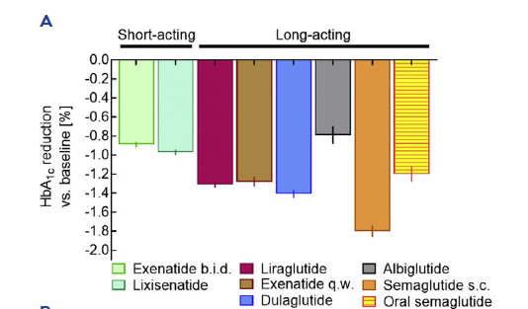
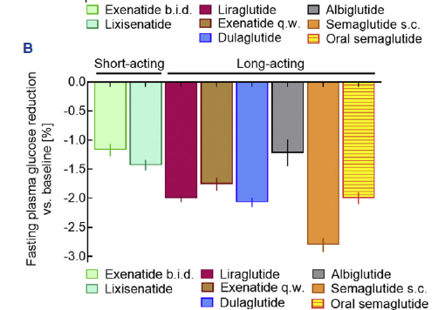
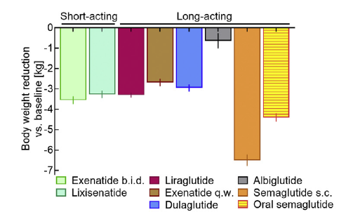
aGLP-1: aspetti metabolici, non sono tutti uguali
Kristensen, lancet diabetes endocrinol 2019
Metanalisi su medline chochrane
56004

Slide 7
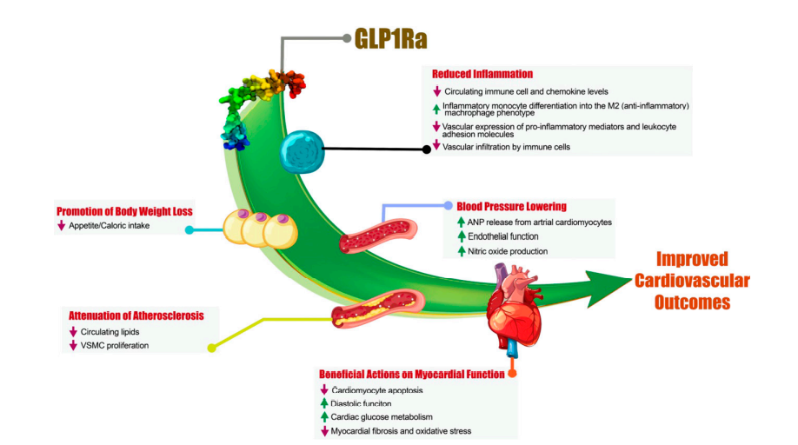
Potenziali meccanismi che contribuiscono al beneficio cardiovascolare
dei GLP-1Ra
Cardiovascular Effects of Incretin-Based Therapies: Integrating Mechanisms With Cardiovascular Outcome Trials John R. Ussher, Amanda A. Greenwell, My-Anh Nguyen and Erin E. Mulvihill. Diabetes 2022;71:173–183

Slide 8
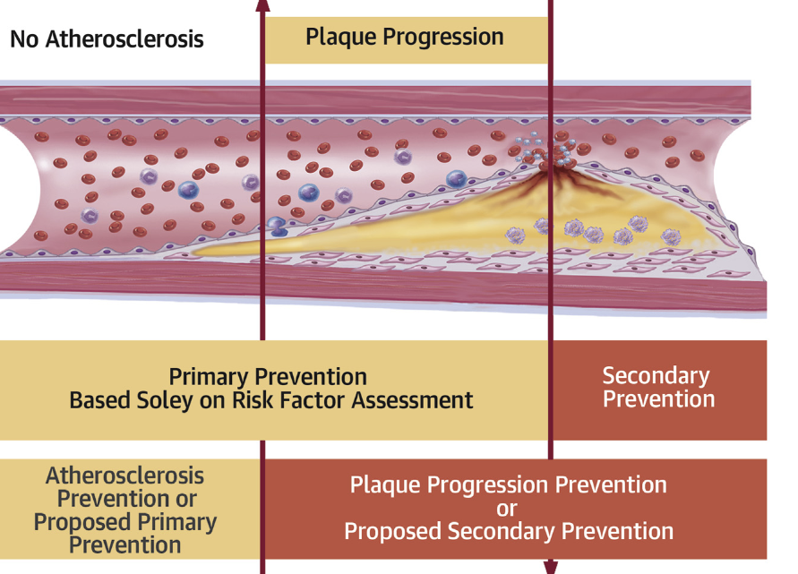
Dalla disfuzione endoteliale all’evento clinico
Storia naturale della malattia aterotrombotica
Pratica corrente:
Approccio legato a prevenzione primaria o secondaria
Approccio innovativo:
Intervenire precocemente sulla storia naturale dell’aterotrombosi
Ahmadi A, et. al J Am Coll Cardiol. 2019

Slide 9
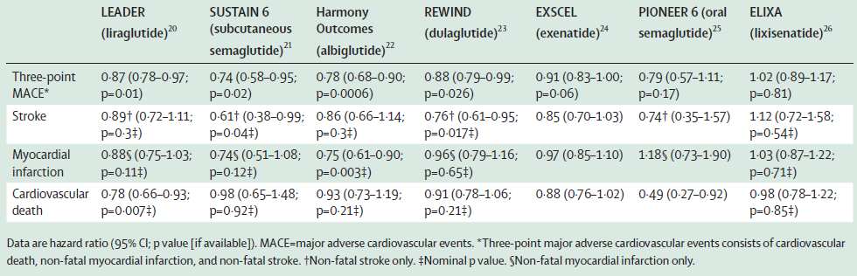


End point primario nei singoli studi CVOT con aGLP-1: chi ha raggiunto il MACE
Bentley-Lewis R, et al. Am Heart J 2015;169(5):631-8; Pfeffer MA, et al. N Engl J Med 2015;373:2247-57; Marso SP, et al. N Engl J Med 2016;375:311-22; Mann JFE, et al. N Engl J Med 2017;377(22):2197-8; Marso SP, et al. N Engl J Med 2016;375:1834-44; Mentz RJ, et al. Am Heart J 2017;187:1-9; Holman RR, et al. N Engl J Med 2017 ;377:1228-39; Hernandez AF, et al. Lancet 2018;392:1519-29; Gerstein HC, et al. Lancet. 2019;394(10193):121-130.
Comprovata Protezione cardiovascolare
Protezione cardiovascolare non dimostrata
Marx N, Davies MJ, Grant PJ, Mathieu C, Petrie JR, Cosentino F, Buse JB. Guideline recommendations and the positioning of newer drugs in type 2 diabetes care. Lancet Diabetes Endocrinol. 2021 Jan;9(1):46-52

Slide 10

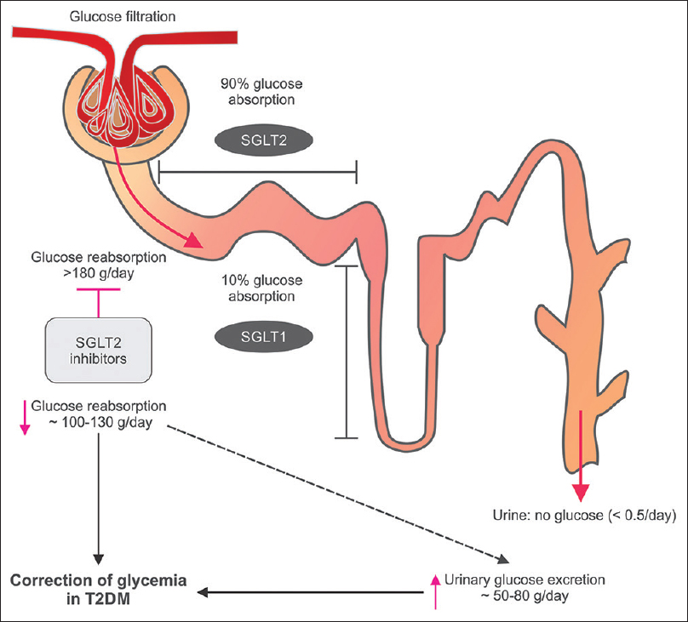
DAPAGLIFLOZIN
EMPAGLIFLOZIN
CANAGLIFLOZIN
ERTUGLIFOZIN
SGLT : Cotrasportatori sodio-glucosio
SGLT1 trasportatore a bassa capacità nel tenue e nel tubulo contorto prossimale
SGLT2 ad alta affinità a livello del tubulo contorto prossimale
Hba1c 0.4-0.8 %
PA 5-7 mmHg
Peso 2-3 kg
Albuminuria 30-40%
Meccanismo insulino-indip
Diuresi osmotica e natriuresi

Slide 11













Gli effetti degli inibitori SGLT2 sui sistemi cardio-renale-metabolico possono essere mediati da molteplici meccanismi
Inibitori SGLT2 (insulino-indipendenti)
Intermediate
effects
Effetti osservati a valle
Na⁺
3P-MACE ⁵
↓14%
Diuresi ¹
Inibizione dei recettori di scambio Na⁺/H⁺ ²
Pressione intraglomerulare
(via TGF) ²
Postcarico (miglioramento della funzione vascolare) ³
Morte CV ⁵
↓38%
Escrezione
di glucosio ¹
Mortalità per tutte le cause ⁵
↓32%
Sollecitazione parete VS/
Massa VS ³
Precarico (diminuito
volume interstiziale) ³
HHF ⁵
↓35%
Natriuresi ¹
Incidenza di nefropatia o in peggioramento ⁶
↓39%
Bioenergetica ²
Infiammazione e stress ossidativo (fibrosi) ²
Ematocrito ⁴
SGLT2: sodium‐glucose cotransporter 2, LV: left ventricular; HHF: hospitalisation for heart failure; TGF: tubuloglomerular feedback
1. Giugliano et al. Cardiovasc Diabetol (2021) 20:17; 2. Barutta et al., Diabetes Metab Res Rev. 2019;e3171; 3. Margonato D et al., Heart Failure Reviews (2021) 26:337–345; 4. Sano M et al., J Clin Med Res. 2016;8(12):844-847, 5. Zinman B et al. N Engl J Med 2015:373:2117; 6. Wanner C et al. N Engl J Med 2016;375:323

Slide 12
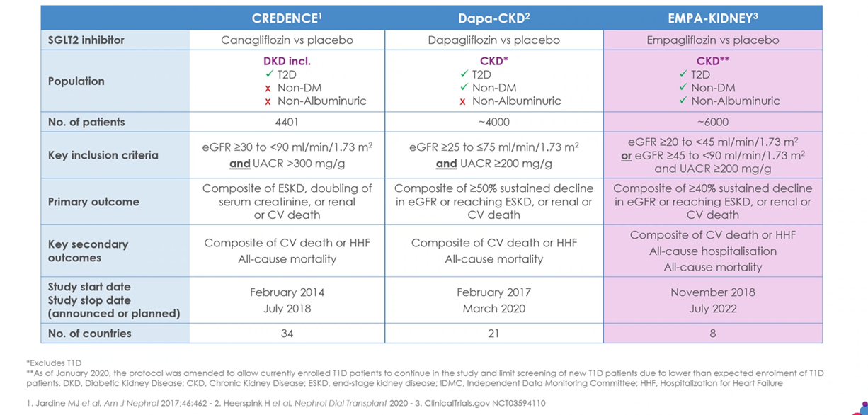
Trial Randomizzati e Controllati degli SGLT2-i per DKD/CKD

Slide 13
Mean Change of HbA1c, Blood Pressure and Body Weight
 | HbA1c | Systolic Blood Pressure | Body Weight
Empagliflozin | - 0.66 | - 3.66 | - 2.24
Canagliflozin | - 0.86 | - 4.87 | - 2.47
Dapagliflozin | - 0.66 | - 3.01 | - 2.18
Lixisenatide OD | - 0.55 |  | - 0.78
Liraglutide OD | - 1.15 | - 4.04 | - 1.96
Semaglutide OW | - 1.6 | - 2.7 | - 4.5
Exenatide OW | - 1.08 | - 3.64 | - 1.49
Albiglutide OW | - 0.94 |  | - 0.41
Dulaglutide OW | - 1.21 | - 3.35 | - 1.57
Semaglutide OD | - 0.9 |  | - 0.2
iSGLT-2
o
aGLP-1
Effect of Hemoglobin A1c Reduction or Weight Reduction on Blood Pressure in Glucagon‐Like Peptide‐1 Receptor Agonist and Sodium‐Glucose Cotransporter‐2 Inhibitor Treatment in Type 2 Diabetes Mellitus: A Meta‐Analysis. Mengdie Hu, Xiaoling Cai, Wenjia Yang, Simin Zhang, Lin Nie, Linong Ji. J Am Heart Assoc. 2020 Apr 7; 9(7): e015323.

Slide 14


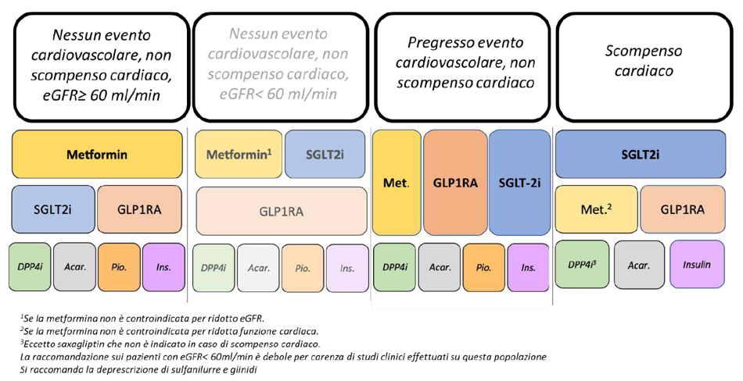
“LINEE GUIDA ITALIANE PER IL TRATTAMENTO DEL DIABETE DI TIPO 2 – Versione aggiornata a Dic 2022”
Linea guida pubblicata nel Sistema Nazionale Linee Guida
Aggiornamento del
23 febbraio 2023
N.B. Gli insulino-secretagoghi (sulfaniluree e repaglinide) hanno minore efficacia a lungo termine, con rischio di ipoglicemia e mortalità maggiori delle altre classi e pertanto non dovrebbero essere più considerati nel trattamento del paziente con diabete di tipo 2.
Pre-esistenti trattamenti dovrebbero essere progressivamente deprescritti o sostituiti con altre terapie

Slide 15

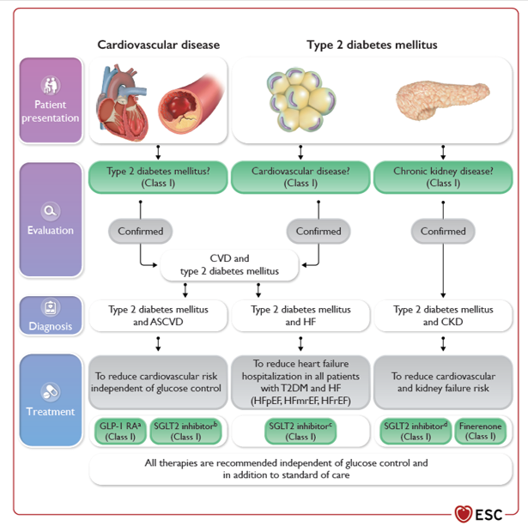
Gestione della malattia cardiovascolare nei pazienti con diabete di tipo 2:
approccio clinico e raccomandazioni chiave
2023 ESC - Guidelines for the management of cardiovascular disease in patients with diabetes
ASCVD, atherosclerotic
cardiovascular disease; CKD, chronic kidney disease; CVD, cardiovascular disease; GLP-1 RA, glucagon-like peptide-1 receptor agonist; HF, heart failure;
HFmrEF, heart failure with mildly reduced ejection fraction; HFpEF, heart failure with preserved ejection fraction; HFrEF, heart failure with reduced ejection
fraction; s.c. subcutaneous; SGLT2, sodium–glucose co-transporter-2; T2DM, type 2 diabetes mellitus. (a) GLP-1 RAs with proven cardiovascular benefit: liraglutide,
semaglutide s.c., dulaglutide, efpeglenatide. (b) SGLT2 inhibitors with proven cardiovascular benefit: empagliflozin, canagliflozin, dapagliflozin, sotagliflozin.
(c) Empagliflozin, dapagliflozin, sotagliflozin in HFrEF; empagliflozin, dapagliflozin in HFpEF and HFmrEF. (d) Canagliflozin, empagliflozin, dapagliflozin
European Heart Journal (2023) 00, 1–98 https://doi.org/10.1093/eurheartj/ehad192
(c) Empagliflozin, dapagliflozin, sotagliflozin in HFrEF; empagliflozin, dapagliflozin in HFpEF and HFmrEF.

Slide 16


INDICAZIONI
DMT2
HF
CKD
rEF
pEF
EMPAGLIFOZIN
DAPAGLIFOZIN
CANAGLIFOZIN
ERTUGLIFOZIN
SEMAGLUTIDE OR.
Aggiornate al 01 sett 2023

Slide 17
RIMBORSABILITA’
DMT2
HF
CKD
rEF
pEF
EMPAGLIFOZIN
DAPAGLIFOZIN
CANAGLIFOZIN
ERTUGLIFOZIN
SEMAGLUTIDE OR.
Aggiornate al 01 sett 2023

Slide 18
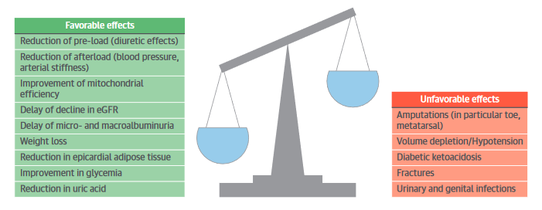
iSGLT2 aGLP1
-carenza farmaco
-costo-beneficio
-sostenibilità
aGLP1
aGLP1
iSGLT2
aGLP1

Slide 19
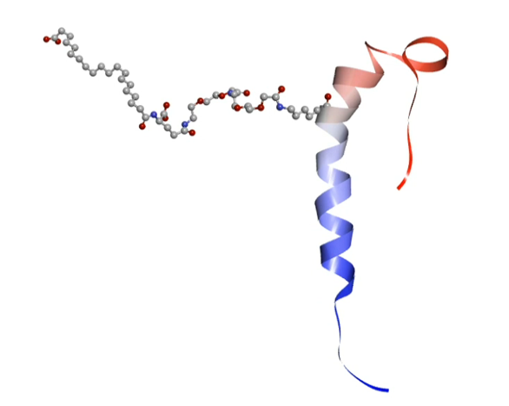
Tirzepatide : il primo doppio agonista ormonale
Tirzepatide is a multi-functional peptide based on the native GIP peptide sequence, modified to bind to both GIPR and GLP-1R
Tirzepatide is a 39 amino acid linear peptide and includes a C20 fatty diacid moiety
Tirzepatide has a mean half-life of approximately 5 days
(116.7 hours), enabling
once-weekly dosing
-I doppio agonista ormonale
-Lega e attiva i recettore GIP e GLP1
-incremento della produzione insulinica al pasto
GIP = glucose-dependent insulinotropic polypeptide; GIPR = glucose-dependent insulinotropic polypeptide receptor; GLP-1R = glucagon-like peptide-1 receptor.
Coskun T, et al. Mol Metab. 2018;18:3-14.
Notes:
GIP peptide insulinotropico glucosio dipendente –stimola il rilascio di insulina
Glp1—peptide 1 glucagone simile
Gip e glp1—prodotti int tenue e crasso

Slide 20
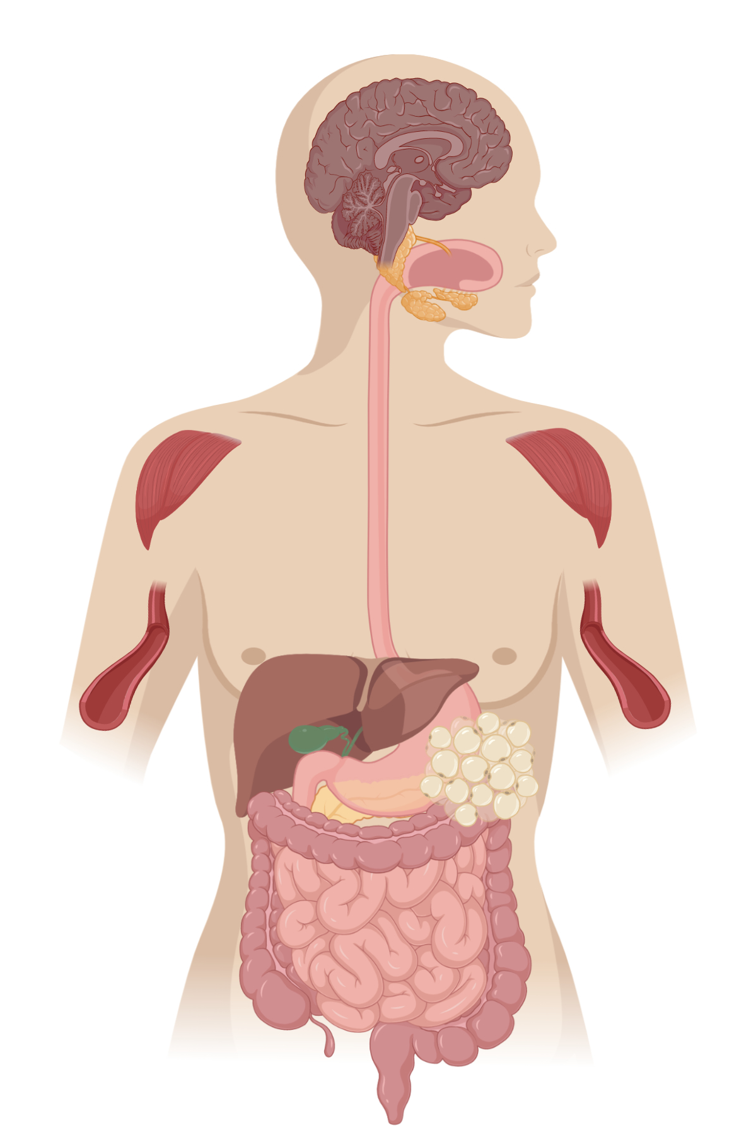
Can next generation incretin therapies combine GLP-1R and GIPR-mediated actions?
GLP-1 Receptor Agonism
GIP Receptor Agonism
Central Nervous System
Central Nervous System
↑ Satiety
↓ Food Intake
↑ Nausea
↓ Body Weight
Central Nervous System
↓ Food intake
↓ Nausea
↓ Body weight
Pancreas
↑ Insulin
↓ Glucagon
Pancreas
↑ Insulin
↑ Glucagon
Stomach
↓ Gastric Emptying
Skeletal Muscle
Subcutaneous White Adipose Tissue
↑ Insulin Sensitivity
↑ Lipid Buffering Capacity
↑ Blood Flow
↑ Storage Capacity
↓ Proinflammatory Immune Cell Infiltration
Systemic
↓ Hyperglycemia
Liver
Stomach
Liver
↑ Insulin Sensitivity
↓ Hepatic Glucose Production
↓ Ectopic Lipid Accumulation
Pancreas
Systemic
↓ Hyperglycemia, Dietary Triglyceride
Subcutaneous White Adipose Tissue
Skeletal Muscle
↑ Insulin Sensitivity
↑ Metabolic Flexibility
↓ Ectopic Lipid Accumulation
GLP-1 Receptor Agonism
GIP Receptor Agonism
Indirect Action
Notes:
Despite the robust efficacy profile of the GLP-1 RA class, there are patients treated with these agents who would benefit from additional glycemic and/or body weight control.
The mechanism of action by which a dual GIP/GLP-1 receptor agonist improves glycemic and weight control in T2D has not been fully elucidated. The contribution of GLP-1 R agonism to these favorable PD effects is well established. As with selective GLP-1 RAs, these include enhancement of glucose-stimulated insulin secretion from the pancreatic beta-cell (incretin effect), reduction of glucagon secretion from the pancreatic alpha-cell, and reduced nutrient intake via central effects, promoting weight loss. The role of GIPR agonism is less clear and continues to be an area of active investigation.
GIP is a 42 amino acid peptide that is produced within and released from intestinal K cells that are located primarily in the proximal small bowel. Similar to GLP1, GIP is secreted in response to nutrient ingestion and enhances meal-stimulated insulin secretion in a glucose-dependent manner by activating its cognate GIP receptor (GIPR) in pancreatic beta cells (Baggio Molecular Metabolism 2020).
The Dual GIP/GLP-1 Hypothesis
Activating both the GIP and GLP-1 receptors is especially attractive in the treatment of T2DM because the combined mechanisms may enhance insulin secretion, decrease energy consumption, and both directly and indirectly improve insulin sensitivity. The approach is feasible because improved glycemia restores sensitivity to GIP, and peptide engineering enables the design of hybrid ligands that exhibit dual agonism. Strong effects of dual agonism are predicted for insulin secretion because both receptors are found in pancreatic β cells; however, the CNS shows both overlapping and differential receptor distributions in various metabolic centers, and adipocytes only express GIPR. Activation of GIPR in the brain andwhite adipose tissue (WAT) could be uniquely complementary to GLP-1R signaling. If GIP expands the tolerance window of GLP1 RAs, and GIP improves WAT function and lipid handling, dual incretin agonists may advance therapeutic outcomes (Samms 2020).
With respect to the incretin effect, at least partial restoration of beta-cell responsiveness to GIP has been demonstrated with the lowering of glucose concentrations into the normal or near-normal range. Given this, it has been postulated that improvement in glycemic control, initially with GLP-1-related activity, may restore beta-cell responsiveness to GIP by, in a sense, ‘priming’ the beta-cell for the additional favorable effects of GIPR agonism.
GIP Enhances the Lipid-Buffering Capacity of WAT
Additionally, it has been postulated that the effects of GIP on adipose tissue may play an important role in the pharmacodynamic effects of the dual GIP/GLP-1 RAs. The GIPR, unlike the GLP-1 R, is highly expressed in adipose tissue and plays an important physiologic role in acutely clearing dietary triglycerides and in overall adipocyte health. A recent review by Samms, et al. elegantly outlines the role GIP plays in promoting normal adipocyte lipid storage and release, and helping prevent the deleterious consequences of dysfunctional adipocytes (common in T2D), including ectopic fat accumulation (liver, skeletal muscle, pancreas) and impaired secretion of insulin-sensitizing adipokines such as adiponectin (Frias Expert Review of Endocrinology and Metabolism 2020; Samms 2020).
Indeed, GIPR agonism is hypothesized to enhance the ability of adipocytes to acutely clear dietary triglyceride (TAG), as well as improve the long-term storage of lipids through facilitating the healthy expansion of WAT. Expanding WAT to store calories reduces lipid ‘spillover’ and ectopic fat accumulation in tissues such as liver, skeletal muscle, heart, and pancreas (Samms 2020). In humans under experimental conditions simulating the postprandial period, GIP increases WAT blood flow, lowers FFAs, and stimulates glucose uptake and TAG storage in WAT. Importantly, GIP infusion can drive TAG storage in WAT and reduce circulating FFAs in T2DM patients, although there is evidence that the lipogenic effect of GIP on WAT blood flow and TAG deposition is attenuated in T2DM, an effect possibly linked to reduced GIPR expression in WAT. However, in follow-up experiments, the ability of GIP to increaseWAT perfusion and TAG storage was rescued by weight loss (Samms 2020). GIP promotes TAG storage following food intake by directly activating GIPR on adipocytes, indirectly through the lipogenic actions of insulin, or through the combination of the two. The GIPR is expressed in both visceral and subcutaneous WAT. GIP may also improve energy storage by facilitating WAT expansion (Samms 2020)
GIP Can Act in the CNS to Lower Food Intake and Reduce Body Weight
Several lines of evidence support a central mode of action for GIP. The GIPR is widely expressed within the CNS and is found in areas implicated in regulating energy balance. Although the data are limited, GIP appears to be capable of crossing the blood–brain barrier to access sites of action. For metabolic disease, experiments show that GIPR agonism can drive weight loss (Samms 2020).
More recent preclinical studies have demonstrated that the central genetic activation of GIPR + neurons in the hypothalamus may also reduce food intake and promote weight loss, findings consistent with the peripheral administration of long-acting degradation-resistant GIPR agonists in mice with diet-induced obesity (Baggio Molecular Metabolism 2020).
A key finding of this work is that, within the hypothalamus, GIPR is expressed by cells lacking GLP-1R but also in cells where GLP-1R is found (in mice and humans). Therefore, GIP/GLP-1 synergism may occur by activating each receptor on separate cells (classical signaling pathways), on the same cell (generating a unique signal), or the downstream integration of both. Other studies indicate that GIP and GLP-1 activate distinct neurons when inhibiting food intake. Notably, GIPR is expressed in non-neuronal cells of the mediobasal hypothalamus.. This raises the possibility that GIP may enhance GLP-1 function by increasing its access to anorexigenic neuronal populations within the mediobasal hypothalamus. Further, other studies show that central and peripheral administration of GIPR agonists lowers body weight by reducing caloric intake (Samms 2020).
With respect to glucagon, it is well established that the GLP-1 receptor agonism reduces glucagon concentrations. Short-term studies assessing acute GIP infusions in patients with T2D have demonstrated increased glucagon concentrations, including, as mentioned above, patients with well-controlled diabetes on chronic GLP-1 RA therapy. Clinical studies assessing short term co-infusion of GLP-1 and GIP RAs or administration of an unimolecular dual GLP-1/GIP RAs in patients with T2D have generally demonstrated a neutral effect on glucagon concentrations, with the glucagonotropic effect of GIPR agonism being ‘nullified’ by the glucagonostatic effect of the GLP-1 RA. Interestingly, fasting glucagon concentrations were reduced to a greater extent after 26 weeks of tirzepatide therapy compared with the selective GLP-1 RA dulaglutide in the 26-week Phase 2 clinical trial (Frias Review 2020).
A factor affecting the tolerability of GLP-1RA treatment is the occurrence of drug-related nausea. Interestingly, GIPR agonism attenuates the aversive and emetic responses characteristic of the gut peptide PYY and the oncology drug cisplatin, respectively. This suggests a novel hypothesis where GIP may enhance GLP1R-mediated weight loss by increasing tolerance, thereby expanding the therapeutic index. Together, current evidence suggests that GIP has the potential to drive weight loss by directly targeting its receptor in the CNS to inhibit caloric intake, by enhancing the anorectic action of GLP-1, or by reducing drug-induced nausea to expand GLP-1RA efficacy, or combinations thereof (Samms 2020).
The primary physiological role of WAT is to function as a daily buffer of circulating lipids [22], releasing free fatty acids (FFAs) in the fasted state and storing dietary lipid in the fed state (Box 1). In T2DM, the lipid-buffering capacity of WAT is dysregulated because storage capacity is exceeded and is accompanied by reduced insulin-mediated suppression of FFA release, lowered adipose tissue perfusion (blood flow), and impaired recruitment of lipoprotein lipase (LPL)

Slide 21
Tirzepatide improves glycemic control vs selective GLP-1RA
Mean HbA1c range at baseline: 8.0%-8.2%
+0.1
TZP 1 mg
TZP 5 mg
-0.7*
TZP 10 mg
Mean change in HbA1cfrom baseline (%)
-1.1*
TZP 15 mg
-1.6*†
PL
DU 1.5 mg
-2.0*†
-2.4*†
0
1
2
4
8
12
16
20
24
26
Time (weeks)
MMRM analysis, mITT on-treatment population. Values reported are LSM (SE).
*P<.05 vs PL; †P<.05 vs DU 1.5 mg.
DU = dulaglutide; HbA1c = glycated hemoglobin; LSM = least-squares mean; mITT = modified intention-to-treat; MMRM = mixed model repeated measures; PL = placebo; TZP = tirzepatide.
Frias JP, et al. Lancet. 2018;392(10160):2180-2193.

Slide 22
Tirzepatide reduces body weight vs selective GLP1-RA
-0.4
TZP 1 mg
-0.9
TZP 5 mg
-2.7*
TZP 10 mg
Mean change in body weight
from baseline (kg)
-4.8*
TZP 15 mg
PL
-8.7*†
DU 1.5 mg
-11.3*†
Mean body weight range at baseline: 89.1-93.2 kg
0
1
2
4
8
12
16
20
24
26
Time (wk)
MMRM analysis, mITT on-treatment population. Values reported are LSM (SE).
*P<.05 vs PL; †P<.05 vs DU 1.5 mg.
DU = dulaglutide; HbA1c = glycated hemoglobin; LSM = least-squares mean; mITT = modified intention-to-treat; MMRM = mixed model repeated measures; PL = placebo; TZP = tirzepatide.
Frias JP, et al. Lancet. 2018;392(10160):2180-2193.

Slide 23
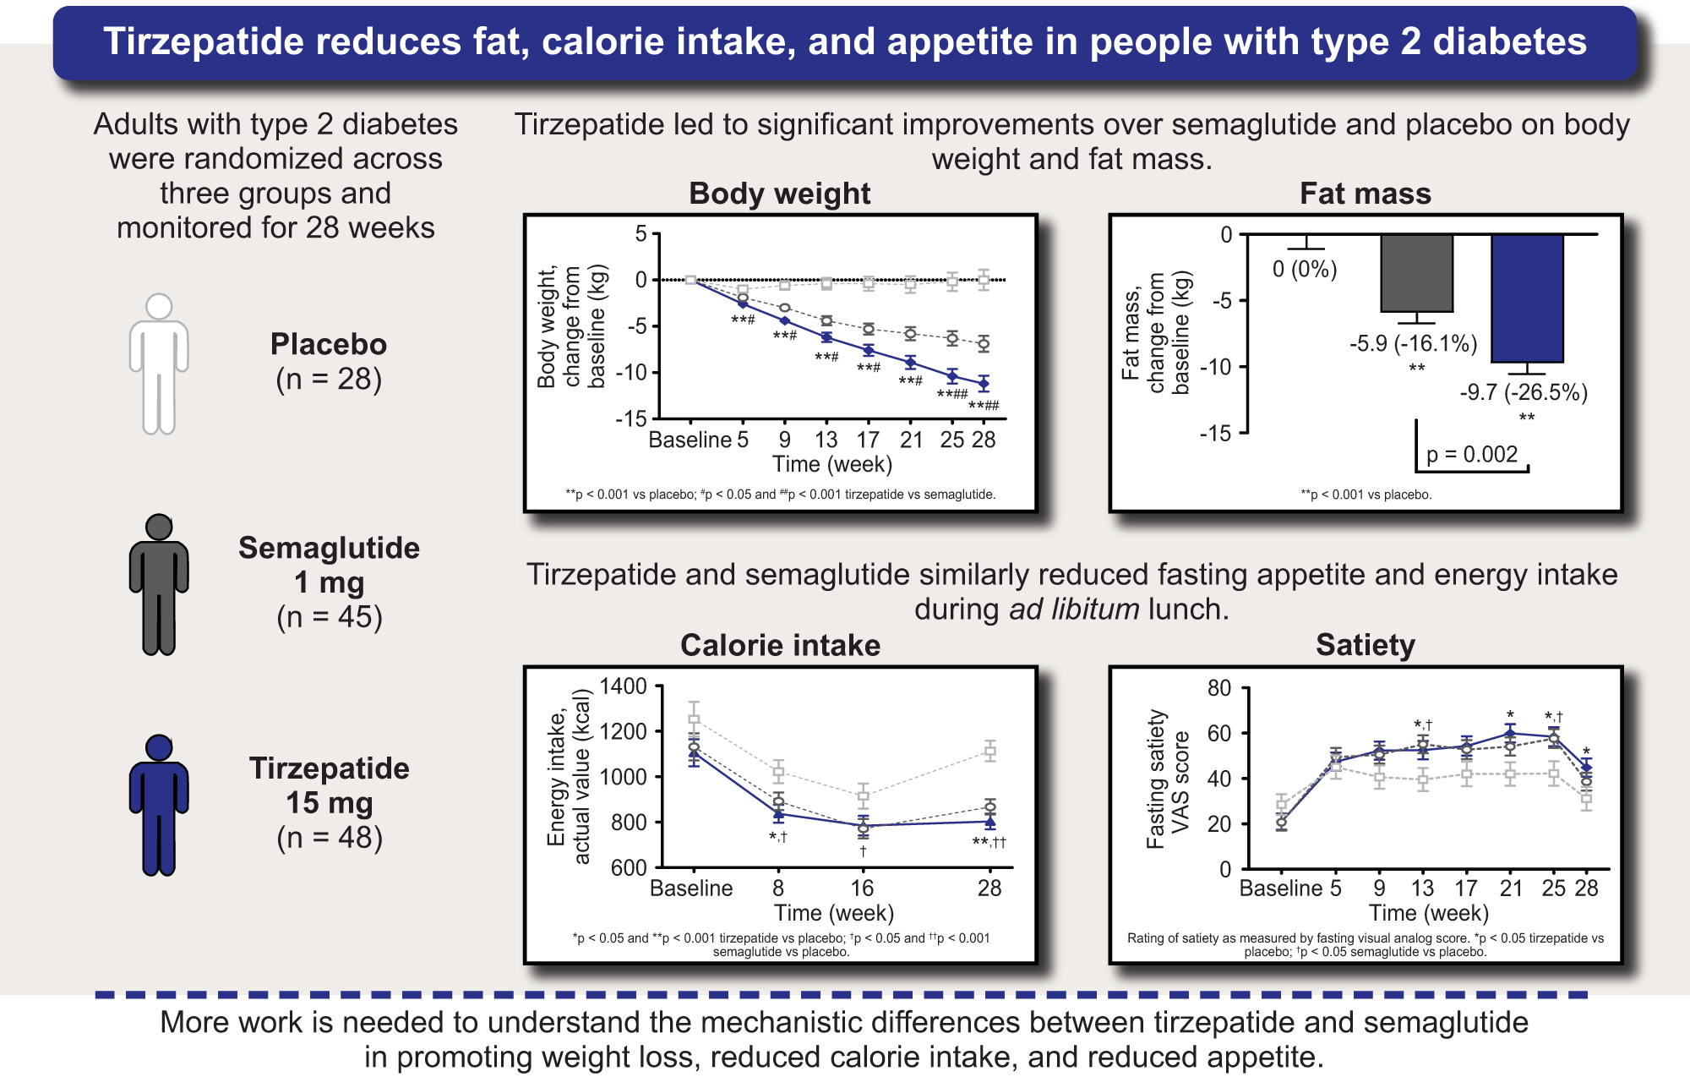

Slide 24
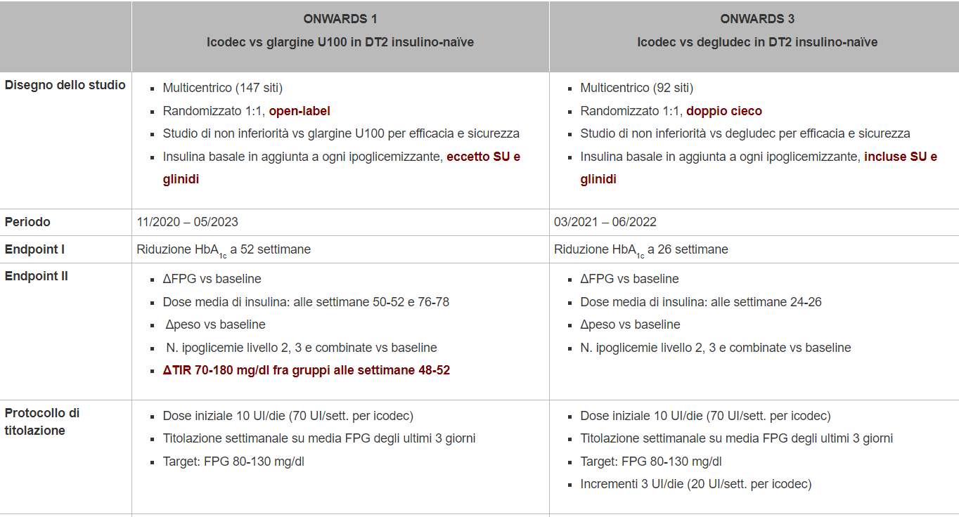
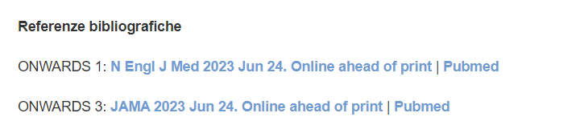
ICODEC: insulina settimanale

Slide 25
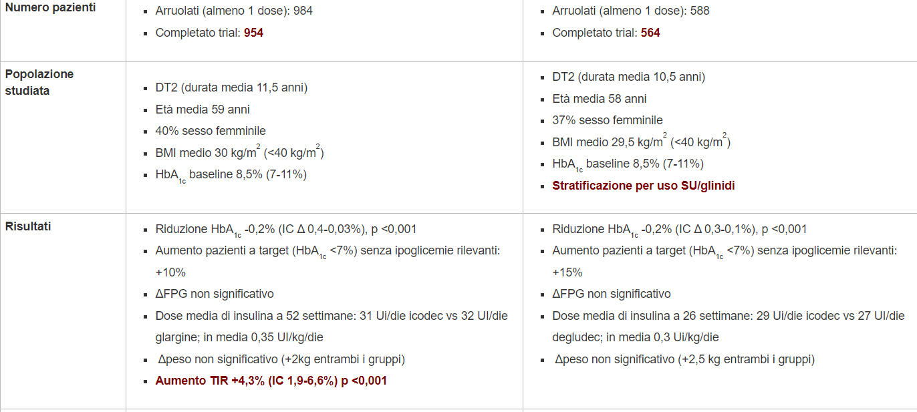
ICODEC

Slide 26
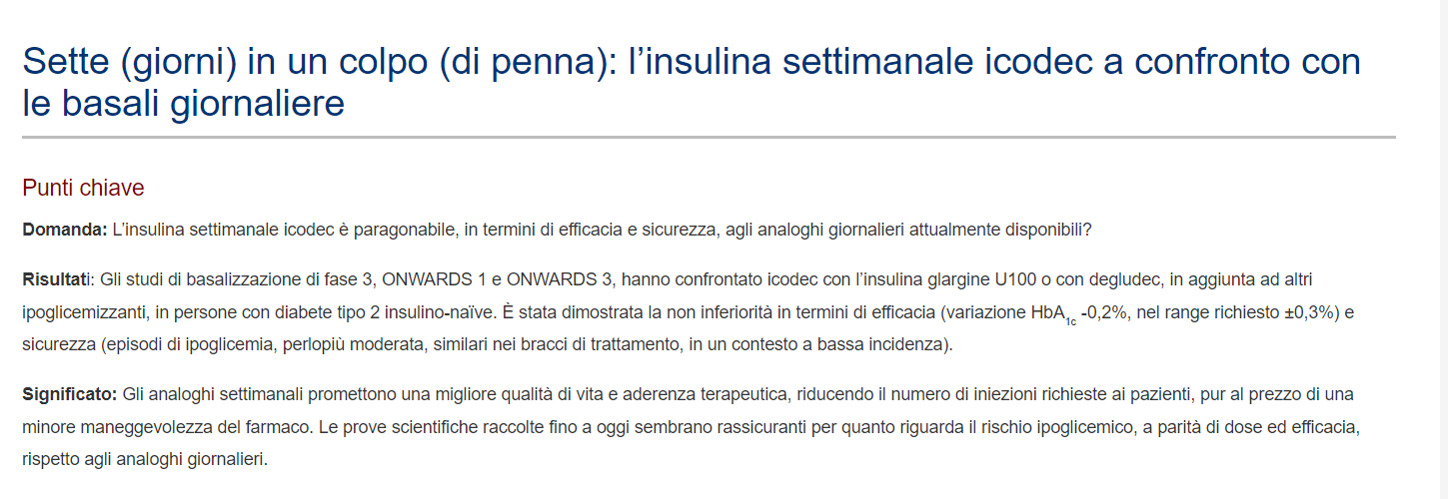
ICODEC

Slide 27
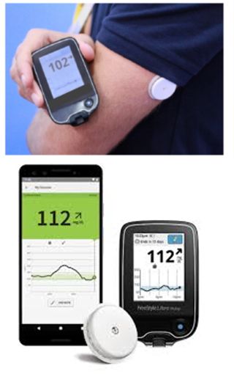

SISTEMI CGM
Real-time CGM (rtCGM)
Intermittente o flash (isCGM)
Notes:
rtCGM: Tiene traccia delle concentrazioni di glucosio nel liquido interstiziale del corpo, fornendo dati sul glucosio quasi in tempo reale. Può avvisare gli utenti se il glucosio tende all'ipoglicemia o all'iperglicemia.
iCGM: Mostra le misurazioni glicemiche continue in modo retrospettivo al momento del controllo I trend possono essere visualizzati solo dopo aver scansionato fisicamente il sensore

Slide 28
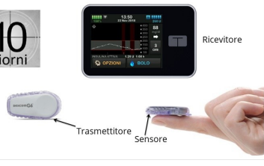
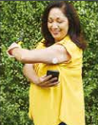
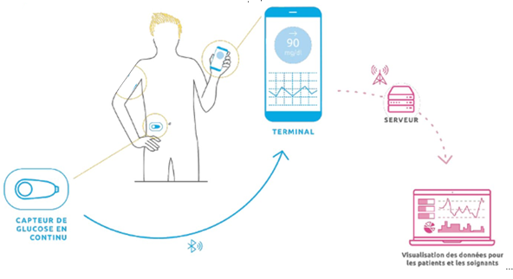
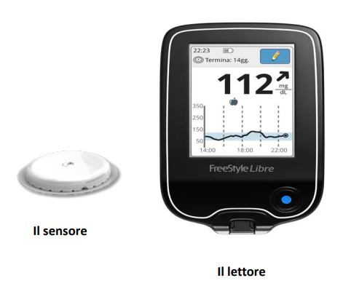
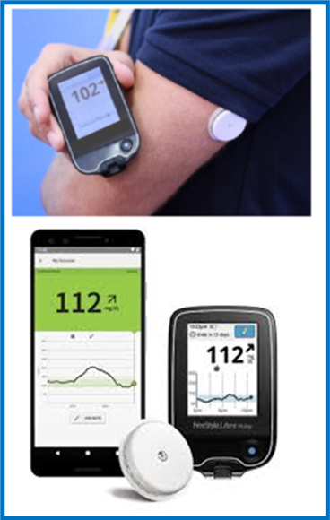
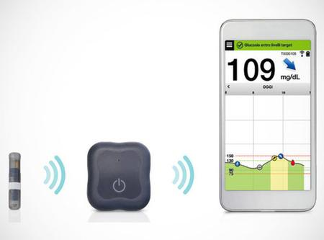
rtCGM e FGM si differenziano principalmente per l’interazione con il paziente portatore del sistema
Rt-CGM (real time- Continuous Glucose Monitoring)
FGM (Flash Glucose Monitoring)
Invia passivamente le informazioni senza richiedere l’intervento del paziente
Richiede la scansione da parte del paziente per fornire le informazioni
Notes:
Both rtCGM and FGM sensors collect real-time glucose readings continuously. FGM provides this information each time the user actively scans the sensor with the device reader or via an app on their smartphone, whereas rtCGM passively transmits this information without user engagement

Slide 29
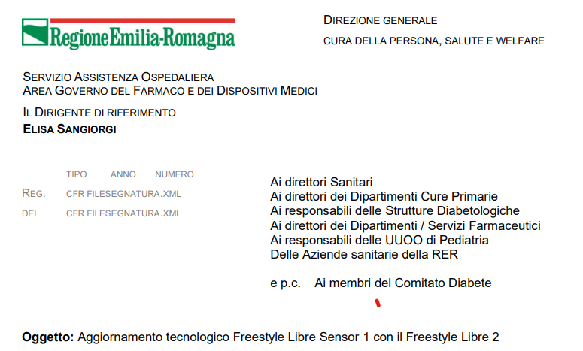
Ufficializzazione del passaggio dal FSL al FSL2
NUOVI CRITERI
diabete gestazionale
diabete di tipo 1 adulto
diabete di tipo 1 età pediatrica (4-17 anni)
diabete tipo 2 nei criteri di eleggibilità indicati: pazienti in terapia insulinica intensiva multi iniettiva

Slide 30
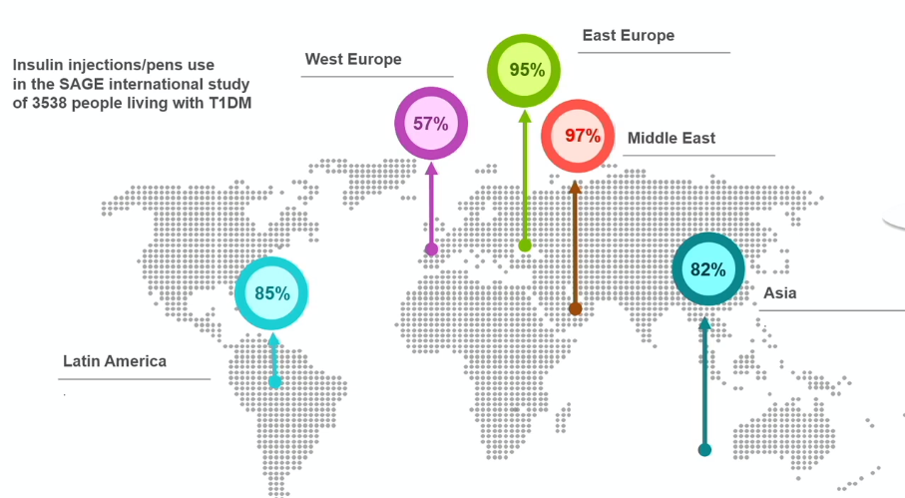
La terapia multi-iniettiva è ancora la modalità più frequente di terapia insulinica
Renard E et al. Diabetes Netab Res Rev 2020

Slide 31

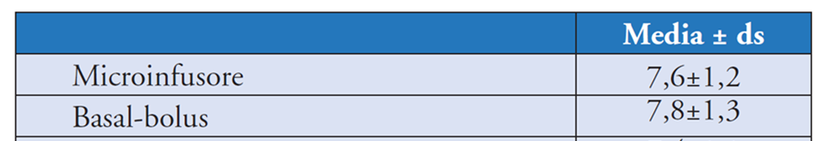
(34.705 T1D>18 anni)
Livelli medi dell’HbA1c per tipo di trattamento (%)
Solo il 30% dei pazienti raggiunge il target di Hb glicata <7%

Slide 32
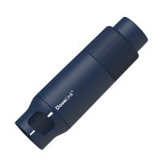
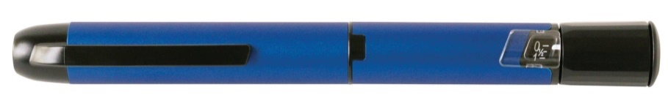
Smart pen e cappucci per penna
Possono avere funzioni di:
connettività (Bluetooth o NFC)
memorizzazione e trasmissione automatica della dose e dell’orario di somministrazione dell’insulina ad un dispositivo mobile
promemoria della dose di insulina e dei pasti
connessione ad app con calcolatore della dose del bolo
calcolo insulina attiva (IOB)
integrazione con sistemi di monitoraggio del glucosio
report scaricabili
condivisione ed analisi dei dati (diario completo)
Cappucci
Generalmente attaccati lateralmente o inseriti nell’estremità della penna
Smart pen
Penne per insulina digitali, connesse
Notes:
Near field communication

Slide 33
Disclaimer
Nelle slides successive è riportata la comparazione di vari strumenti presenti sul mercato.
Questa trattazione è obiettiva e imparziale ed è realizzata per scopi didattici.

Slide 34
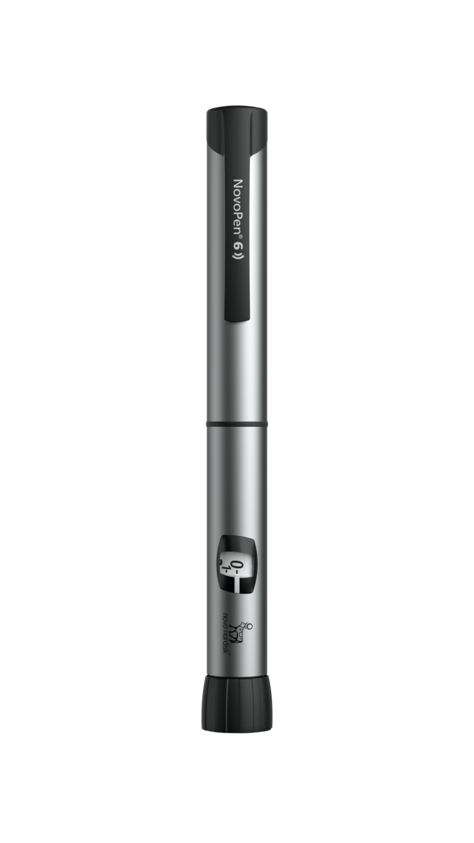
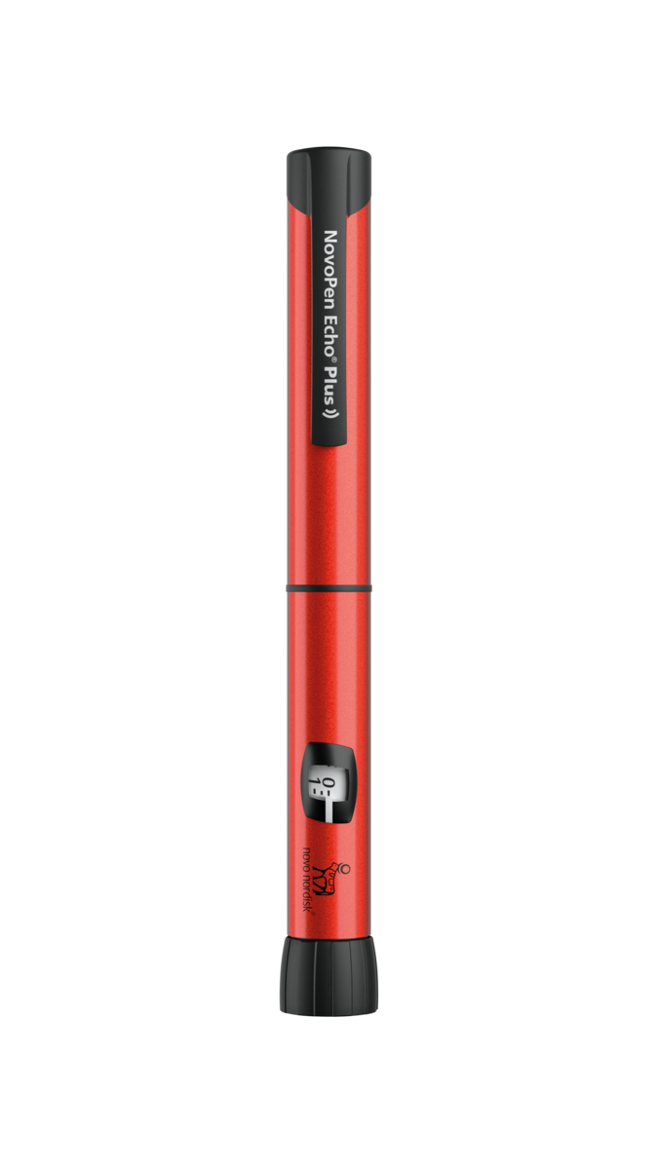
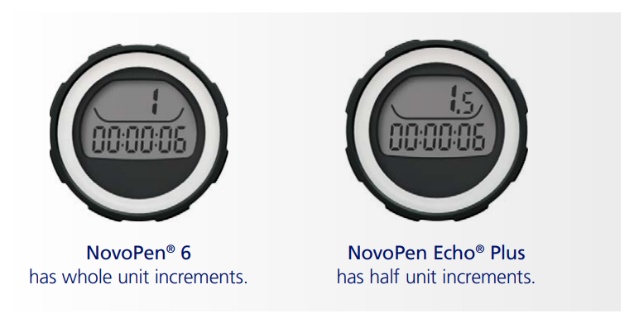
NOVOPEN
  Panoramica dei dispositivi
  NovoPen® 6 e NovoPen Echo® Plus sono penne per insulina riutilizzabili con funzione di memoria della dose. Le due penne sono le stesse, ma NovoPen Echo® Plus permette di somministrare anche la mezza unità di insulina, principalmente per uso pediatrico. La dose massima di NovoPen Echo® Plus è di 30 unità (UI), rispetto alle 60 unità di NovoPen® 6.
  Memoria della dose
  Le penne hanno una memoria della dose che registra il numero delle ultime unità iniettate e il tempo trascorso dall’ultima iniezione. Gli utenti possono trasferirla avvicinando la penna all'app FreeStyle LibreLink per mantenere un registro di iniezione personale.
  Riutilizzabili
  Le penne sono resistenti e riutilizzabili. Quando l'insulina in una cartuccia sarà terminata, gli utenti semplicemente dovranno sostituirla con una nuova. Durata della penna 5 anni.
Notes:
La penna tiene memoria delle ultime 800 iniezioni quindi circa 3 mesi

Slide 35
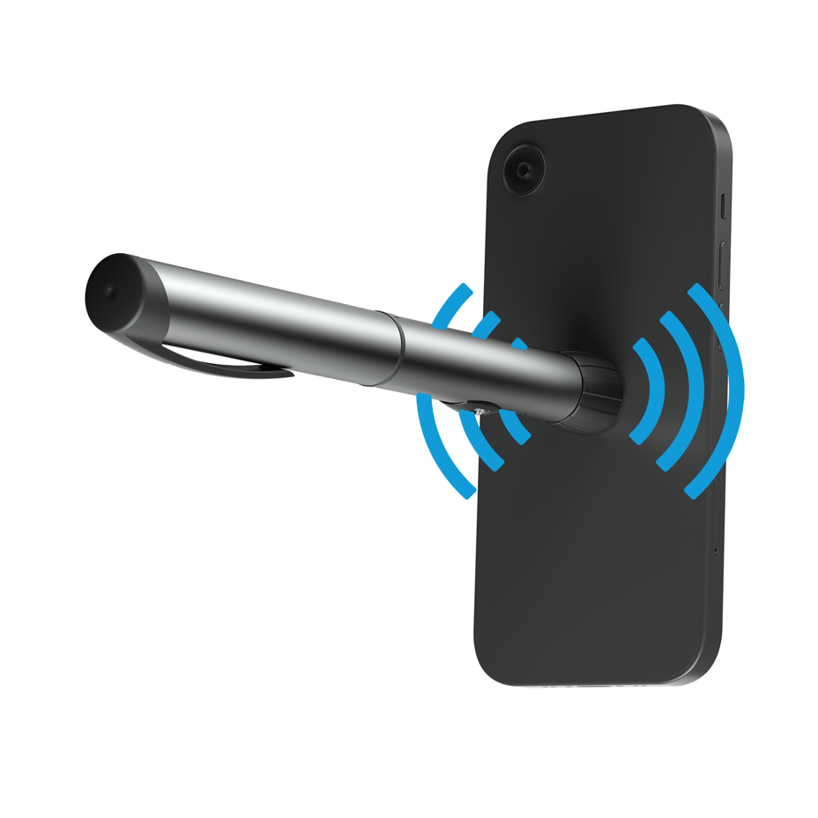
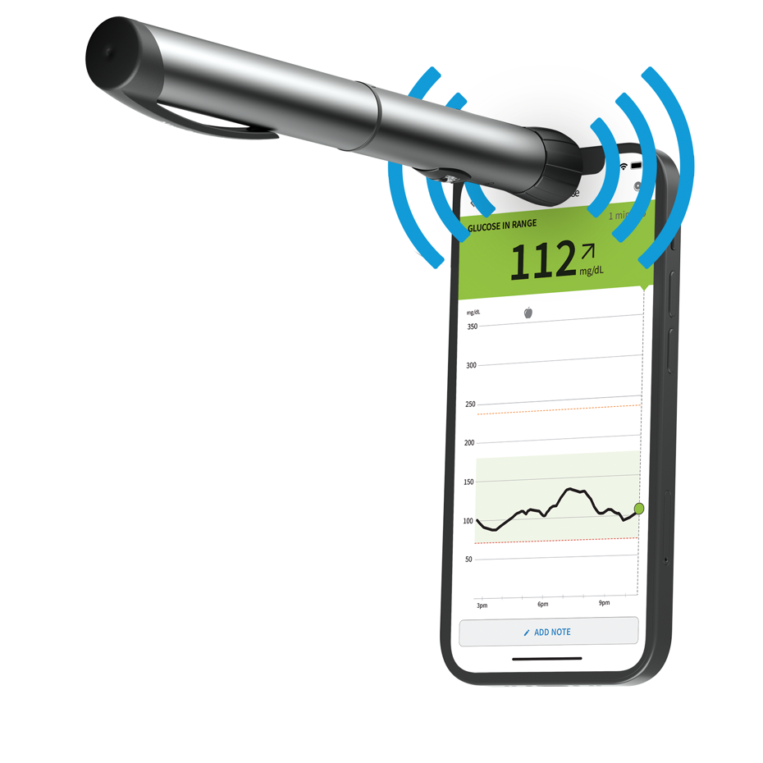
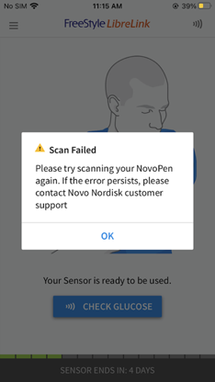

Differenze tra le posizioni di scansione Android e iPhone
Come FreeStyle Libre, la connettività NovoPen 6 e NovoPen® Echo® Plus si basa sulla Near Field Communication (NFC), il che significa che la penna e l'antenna NFC sul telefono devono essere messe in stretto contatto (distanza da 0 a 2 cm) l'una con l'altra per avviare il trasferimento dei dati. Il telefono e la penna devono essere in contatto abbastanza a lungo per completare il trasferimento (3-10 secondi).
Android
iPhone
Avvicinare NovoPen® al
RETRO del telefono Android. Potrebbe essere necessario provare a scansionare con diverse aree per trovare il posto giusto.
Avvicinare NovoPen® alla parte SUPERIORE dell’Iphone
TIP
Non agitare la NovoPen® come una bacchetta quando si tenta di eseguire la scansione poiché di solito si verifica un errore di scansione non riuscita.

Slide 36
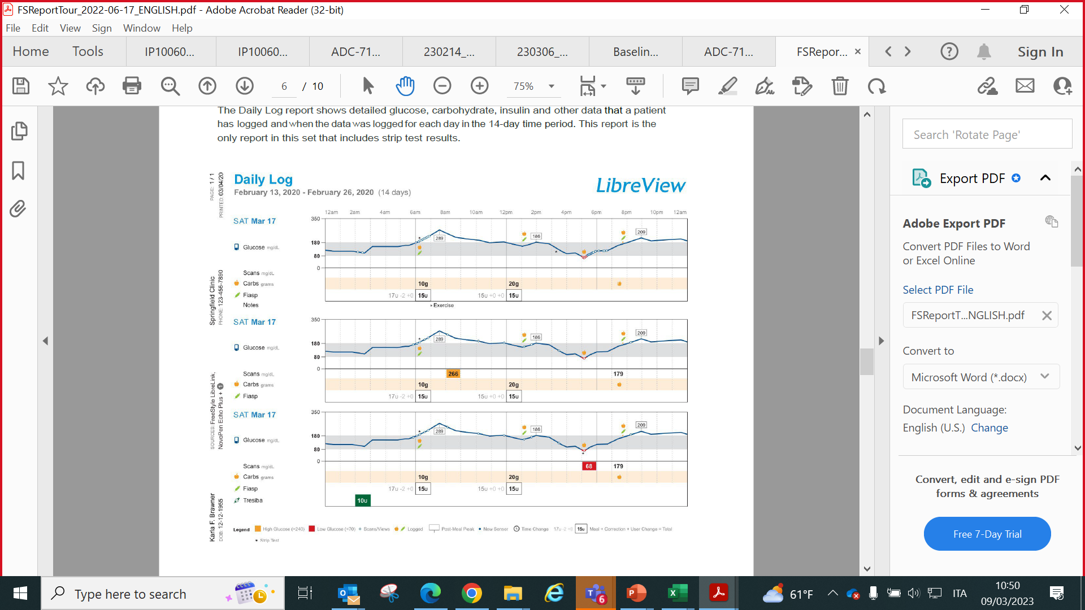
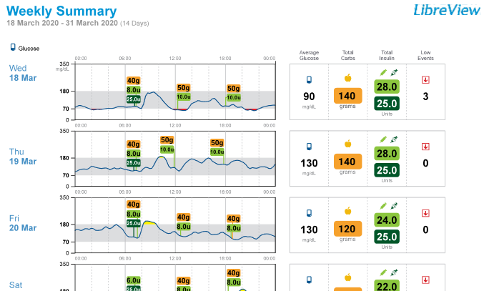
Visualizzazione integrata di insulina erogata e valori di glucosio anche su Libreview
Visualizza i dati codificati a colori, sull'insulina e sul glucosio insieme al grafico AGP
Rendi più facile per i tuoi pazienti l'adattamento delle dosi di insulina alle necessità della giornata
I dati sull'insulina di NovoPen®¹ saranno visibili nei rapporti LibreView² ovunque appaiano dosi di insulina registrate manualmente
Istantanea
Riepilogo Settimanale
Andamento ai Pasti
Diario giornaliero
Dettagli Dispositivo
1. Only compatible with NovoPen® 6 or NovoPen Echo® Plus
2. The LibreView website is only compatible with certain operating systems and browsers. Please check www.libreview.com for additional information.

Slide 37
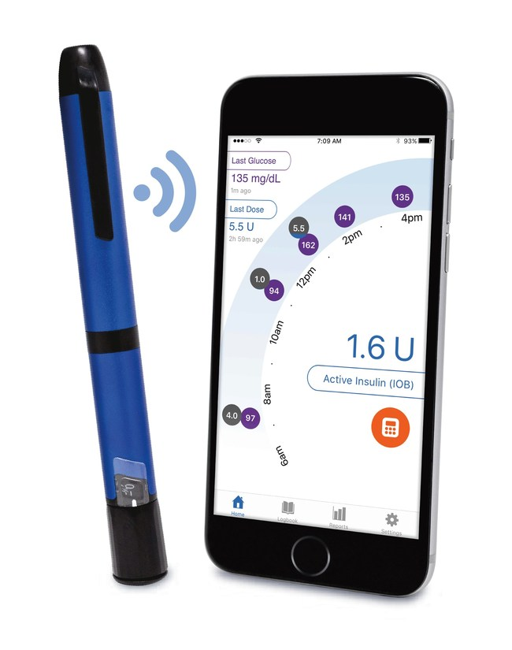
Smart Insulin Pen: INPEN
Approvazione FDA nel 2017 e CE nel 2020
  Connessione Bluetooth all’App con integrazione dei dati del CGM
  Calcolatore e suggeritore della dose insulinica
  Memoria delle dosi e degli orari di somministrazione dell’insulina dell’ultimo anno
  Promemoria della somministrazione di insulina
  Visualizza l’ultima dose e l’insulina attiva (IOB)
  Controlla la temperatura dell’insulina
  Dose incrementabile di ½ unità
  Report condivisibili con team medico
Compatibile con:
  Lyspro
  Aspart
  Faster aspart
Timothy S Bailey, Jenine Y Stone Expert Opin Drug Deliv 2017 May;14(5):697-703

Slide 38
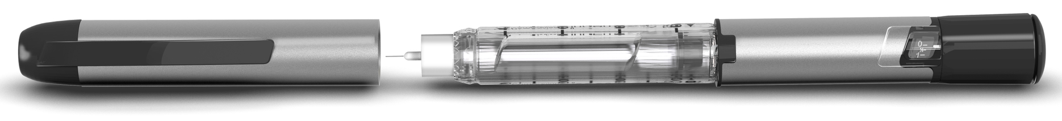
Penna intelligente per insulina InPen™
Caratteristiche principali
Condividere i dati da più Inpen™ contemporaneamente alla stessa applicazione
Connessione all’applicazione via Bluetooth®
Disponibile in due colori:
Blue: compatibile con cartucce preriempite da 3mL (300UI) di NovoRapid® (Novo Nordisk) o di Fiasp® (Novo Nordisk)
Grigio: compatibile con cartucce preriempite da 3mL (300UI) di Humalog® (Lilly) o di Lyumjev® (Lilly)
L’incremento di quantità erogabile è di mezza unità (con un massimo di 30 UI)
La batteria dura un anno senza necessità di essere ricaricata
Monitora la temperatura dell’insulina
Humalog® e Lyumjev® sono marchi registrati di Eli Lilly and Company. Fiasp®, Novorapid® e Novo Nordisk Insulin Aspart sono marchi registrati di Novo Nordisk A/S.
Notes:
The InPenTM is intended for single-patient use by people with diabetes for the self-injection of a desired dose of insulin. The pen injector is compatible with 3.0 mL cartridges of insulin (U-100) and single-use detachable and disposable pen needles (not included). The pen injector allows the user to dial the desired dose from 0.5 to 30 units in one-half (1/2) unit increments.

Slide 39
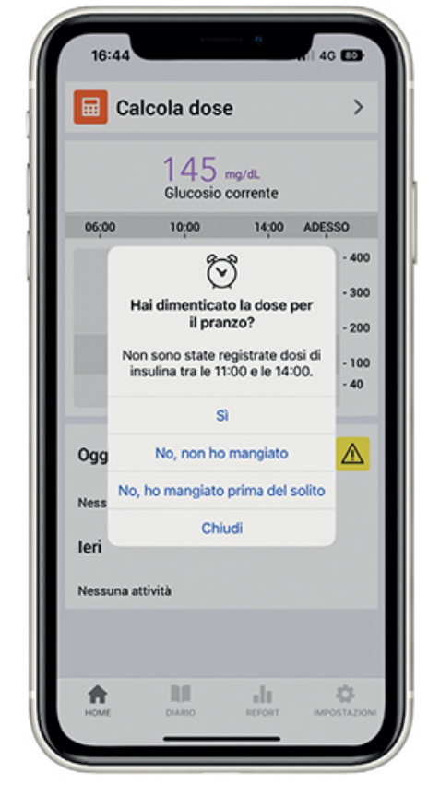
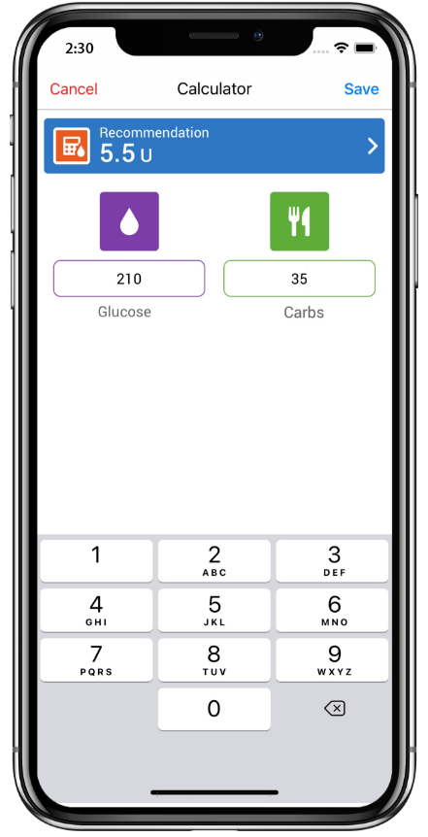
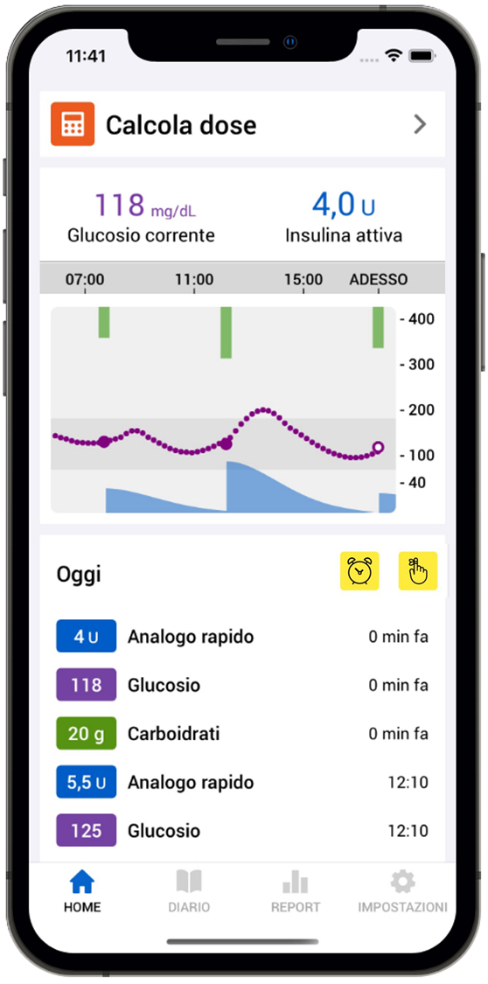
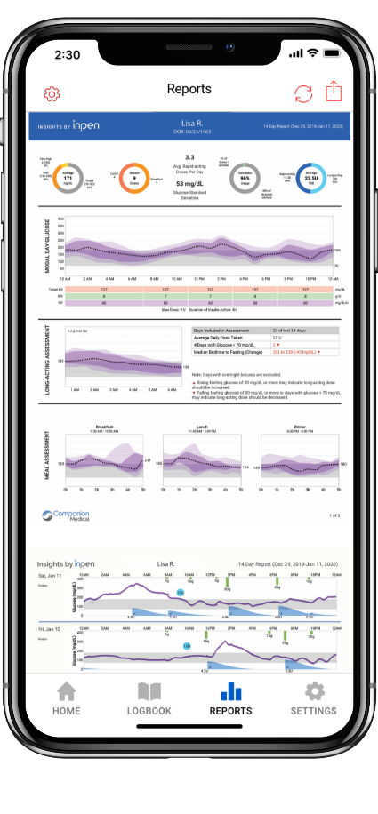
Smart Insulin Pen
Promemoria
dose omessa
Calcolatore
di bolo
Insulin on
board
Report
condivisibili

Slide 40
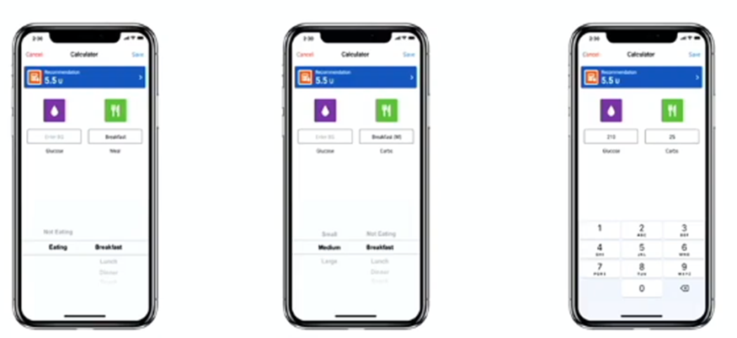
Smart Insulin Pen: suggeritore del bolo
DOSE FISSA STIMA DEI PASTI CALCOLO DEI CHO
ricorda la corretta dose abbina pasti con CHO calcola la dose in base a
di insulina e l’orario di scarsi, medi, abbondanti conteggio dei CHO, ISF,
somministrazione con la corretta dose di rapporto insulina/CHO
insulina

Slide 41
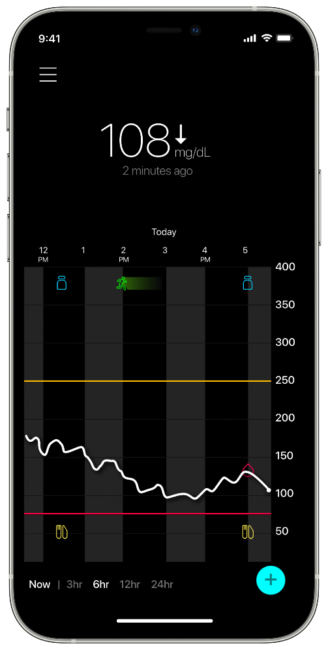
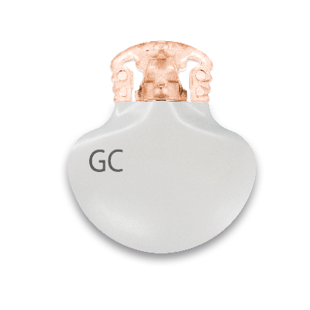
Sistema di Smart CGM Guardian™ 4
Componente fondamentale del sistema Smart MDI
Predice ipoglicemie ed iperglicemie fino a 60 minuti prima
  L’applicazione Guardian™ ha al suo interno il volume degli avvisi personalizzabile, la configurazione iniziale guidata ed alcune risorse. E’ compatibile con dispositivi iOS ed Android.
Non richiede calibrazioni e sostituisce le glicemie capillari per le decisioni terapeutiche
288 letture dei valori di glucosio al giorno senza necessità di pungersi il dito*. Le calibrazioni sono opzionali.
Accesso semplificato ai report
Il medico ha accesso ai report di CareLink™ Personal con la cronologia dei valori di glucosio che aiuta ad individuare le informazioni utili per ottimizzare la terapia del paziente. Quando l’applicazione Guardian™ è connessa con l’applicazione InPen™, tutti i dati (terapia insulinica e monitoraggio CGM) sono disponibili e correlati nell’app InPen™ nei report di approfondimento.
Sistema Guardian™ 4
*Se le letture dei valori di CGM non corrispondono ai sintomi o alle aspettative, utilizzare un valore di glicemia capillare per prendere decisioni terapeutiche. Fare riferimento alla Guida per l’utente del sistema

Slide 42
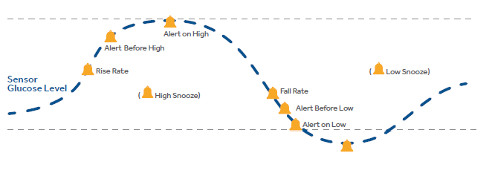
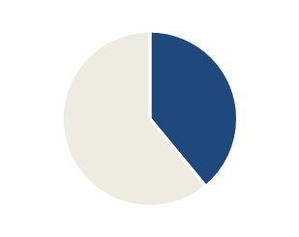

Vantaggi degli avvisi predittivi del glucosio
Aiutano a prevenire le iperglicemie e le ipoglicemie prima che queste si verifichino*
Avvisi di ipoglicemie e di iperglicemia possono essere emessi fino a
60 minuti prima di raggiungere il valore basso o alto senza necessità di effettuare una misurazione capillare*
Limite alto
100 - 400 mg/dL
59%
Avviso glucosio alto
Avviso glucosio alto previsto
Valore glucosio sensore
Avviso aumento rapido
(Silenziamento avvisi bassi)
39%
Avviso diminuzione rapida
(Silenziamento avvisi alti)
Avviso glucosio basso previsto
Avviso glucosio basso
eventi ipoglicemici evitati^{1*}
eventi iperglicemici evitati^{1*}
Limite basso
60 - 90 mg/dL
Urgente: glucosio sensore basso
54 mg/dL. Impostazione non
modificabile per la sicurezza del paziente
* e’ richiesta l’interazione da parte dell’utilizzatore. Le decisioni terapeutiche devono essere prese tenendo in considerazione il valore del glucosio del sensore, le frecce di tendenza, l’obiettivo glicemico, gli avvisi e gli eventi recenti (come insulina attiva presente, esercizio fisico e farmaci ingeriti)
Abraham SB, et al. Improved Real-World Glycemic Control With Continuous Glucose Monitoring System Predictive Alerts. Journal of Diabetes Science and Technology 2022; 15(1):91–97.
*Outcomes coming from one study with Guardian™ Connect.​​

Slide 43


LE ORIGINI …..
NEL 1963
IL DR. ARNOLD KADISH DISEGNA IL PRIMO PROTOTIPO DI POMPA INSULINICA CHE VENIVA PORTATO COME UNO ZAINO
NEL 1976
DEAN KAMEN PROGETTA LA PRIMA POMPA PER INSULINA INDOSSABILE, CONOSCIUTA COME IL «BLUE BRICK» E IN SEGUITO «AUTOSIRINGA»

Slide 44





… IL FUTURO
Nel 2003 prima pompa «Smart»: il glucometro trasmette wireless le glicemie al CSII che suggerisce i boli grazie ad un calcolare di bolo (M.512)
MICROINFUSORI
«SMART PUMPS»
SENSOR AUGMENTED PUMP
SAP CON LGS
PATCH PUMP
Nel 2006 la prima pompa con dati CGM integrati (M.P.) visibili in real time sul display
Nel 2009 la prima pompa con dati CGM integrati (M.P.) visibili in real time sul display e Low sospended glucose (LGS)
Nel 2011 la prima pompa senza catetere (O.)
Notes:
SMART Minimed PARADIGM 512

Slide 45





INTEGRAZIONI … PASSO PASSO …
SOSPENSIONE - LGS
(a soglia)
L’infusione insulinica viene sospesa per circa 2 ore se la glicemia registrata dal CGM scende sotto la soglia stabilita
SOSPENSIONE
PREDITTIVA (PLGS)
L’infusione insulinica viene sospesa in modo automatico in modo predittivo e riattivata in previsione di un aumento glicemico
SOMMINISTRAZIONE AUTOMATIZZATA DI INSULINA
Algoritmo che controlla sia l’ipoglicemia sia l’iperglicemia
MICROINFUSORE CON ALGORITMO
SENSORE
MICROINFUSORE
CONTROLLO IN REMOTO CON ALGORITMO

Slide 46


SISTEMI IBRIDI AVANZATI (AHCL)
«PANCREAS ARTIFICIALE IBRIDO»
Un sensore che rileva la glicemia in continuo (rtCGM)
Un microinfusore che eroga insulina
Un algoritmo che dirige il sistema
Closed-loop systems
ALGORITMI
Integrati nel microinfusore
Esterni (es. cellulare)

Slide 47
COS’E’ UN ALGORITMO
Strategia che serve per risolvere un problema, costituito da una sequenza finita di operazioni (dette anche istruzioni) che consente di risolvere un quesito specifico, un problema.
L’ALGORITMO NEI MICROINFUSORI
Insieme di «istruzioni» finalizzate alla somministrazione «automatica» di insulina sulla base della concentrazione di glucosio rilevata da un sensore, per mantenere costante il livello stabilito di glucosio (target), minimizzando le oscillazioni glicemiche estreme.

Slide 48


ALGORITMI: perché è importante conoscerli
Gli algoritmi sono il centro di controllo dei sistemi AHCL – Advanced Hybrid Closed Loop
Ne esistono di diversi tipi ed è importante conoscerli poiché hanno dei criteri di funzionamento differenti
I più utilizzati sono:
- MPC Il modello predittivo di controllo
(PREVEDE)
- PID Proporzionale Integrale-Derivativo
(REAGISCE)
- (Fuzzy Logic)
(RAGIONA)

Slide 49
Disclaimer
Nelle slides successive è riportata la comparazione di vari strumenti presenti sul mercato.
Questa trattazione è obiettiva e imparziale ed è realizzata per scopi didattici.

Slide 50





ALGORITMI IN USO
MINIMED™ 780G
SmartGuard
TENDEM T-SLIM
Control IQ
CamAPS FX
DBLG 1
OMNIPOD 5

Slide 51
CARATTERISTICHE GENERALI dei sistemi AHCL
-Riduzione della velocità di insulina basale fino a sospensione per valori glicemici prossimi al valore limite per ipoglicemia (PLGS)
-Incremento della velocità di insulina basale in caso di rialzo glicemico o previsione di rialzo glicemico
-Microboli correttivi automatici in caso di persistenza di iperglicemia nonostante l’incremento della basale
-Funzione protettiva per l’attività fisica con impostazione di «modalità attività fisica» o inserimento del target glicemico temporaneo più alto o attivazione di funzioni specifiche che riducono l’aggressività del sistema
-Presenza di calcolatore di bolo con calcolo dell’insulina attiva residua

Slide 52

AZIONI COMPIUTE AL GIORNO IN TERAPIA CON MDI

Slide 53

AZIONI COMPIUTE AL GIORNO CON AIUTO DI AUTOMAZIONE
….AUTOMAZIONE = RIVOLUZIONE…..

Slide 54

EFFICACIA
Meta-analisi , 40 studi cross-over o in parallelo per un totale di oltre 1.000 pazienti che avevano utilizzato AHCL e pancreas bi-ormonale

Slide 55

EFFICACIA
End-point primario:
TIR
End-point secondari
TAR
TBR
Glicemia media
HbA1c
Conclusioni: un sistema ibrido a circuito chiuso ha migliorato significativamente il controllo glicemico nei bambini molto piccoli con diabete di tipo 1, senza aumentare il tempo trascorso in ipoglicemia.
studio multicentrico, randomizzato, crossover, bambini di età compresa tra 1 e 7 anni con diabete di tipo 1
2 periodi di 16 settimane, in ordine casuale, il sistema ibrido ad ansa chiusa è stato confrontato con la terapia con CSII associato a sensore (controllo)

Slide 56


EFFICACIA
studio prospettico, multicentrico, in aperto, randomizzato e controllato
14 centri in tre paesi europei (Francia, Germania e Regno Unito).
105 persone sono state sottoposte a screening e 82 assegnate in modo casuale al trattamento (41 in ciascun braccio)
RAZIONALE : Gli adulti con diabete di tipo 1 trattati con MDI associata a monitoraggio continuo della glicemia a scansione intermittente (isCGM) possono avere un controllo glicemico non ottimale.
OBBIETTIVO: valutare l'efficacia di un sistema ibrido avanzato ad ansa chiusa (AHCL) rispetto a terapia MDI con isCGM.

Slide 57

EFFICACIA
END-POINT PRIMARIO: differenza tra i gruppi nell'HbA1c, cambiamento dal basale a 6 mesi nella popolazione intention-to-treat che utilizza la terapia AHCL e in quella che utilizza più iniezioni giornaliere di insulina più isCGM.

Slide 58

EFFICACIA
CONCLUSIONI: Nelle persone con diabete di tipo 1 che utilizzano MDI più isCGM e con HbA1c di almeno l'8%, l'uso di AHCL conferisce maggiori benefici in termini di controllo. Questi dati supportano un accesso più ampio all'AHCL nelle persone con diabete di tipo 1 non a livelli glicemici target.

Slide 59



EFFICACIA
STUDIO PEDAP – 15 marzo 2023
(Pediatric Artificial Pancreas clinical trial)
102 pz---34 MDI, 68 AHCL
13 settimane
Scopo dello studio è presentare i dati di efficacia e sicurezza emersi dal trial per estendere l’età (2-5 anni) di utilizzo della tecnologia Control-IQ, che al momento è indicata sopra i 6 anni di età ed ottenere la marchiatura CE e l’autorizzazione FDA .

Slide 60



EFFICACIA
OUTCOME PRIMARIO: TIR 70-180 mg/dL
Efficacia dell’Attività Sonno
Il tempo medio di permanenza nel Time in Range con la
tecnologia Control-IQ è aumentato del 12,4%
rispetto al gruppo di controllo
TIR è stato del 74% nel gruppo Control-IQ rispetto al 56% nel gruppo di controllo (Standard Care)
N.B. Un punto percentuale equivale a ca. 15.00 minuti in TIR.

Slide 61


NON è TUTTO ORO QUELLO CHE LUCCICA…..
GESTIONE QUOTIDIANA E POSSIBILI PROBLEMATICHE
IPERGLICEMIA NON GUSTIFICATA
Scelta e cura del sito di infusione
Igiene, rotazione, doccia, ecc
Sito di infusione
Infezioni, lipoipertrofia, reazioni cutanee locali…
Set di infusione
Occlusione o attorcigliamenti del catetere, distacco dell’agocanula e problemi di adesione, agocanula piegata….
Microinfusore
Bolo dimenticato, mancato collegamento dopo rimozione del microinfusore es. per attività in acqua,
serbatoio vuoto (allarme ignorato) o malposizionato, malfunzionamento
Insulina
Insulina scaduta o inattiva, insulina esposta a temperature estreme…

Slide 62

EDUCAZIONE TERAPEUTICA
PERCORSO FATICOSO, CHE RICHIEDE IMPEGNO, TEMPO E FATICA

Slide 63

IL METODO

Slide 64

IL METODO
VALUTAZIONE-----------------→EFFICACIA-------------→SOSTENIBILITA’

Slide 65





….E LA PSICOLOGA

Slide 66
TAKE HOME MESSAGES
I nuovi farmaci per il diabete tipo 2 rappresentano una vera rivoluzione nel trattamento della malattia e nella prevenzione delle complicanze cardio-renali, anche se gravati dal problema della reperibilità e sostenibilità
L’utilizzo di alcune tecnologie e nuove tipologie di insuline per il monitoraggio glicemico nel diabete tipo 2 sono un’opportunità di miglioramento del compenso glicemico e prevenzione delle complicanze
Ancora troppe persone con diabete mellito tipo 1 non raggiungono gli obbiettivi terapeutici prefissati e sono esposti ad elevato rischio di complicanze per cui nuovi sistemi tecnologici più o meno avanzati possono essere veramente di aiuto per il paziente nella gestione della malattia e della terapia e permettergli di raggiungere gli obbiettivi prefissati
Le evidenze, anche se ancora limitate, indicano che l’impiego di smart pens sia in grado di incrementare l’aderenza alla terapia, riducendo le dosi dimenticate e le dosi somministrate con un timing scorretto, e, di conseguenza, di migliorare il compenso glicemico, inserendosi in uno scenario intermedio che comprende quei pazienti che non sono ancora idonei ai sistemi più tecnologici disponibili come gli ibridi.

Slide 67
TAKE HOME MESSAGES
L’utilizzo degli algoritmi in ambito medico-diabetologico ha determinato una svolta radicale nel trattamento del diabete mellito di tipo 1, in termini di miglioramento del compenso glicemico e della qualità di vita.
E’ fondamentale conoscere bene gli algoritmi ed il «loro pensiero», il funzionamento dei vari sistemi, al fine di effettuare una scelta adeguata e sartorializzata in base alle caratteristiche e allo stile di vita del paziente
E’ altrettanto fondamentale che sia i pazienti (idonei all’utilizzo di queste tecnologie) che il personale sanitario siano educati con training adeguati e retraining continui sul funzionamento dell’algoritmo e dei sistemi ibridi avanzati prescritti, da effettuare in centri di riferimento specializzati, in quanto sono dispositivi medici e, come tali, soggetti a malfunzionamento o utilizzo improprio.
L’ obbiettivo deve essere sempre il miglioramento del compenso glico-metabolico ed il benessere psico-sociale dei pazienti, cercando di garantire la migliore terapia con nuovi sistemi sempre più efficienti ed efficaci riducendo al minimo il rischio di eventi avversi.

Slide 68

“Il futuro appartiene a coloro che si preparano per esso oggi.” (Malcolm X)
GRAZIE
“No device used in diabetes management works optimally without education, training, and follow-up”

