Slide 1
Come sta Giulietta??

Slide 2
Caso clinico – Giulietta Capuleti 71 aa
La paziente viene dimessa dalla Rianimazione e viene trasferita in UTIC prima e successivamente in Cardiologia da cui viene dimessa.
Il farmacista clinico effettuata la rinconciliazione della terapia alla dimissione con particolare riferimento alla terapia anticoagulante

Slide 3
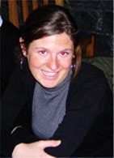
Dott.ssa Virginia Silvari
Virginia Silvari è una Chief II pharmacist che lavora presso il Cork University Hospital. La sua esperienza clinica e di ricerca include l'ottimizzazione dei farmaci per i pazienti affetti da malattie cardiovascolari, in particolare uso di anticoagulanti.
È clinical lecturer presso la Scuola di Farmacia del Trinity College Dublino ed è adjunct clinical senior lecturer presso la Scuola di farmacia di University College Cork.
È membro del comitato scientifico di European association of hospital pharmacists (EAHP) e membro del gruppo Educazione di Hospital Pharmacists Association of Ireland

Slide 4
Working towards the establishment of an Anticoagulation Stewardship Programme
Virginia Silvari
Pharmacy Department, Cork University Hospital, Ireland

Slide 5
TABLE OF CONTENTS
Anticoagulants Risk/Benefits
Anticoagulation Stewardship Programme in Cork University Hospital
Core elements of Anticoagulation Stewardship Programme
Ongoing work

Slide 6
Background
Patients with thromboembolic conditions benefit from anticoagulation therapy:
Stroke prevention in AF patients
Prevention and treatment of VTE
Prevention of valve thrombosis

Slide 7
Millions of patients worldwide currently require anticoagulation
2-3 x 2050
$\sim$75,000 (2018) $\sim$89,000 (2021)
Future projections
Prescription of oral anticoagulants dispensed in Ireland in 2018 and 2021
Notes:
Burnett AE, Barnes GD. A call to action for anticoagulation stewardship. Res Pract Thromb Haemost. 2022;6:e12757. doi: 10.1002/rth2.12757
J Thromb Thrombolysis. 2021; 52(2): 646–653. Published online 2021 Mar 5. doi: 10.1007/s11239-021-02416-4

Slide 8
—Institute For Safe Medication Practices (ISMP)
Anticoagulants have been classified as high alert medications because they have the potential for harm when used clinically.

Slide 9
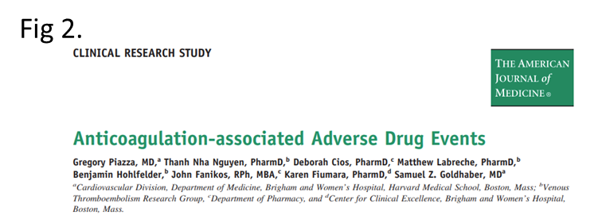
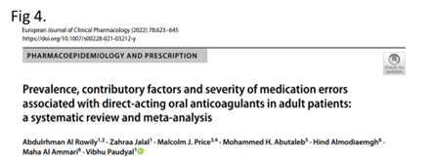
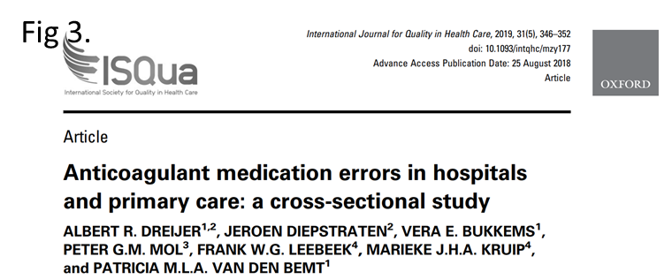
Anticoagulants are accountable for 8-10% of hospital medication errors
5.3–37.3% of hospitalized patients experienced a DOAC-associated medication error

Slide 10
Notes:
In 2020 approximately 12% of incidents (N=11686) submitted through the the National Incident Management System to the Irish State Claim Agency involved an antithrombotic agent.

Slide 11
Three anticoagulants were ranked in the 4 top 10 medications involved in medication incidents
Notes:
Three anticoagulants were ranked in the 4 top 10 medications involved in medication incidents

Slide 12
A PICTURE IS WORTH A THOUSAND WORDS
Anticoagulation Stewardship Programme (ASP)
Stewardship= activity or job of protecting and being responsible for something.
A stewardship programme is a coordinated, efficient, and sustainable system-level initiative designed to achieve optimal health outcomes and minimise avoidable adverse events.
Antimicrobial stewardship is well-established with evidence of improved patient care and reduced healthcare costs.
Anticoagulation stewardship programmes(ASP) requires the same focus and attention as antimicrobial stewardship.

Slide 13
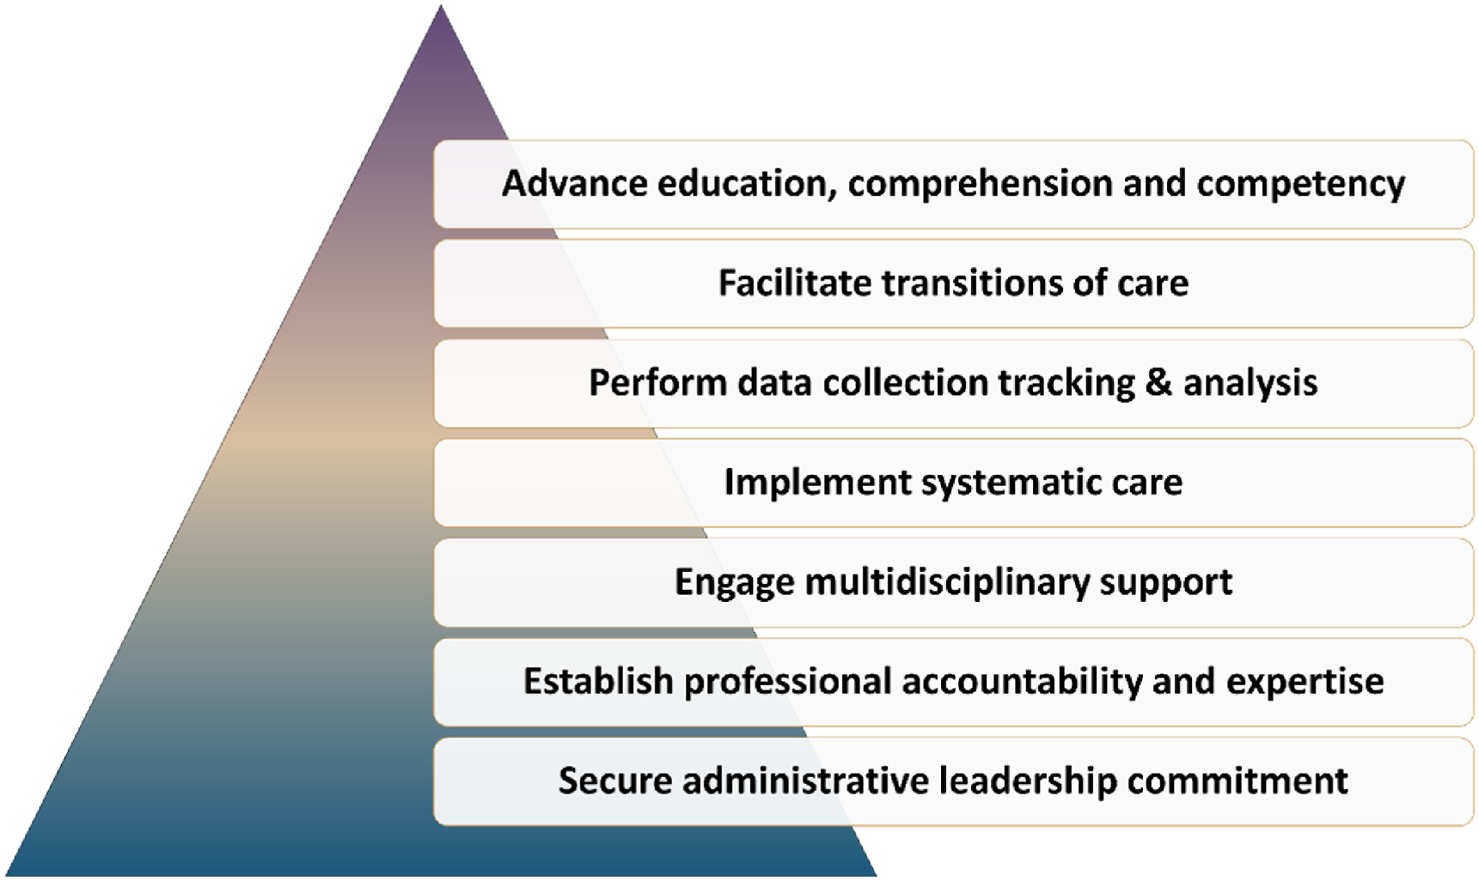
7 Core elements of ASP
In 2019, the Anticoagulation Forum & FDA developed 7 Core Elements of Anticoagulation Stewardship programme to support the implementation across healthcare settings
Burnett A, Rudd KM, Triller D. Thrombosis Update 2022;9:100125

Slide 14
ANTICOAGULATION STEWARDSHIP PROGRAMME in CORK UNIVERSITY HOSPITAL

Slide 15
Facts and figures for CUH
Model 4* tertiary referral centre
800 beds expected to increase to 1000 beds.
The services provided at the hospital include:
All major medical specialities
Surgical specialities including cardiothoracic, neurosurgical.
Interventional radiology, interventional pain management and palliative care.
Approx. 40 hospital pharmacists are currently employed in CUH Pharmacy Department.

Slide 16
ASP CORE TEAM
Haematology Consultant
Anticoagulation Specialist Nurse
D&Tc
Clinical Pharmacist specialised in anticoagulation
Medication Safety Pharmacist
Notes:
Multidisciplinary strategies have been shown to improve safety when anticoagulants are prescribed. In the past year my Hospital has commenced the process of establishing an anticoagulation stewardship programme which will be responsible for continuously improving the care of patients taking these medicines.
The core of the anticoagulation stewardship programme in this tertiary referral hospital are a haematology consultant, a Clinical Pharmacist specialised in anticoagulation, a clinical nurse specialist in anticoagulation and a Medication Safety Pharmacist.

Slide 17
ASP IN CUH
Collaborative approach
Reduce anticoagulants ADEs
Engage MDT support
Data collection tracking & analysis
Education comprehension & competency
Evidence-based clinical guidelines
Notes:
The Anticoagulation Stewardship program is a new service and is in the process of developing interventional strategies for improving patient outcomes related to appropriate anticoagulant use.
The Anticoagulation Stewardship program in CUH is a collaborative approach between the Pharmacy Department and the Haematology Dept. to ensure that patients are receiving safe and optimal anticoagulant therapy.
We aim to ensure that patients requiring anticoagulation are managed appropriately to reduce anticoagulant-related adverse events and prevent hospital complications due to potential over- or under-utilisation of these agents.

Slide 18
My role as Pharmacist in ASP
Development of guidelines and protocols
Review of medication errors
Point of reference for complicated patients
Clinical pharmacists & HCPs education
Standardization of patients’ education
Maintain Clinical role- cardiology
Monitoring/Evaluation of appropriate use of anticoagulants and reversal agents
ASP Pharmacist
Rose, A. (Ed.). (2015). Anticoagulation management : A guidebook for pharmacists. Springer International Publishing AG.
Notes:
.
Lead and/or coordinate all activities related to anticoagulation stewardship.
.
• Lead in the development of anticoagulation-related guidelines and protocols.
• Coordinate all medication use evaluations of anticoagulants.
• Develop, maintain, monitor, and report performance related to anticoagulation
quality/safety metrics.
• Develop, maintain, and monitor anticoagulation management practices/systems
•• Review all reported medication errors and adverse drug reactions involving
anticoagulants.
• Serve as an expert resource for the anticoagulation management of challenging
patients or patient populations.
• Maintain knowledge of current anticoagulation clinical literature, regulatory
requirements, best practices, and quality and safety metrics.
• Participate in scholarly activities (e.g., publications, presentations, posters) with
knowledge gained from the activities of the stewardship program.
• Lead and coordinate the standardization of patient education materials related to
anticoagulants.
• Coordinate professional development and competency activities for pharmacists
related to anticoagulation.
• Coordinate educational efforts for other disciplines related to anticoagulation.
• Participate in the training of medical/pharmacy students/residents and newly
hired pharmacists.
• Maintain an active clinical practice in an anticoagulation clinic and inpatient
cardiology and/or internal medicine practice setting.

Slide 19
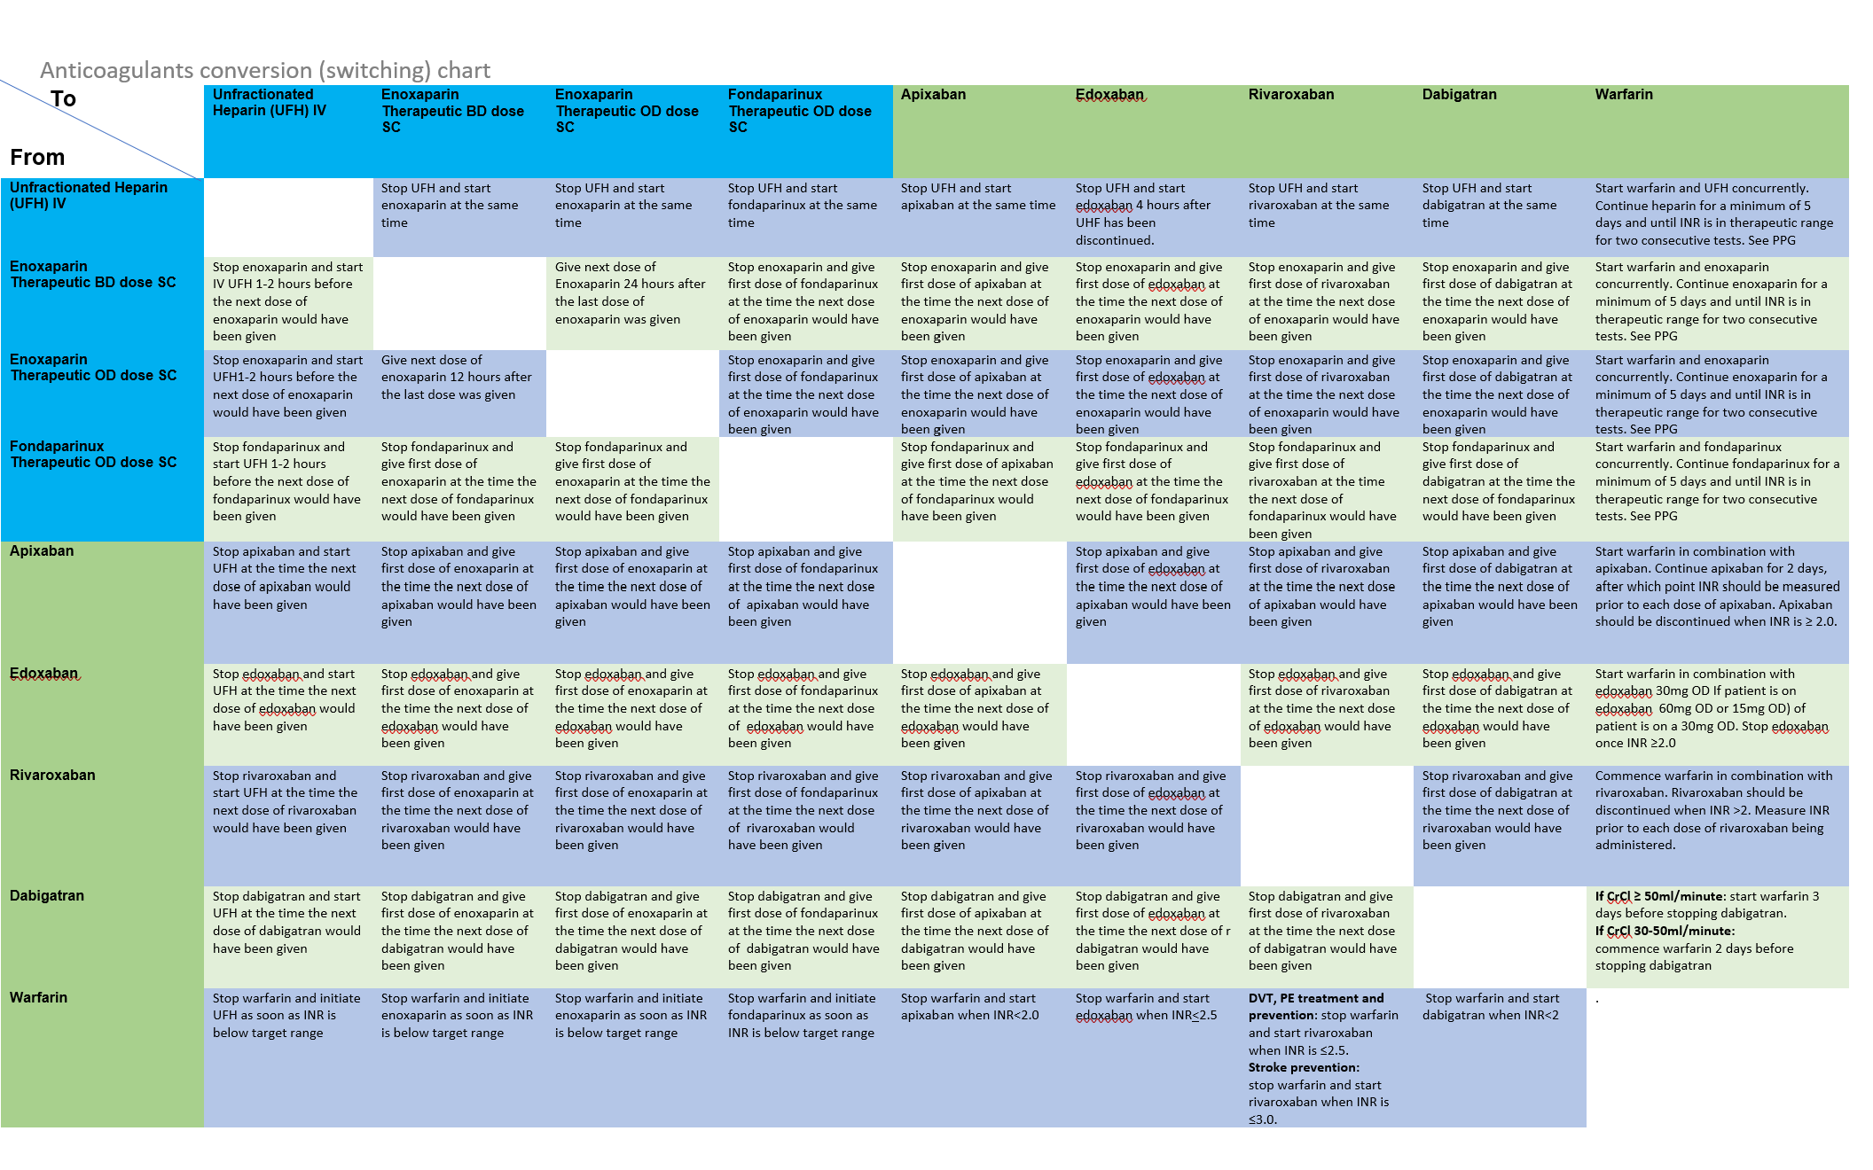
Anticoagulants conversion table

Slide 20
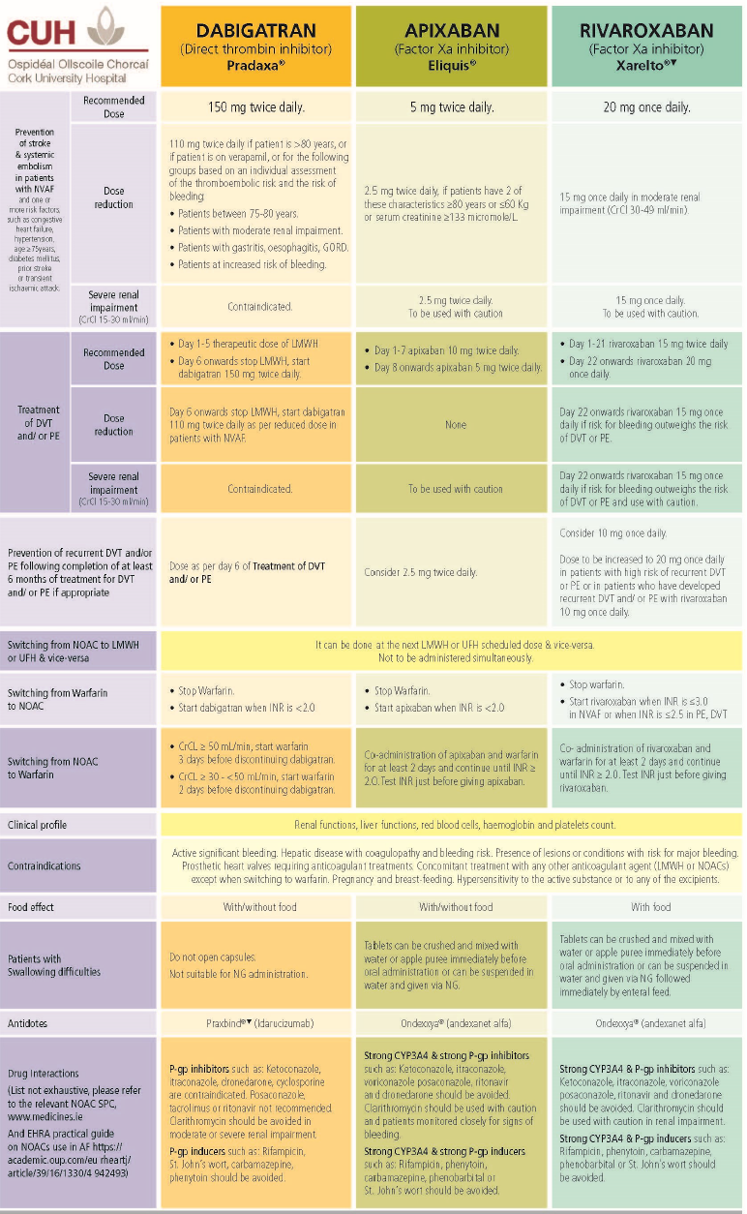
DOACs reference table

Slide 21
DATA COLLECTION TRACKING & ANALYSIS
Pharmacists’ interventions on DOACs prescription- A retrospective study
Appropriate prescribing of anticoagulants Audit
Comparison appropriate prescribing of anticoagulants Audits
Notes:
The Anticoagulation stewardship promotes safe and effective practices, measured as quality of anticoagulation therapy or outcomes.
As part of the anticoagulation stewardship programme adherence to the hospital anticoagulation guidelines was audited as well incidents involving anticoagulants that were reported to the hospital quality system in 2020 were also reviewed and reported in this presentation.
3. Person-centred care is fostered by the Anticoagulation stewardship programme via shared decision making.
4. Healthcare professionals are trained to provide evidence-based practice to patients on anticoagulant medications. When the workforce has the required knowledge and skills, the adverse drug events are reduced (National Quality Forum).
5. Anticoagulants and haemostatic agents are high risk and high cost products. The anticoagulation stewardship programme not only improves outcomes but also reduces related adverse drug events and lowers costs.

Slide 22
CHALLENGES: LMWH- Supply disruption
In December 2021, Irish hospitals were notified about a supply issue affecting certain strengths of the LMWH tinzaparin for the beginning of 2022.
The ASP in collaboration with the renal department:
Select an evidence-based alternative to tinzaparin.
1
Develop new hospital guidelines for safe prescribing of the selected alternative LMWH.
2
Evaluate compliance with the new guidelines and review LMWH medication safety incidents submitted to the risk department.
3

Slide 23
Ongoing work
Evaluation of the use of Prothrombin Complex Concentrate (PCC), Idarucizumab and Andexanet alfa in patients with excessive bleeding.
Appropriateness of Heparin Induced Thrombocytopaenia testing.
Notes:
The Anticoagulation stewardship promotes safe and effective practices, measured as quality of anticoagulation therapy or outcomes.
As part of the anticoagulation stewardship programme adherence to the hospital anticoagulation guidelines was audited as well incidents involving anticoagulants that were reported to the hospital quality system in 2020 were also reviewed and reported in this presentation.
3. Person-centred care is fostered by the Anticoagulation stewardship programme via shared decision making.
4. Healthcare professionals are trained to provide evidence-based practice to patients on anticoagulant medications. When the workforce has the required knowledge and skills, the adverse drug events are reduced (National Quality Forum).
5. Anticoagulants and haemostatic agents are high risk and high cost products. The anticoagulation stewardship programme not only improves outcomes but also reduces related adverse drug events and lowers costs.

Slide 24
Conclusions Developing an ASP to properly use anticoagulants is essential for inpatient facilities. Within an anticoagulation stewardship programme, the clinical pharmacists play an important role to improve management of patients on anticoagulants.
Notes:
In conclusion developing an anticoagulant stewardship programme to properly use anticoagulants is essential for inpatient facilities to decrease the incidence of complications which could arise when anticoagulants are inappropriately prescribed and improve prescribing quality which results in better outcomes for the patient.
Within an anticoagulant stewardship programme, the clinical pharmacists play an important role to improve management of patients on anticoagulants.

Slide 25
Case study
CHA₂DS₂-VASc Score for Atrial Fibrillation Stroke Risk= 5 10.0% risk of stroke/TIA/systemic embolism. Gender=1, Age=1, BP=1, HF=1, CVD=1
HAS-BLED Score for Major Bleeding Risk=3
Age=1, BP=1, Antiplatelets=1
Female, Age 71
Dhx= Sulpiride 100mg TDS, Aspirin 100mg OD, Clopidogrel 75mg OD (6/12 Aug 2023), Pantoprazole 20mg OD, Candesartan 16mg OD, Metoprolol 100mg BD, Ranolazine 375mg BD, Furosemide 25mg OD, Atorvastatin 20mg OD, Apixaban 5mg BD
Pt is discharged from Intensive Care- haemodynamically stable.
Medication review- Medication Optimization- Deprescribing
Notes:
In conclusion developing an anticoagulant stewardship programme to properly use anticoagulants is essential for inpatient facilities to decrease the incidence of complications which could arise when anticoagulants are inappropriately prescribed and improve prescribing quality which results in better outcomes for the patient.
Within an anticoagulant stewardship programme, the clinical pharmacists play an important role to improve management of patients on anticoagulants.

Slide 26
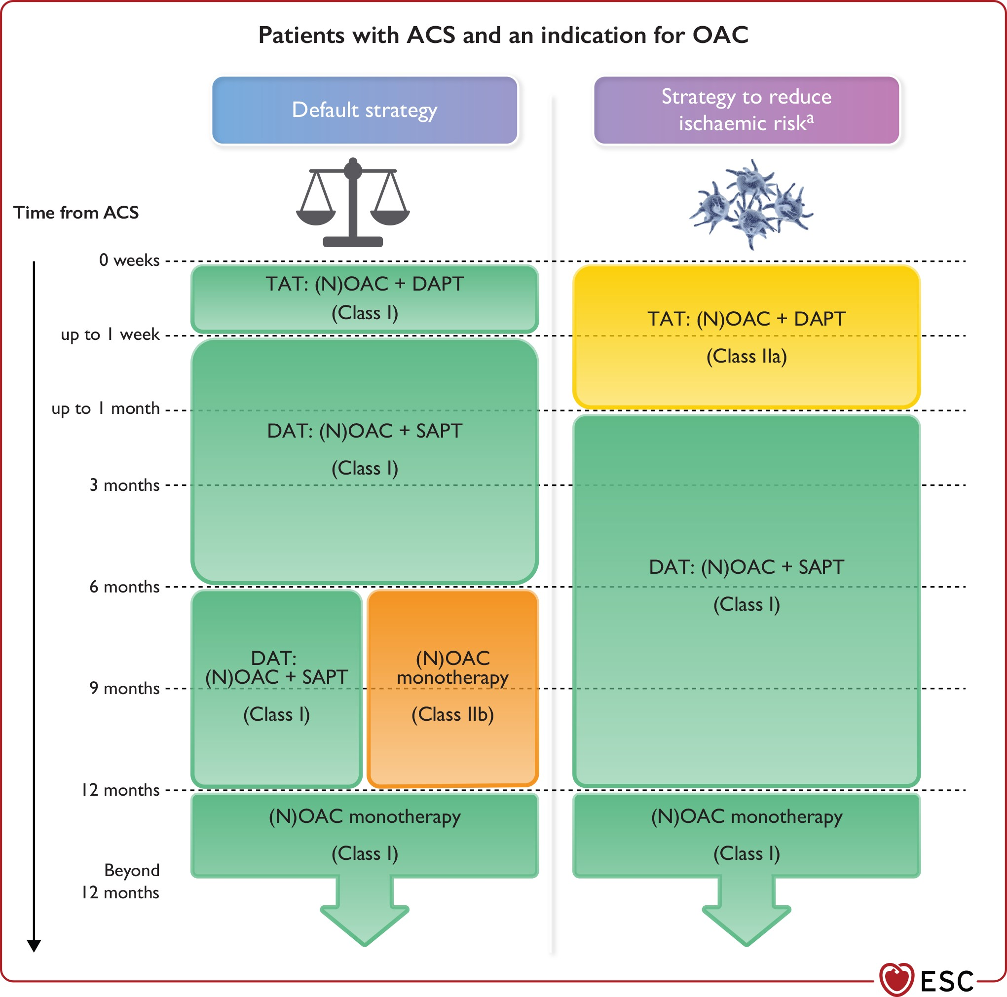
Notes:
Figure 12 Antithrombotic regimens in patients with acute coronary syndrome and an indication for oral anticoagulation. ACS, acute coronary syndrome; ARC-HBR, Academic Research Consortium for High Bleeding Risk; DAPT, dual antiplatelet therapy; DAT, dual antithrombotic therapy; NOAC, non-vitamin K antagonist oral anticoagulant; OAC, oral anticoagulation/anticoagulant; SAPT, single antiplatelet therapy; TAT, triple antithrombotic therapy; VKA, vitamin K antagonist. OAC: preference for a NOAC over VKA for the default strategy and in all other scenarios if no contraindications. For both TAT and DAT regimens, the recommended doses for the NOACs are as follows: Apixaban 5 mg b.i.d., Dabigatran 110 mg or 150 mg b.i.d., Edoxaban 60 mg o.d., Rivaroxaban 15 mg or 20 mg o.d. NOAC dose reductions are recommended in patients based on certain criteria for each of the NOACs (including renal function, body weight, concomitant medications and age). SAPT: preference for a P2Y12 receptor inhibitor (usually clopidogrel) over aspirin. See Bleeding risk assessment in Supplementary data online, Section 8.2.2.3 for details on the ARC-HBR criteria. In addition, patients with a PRECISE-DAPT score of ≥25 are regarded as high bleeding risk. aSee Supplementary material online, Table S9 for examples of high-risk features of stent-driven recurrent events.
Unless provided in the caption above, the following copyright applies to the content of this slide: This article is co-published with permission in European Heart Journal and European Heart Journal - Acute Cardiovascular Care. All rights reserved. © The European Society of Cardiology 2023. The articles are identical except for stylistic differences in keeping with each journal's style. Either citation can be used when citing this article. For permissions, please e-mail: journals.permissions@oup.comThis article is published and distributed under the terms of the Oxford University Press, Standard Journals Publication Model (https://academic.oup.com/pages/standard-publication-reuse-rights)

Slide 27
Case study Med Review/ Optimisation= Sulpiride 100mg TDS, Aspirin 100mg OD, Clopidogrel 75mg OD (6/12 Aug 2023), Pantoprazole 20mg OD, Candesartan 16mg OD, Metoprolol 100mg BD, Ranolazine 375mg BD, Furosemide 25mg OD, Atorvastatin 20mg OD, Apixaban 5mg BD
Aspirin 100mg OD
Ranolazine 375 mg BD (patient has been stented, no angina pain left)
12/12 of DAT= Apixaban 5mg BD and Clopidogrel 75 mg OD then stop clopidogrel and continue Apixaban for life
Atorvastatin 80mg OD
Pantoprazole 40mg OD
Metoprolol to Bisoprolol 5 mg OD to be titrated up to 10 mg OD if necessary
Notes:
In conclusion developing an anticoagulant stewardship programme to properly use anticoagulants is essential for inpatient facilities to decrease the incidence of complications which could arise when anticoagulants are inappropriately prescribed and improve prescribing quality which results in better outcomes for the patient.
Within an anticoagulant stewardship programme, the clinical pharmacists play an important role to improve management of patients on anticoagulants.

Slide 28
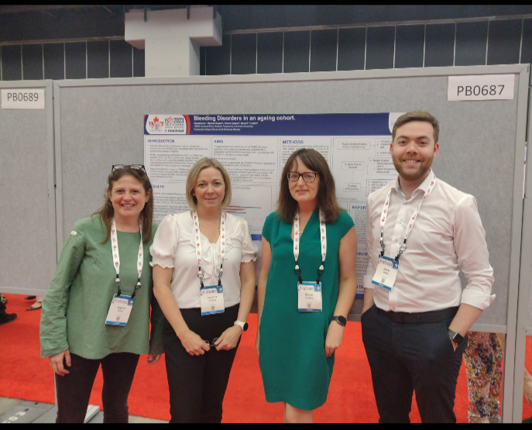
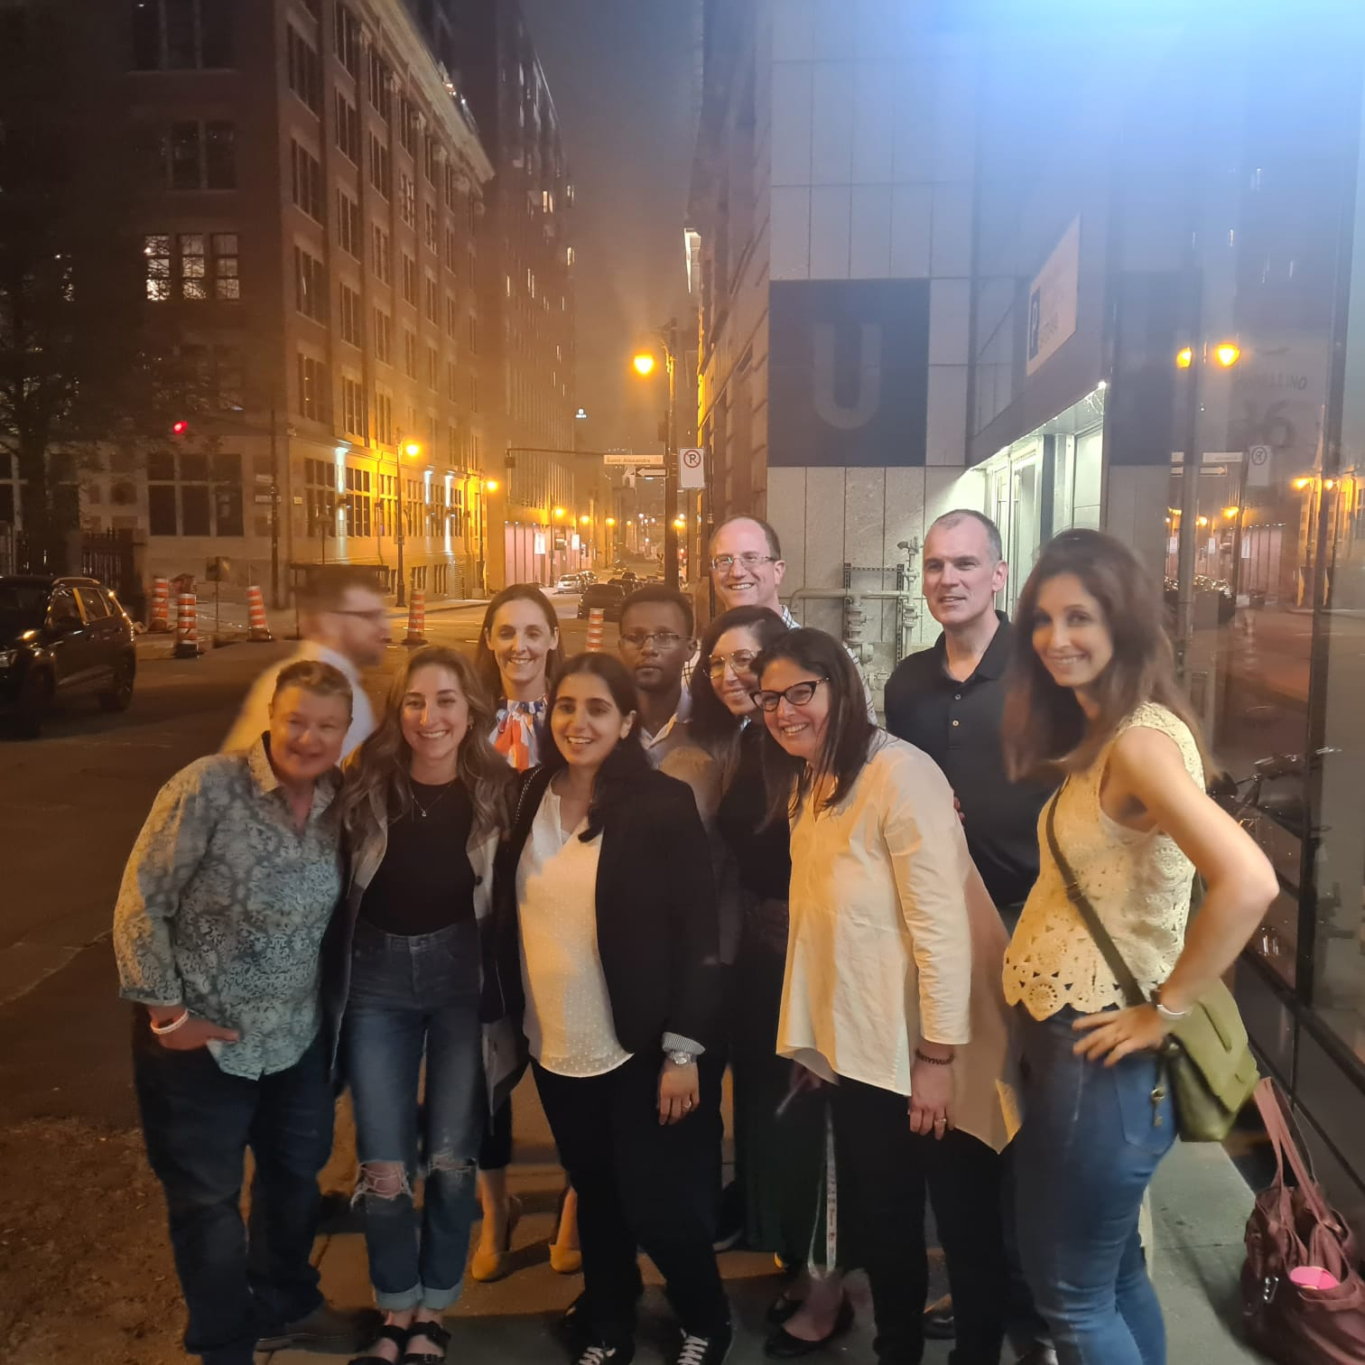
ASP Fun
Pizza night with AC Forum
ISTH2023

Slide 29
THANKS!
Do you have any questions?
virginia.silvari@hse.ie
Anticoagulation Stewardship Programme members
Dr Maeve Crowley
Ms Catriona O’Leary
Ms Aoife Delaney
Drug & Therapeutic Committee
Clinical Pharmacists in CUH

Slide 30
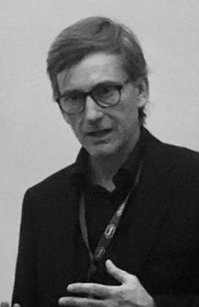
Prof. Cristiano Chiamulera
Cristiano Chiamulera è Professore Ordinario di Farmacologia presso l’Università degli studi di Verona.
Presidente del Corso di Laurea Magistrale a Ciclo Unico in Medicina e Chirurgia e Referente del Corso di Laurea in Farmacia dell’Università di Verona.
Responsabile della U.O.S. di Farmacologia della Azienda Ospedaliera Integrata Verona.
Membro del Comitato direttivo di Farmacologia Clinica della Società Italiana di Farmacologia. In qualità di Presidente della Society for Research on Nicotine &Tobacco ha fondato il chapter europeo.
E’ stato General Secretary della European Behavioural Pharmacology Society. Siede in diversi comitati tecnico-scientifici ed etici per la ricerca, ed è stato membro del Consiglio d’Amministrazione dell’Ateneo veronese.

