Slide 1
Training Clinical Pharmacists to Think Critically, Communicate Effectively, and Collaborate Productively
Frank Massaro, PharmD

Slide 2
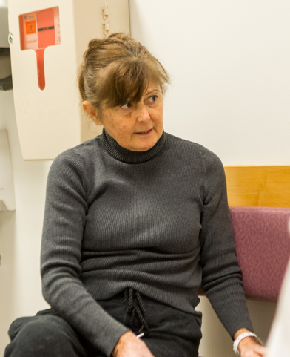
The Patient

Slide 3
The Patient
The Pharmacist
Ensure safe and effective drug therapy
Educate patients and providers
Promote adherence
Mitigate side effects
Improve access
Reduce healthcare costs

Slide 4
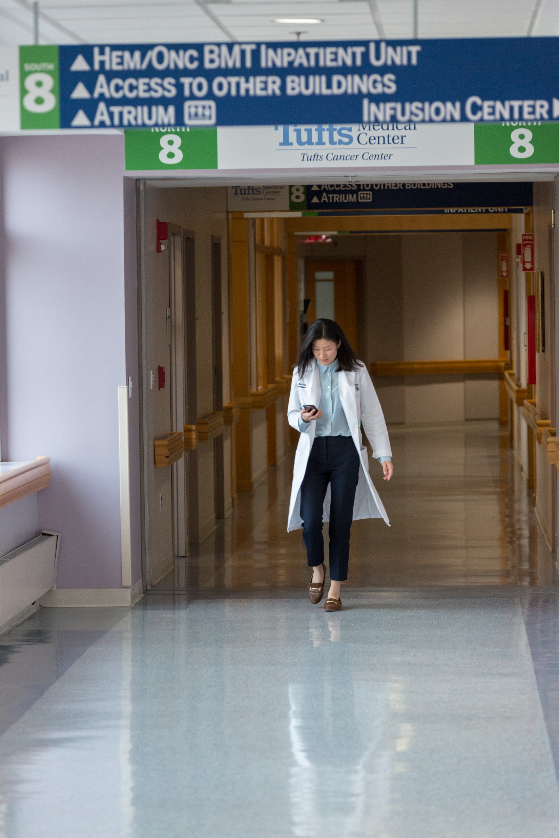
The Pharmacist
Pharmacy Curriculum
General Chemistry • Organic Chemistry
Biochemistry • Medicinal Chemistry
Biology • Anatomy and Physiology
Microbiology • Immunology
Pharmaceutical Calculations • Toxicology
Pharmacology • Statistics and Epidemiology
Pharmacy Safety and Law • Pharmacotherapeutics
Pharmacokinetics • Drug Literature Evaluation
Administration and Leadership • Pharmacogenomics
Marketing • Manufacturing
Disease Prevention • Nutrition
Communication • Ethics

Slide 5
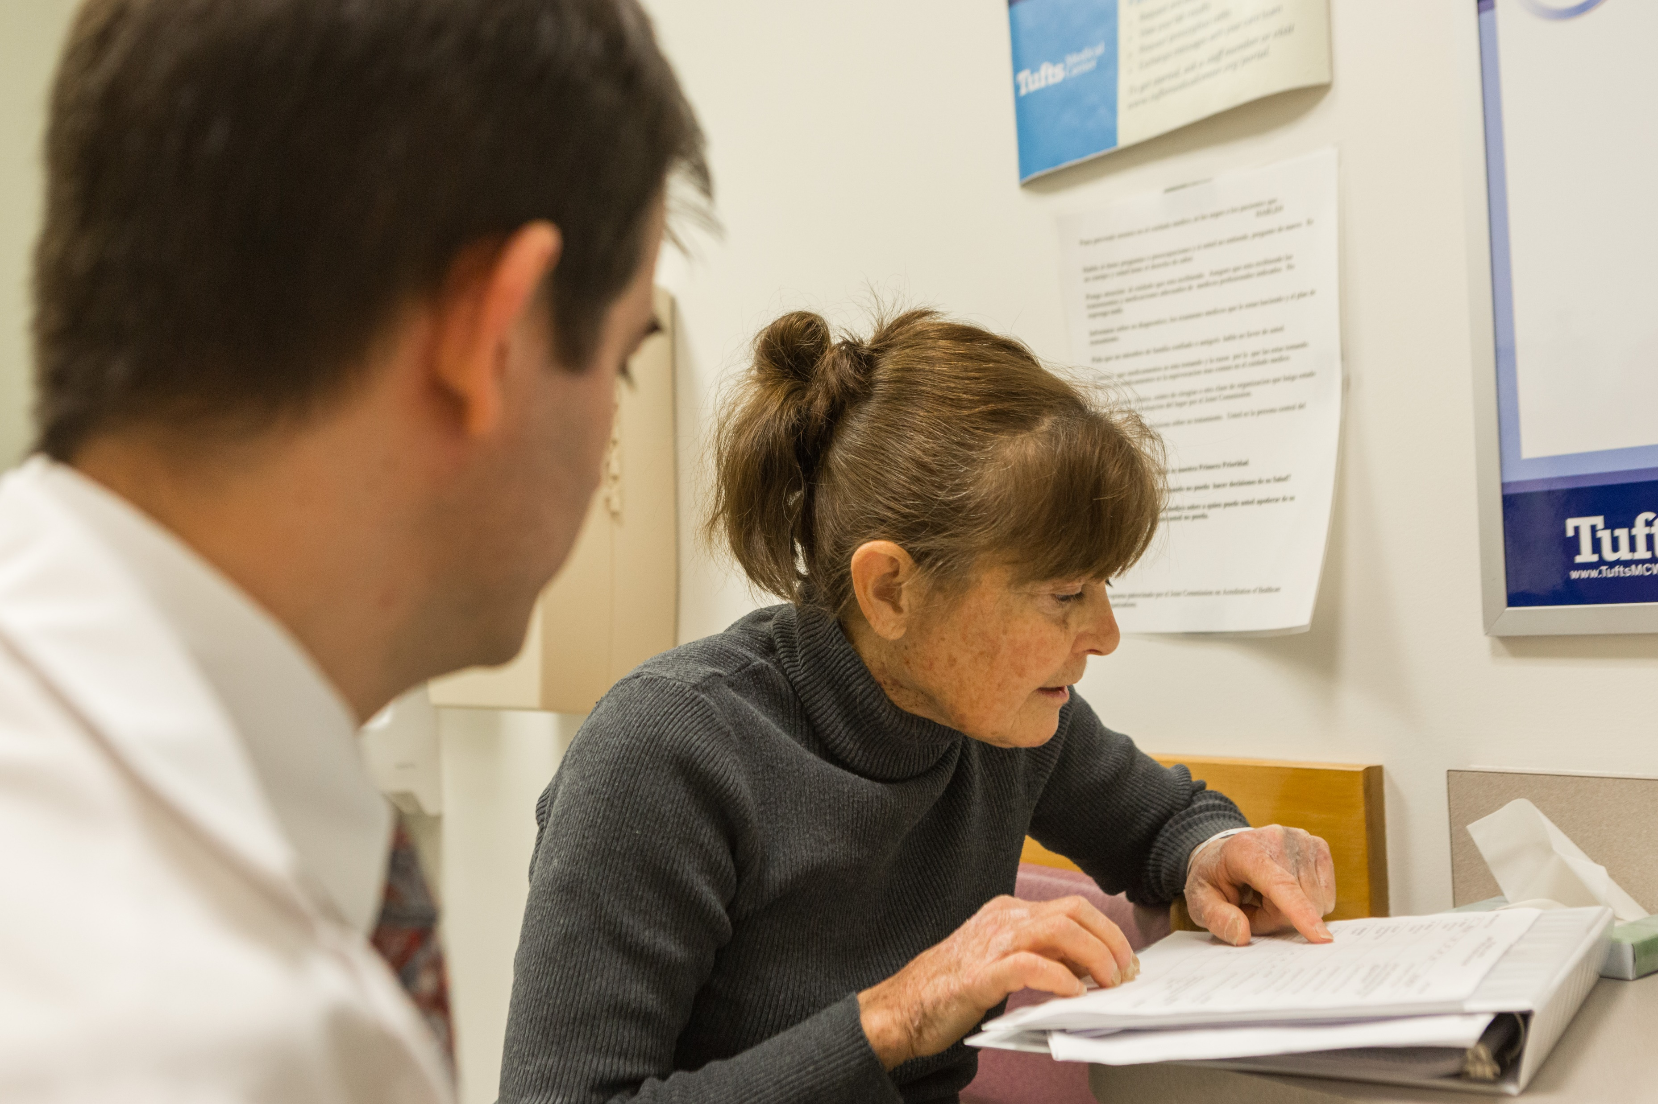
The Clinical Pharmacist
Acquire the knowledge, skills, and attitude of a pharmacist….
to think, perform and behave like a clinician.

Slide 6
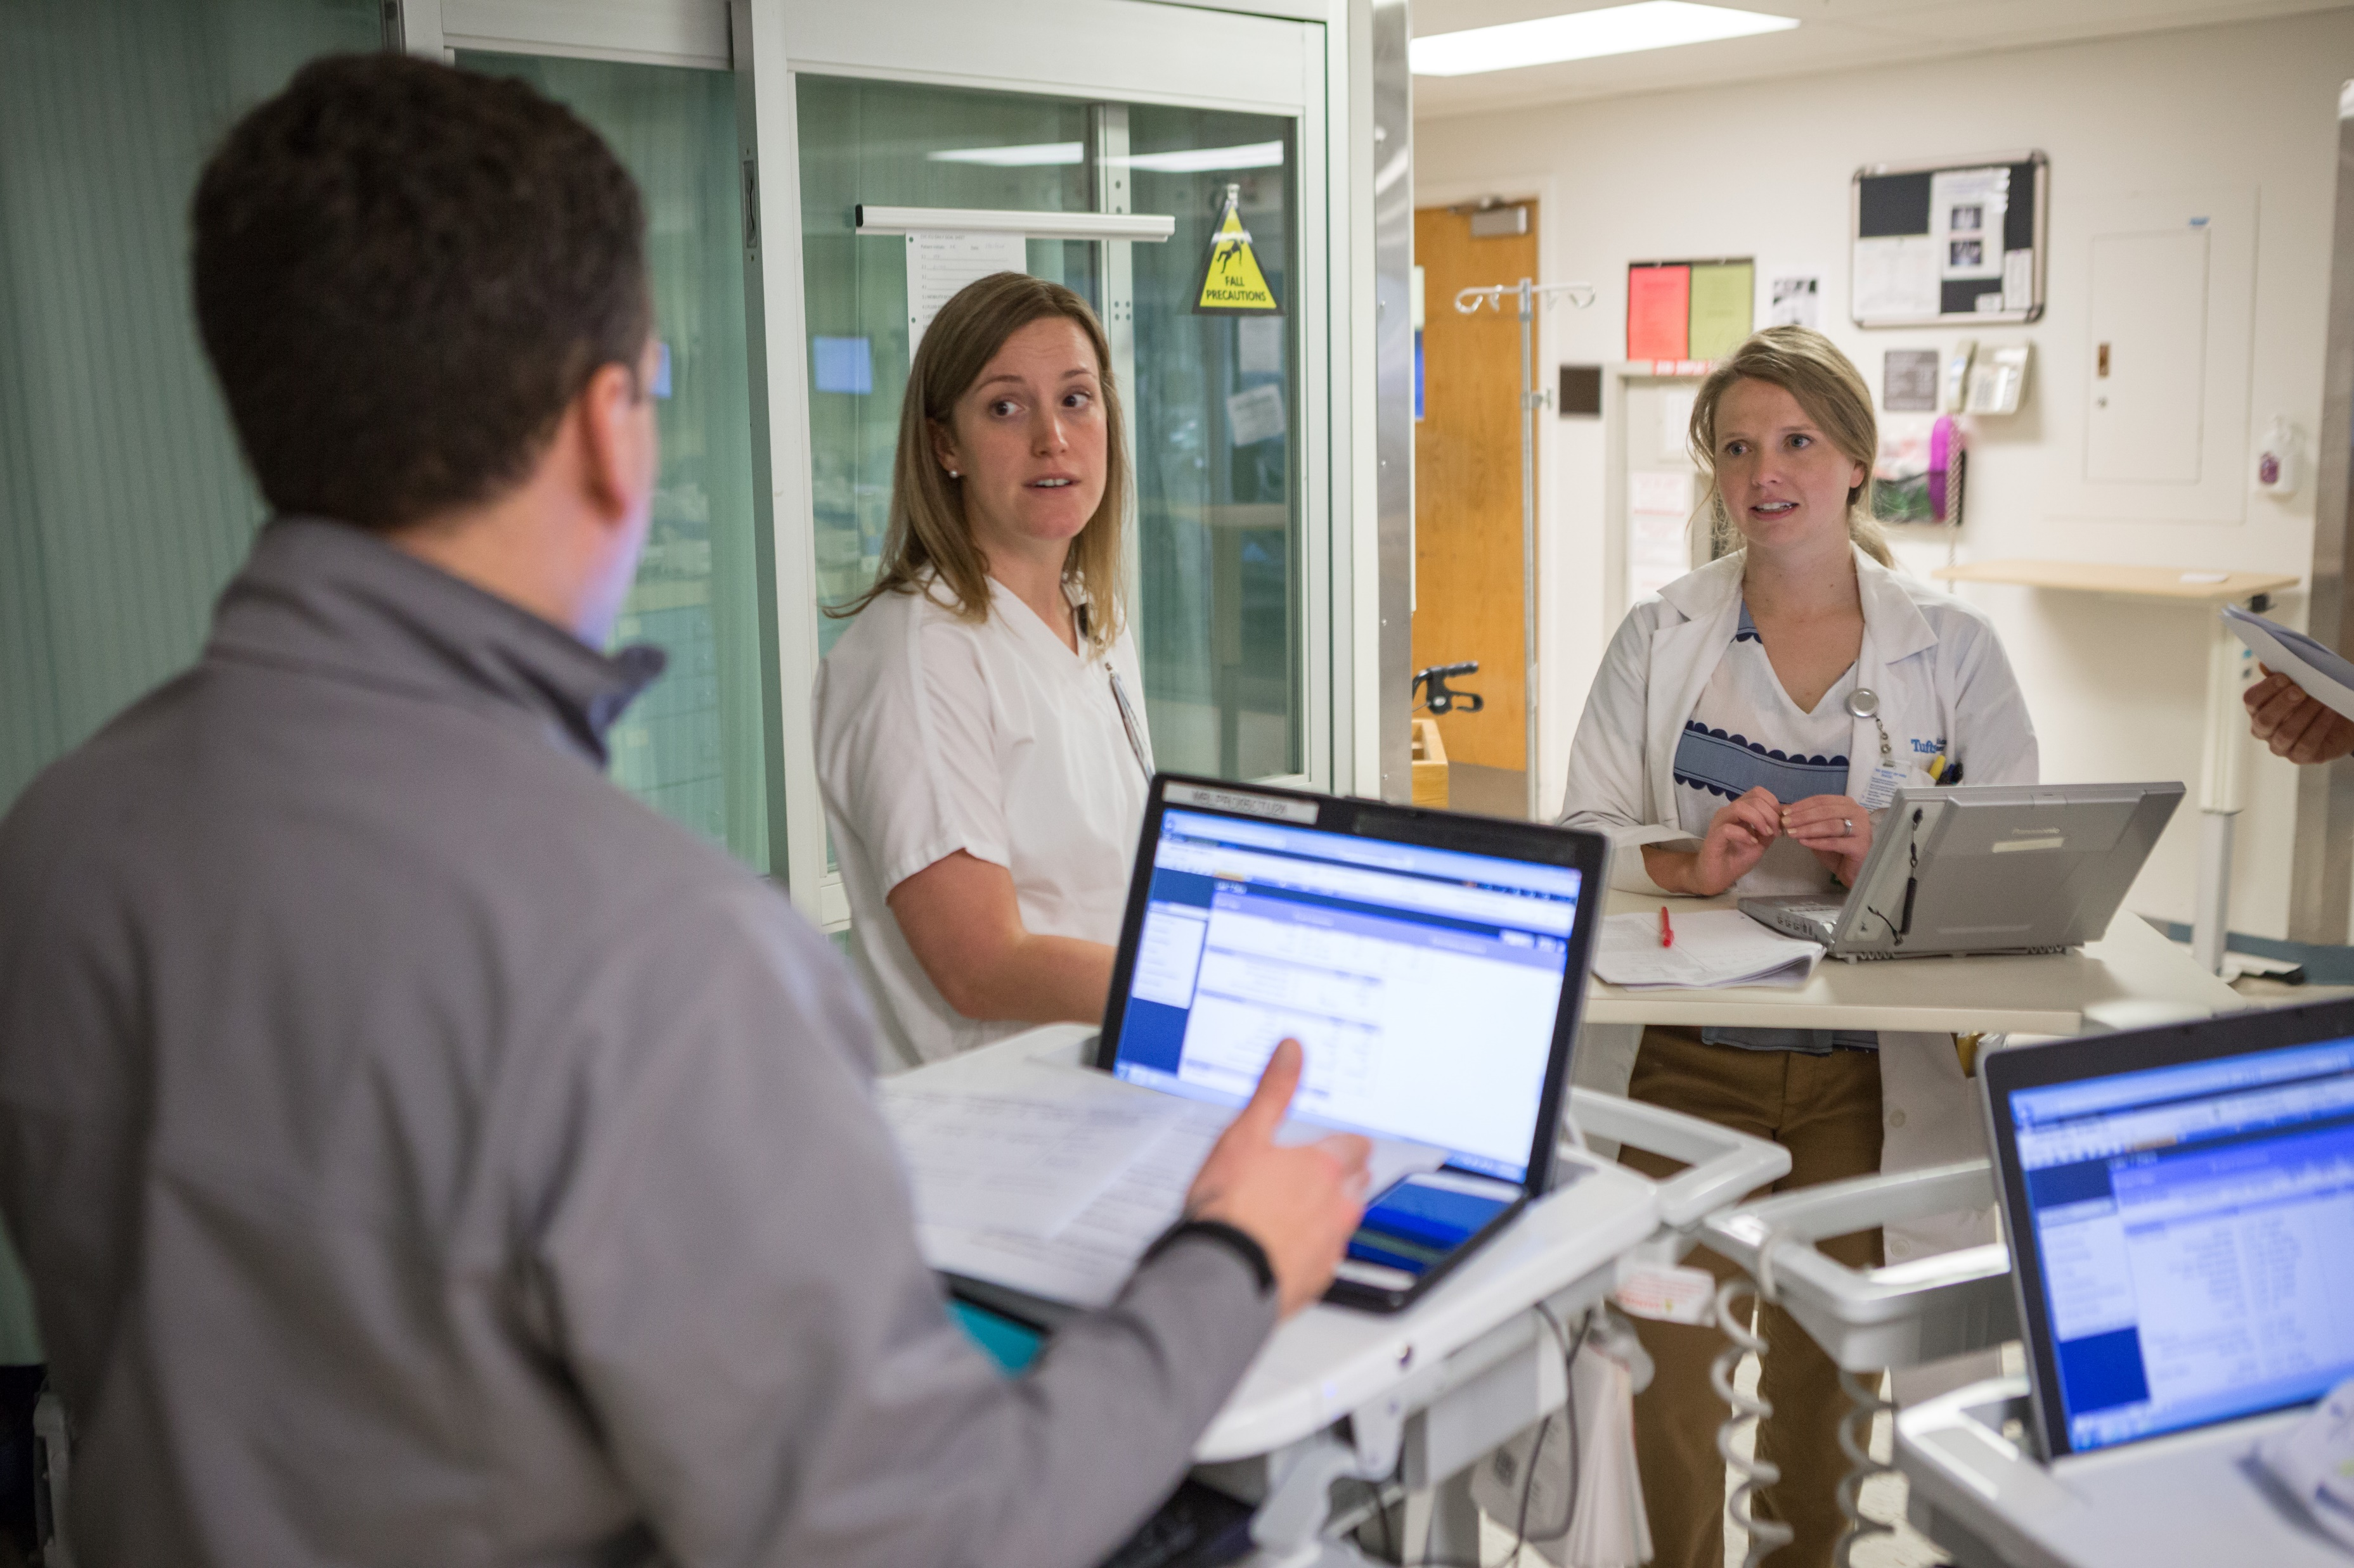
Objectives
After attending this presentation, participants should be able to:
Describe the knowledge, skills, and attitudes required to be a more successful clinical pharmacist
Describe teaching strategies that are effective in training clinical pharmacists
Describe clinical pharmacy services at Tufts Medical Center

Slide 7
Traditional Learning
Told What We Need to Know
Learn the Information
Presentation of the Problem
Knowledge is required before the problem is encountered.

Slide 8
Problem-based Learning
Learning related to the Problem
Presentation of the Problem
Solutions to the Problem
Knowledge arises from work on the problem.

Slide 9
Problem-based Learning
Paula was at home with her husband and her grandson when her telephone rang. It was the transplant coordinator calling to tell her that a kidney was available. She was to come to the hospital as soon as possible to prepare for surgery.

Slide 10
Problem-based Learning
What We Know
Want to Know
Hypotheses
Learning Questions
Paula was at home with her husband and her grandson when her telephone rang. It was the transplant coordinator calling to tell her that a kidney was available. She was to come to the hospital as soon as possible to prepare for surgery.

Slide 11
Problem-based Learning
What We Know
Want to Know
Hypotheses
Learning Questions
Female
Married
Grandmother
Kidney transplant
Kidney failure
Paula was at home with her husband and her grandson when her telephone rang. It was the transplant coordinator calling to tell her that a kidney was available. She was to come to the hospital as soon as possible to prepare for surgery.

Slide 12
Problem-based Learning
What We Know
Want to Know
Hypotheses
Learning Questions
Female
Married
Grandmother
Kidney transplant
Age
Medical history
Medication history
Dialysis
Location
Kidney failure
Causes of kidney failure
Viability of an explanted organ
Surgery preparation
Post-transplant medications
Transplant coordinator
Forms of dialysis
Patient – organ matching
Cost of a transplant
Paula was at home with her husband and her grandson when her telephone rang. It was the transplant coordinator calling to tell her that a kidney was available. She was to come to the hospital as soon as possible to prepare for surgery.

Slide 13
Problem-based Learning
What We Know
Want to Know
Hypotheses
Learning Questions
Female
Married
Grandmother
Kidney transplant
Age
Medical history
Medication history
Dialysis
Location
Kidney failure
Causes of kidney failure
Viability of an explanted organ
Surgery preparation
Post-transplant medications
Transplant coordinator
Forms of dialysis
Patient – organ matching
Cost of a transplant
Paula was at home with her husband and her grandson when her telephone rang. It was the transplant coordinator calling to tell her that a kidney was available. She was to come to the hospital as soon as possible to prepare for surgery.
Part 2.

Slide 14
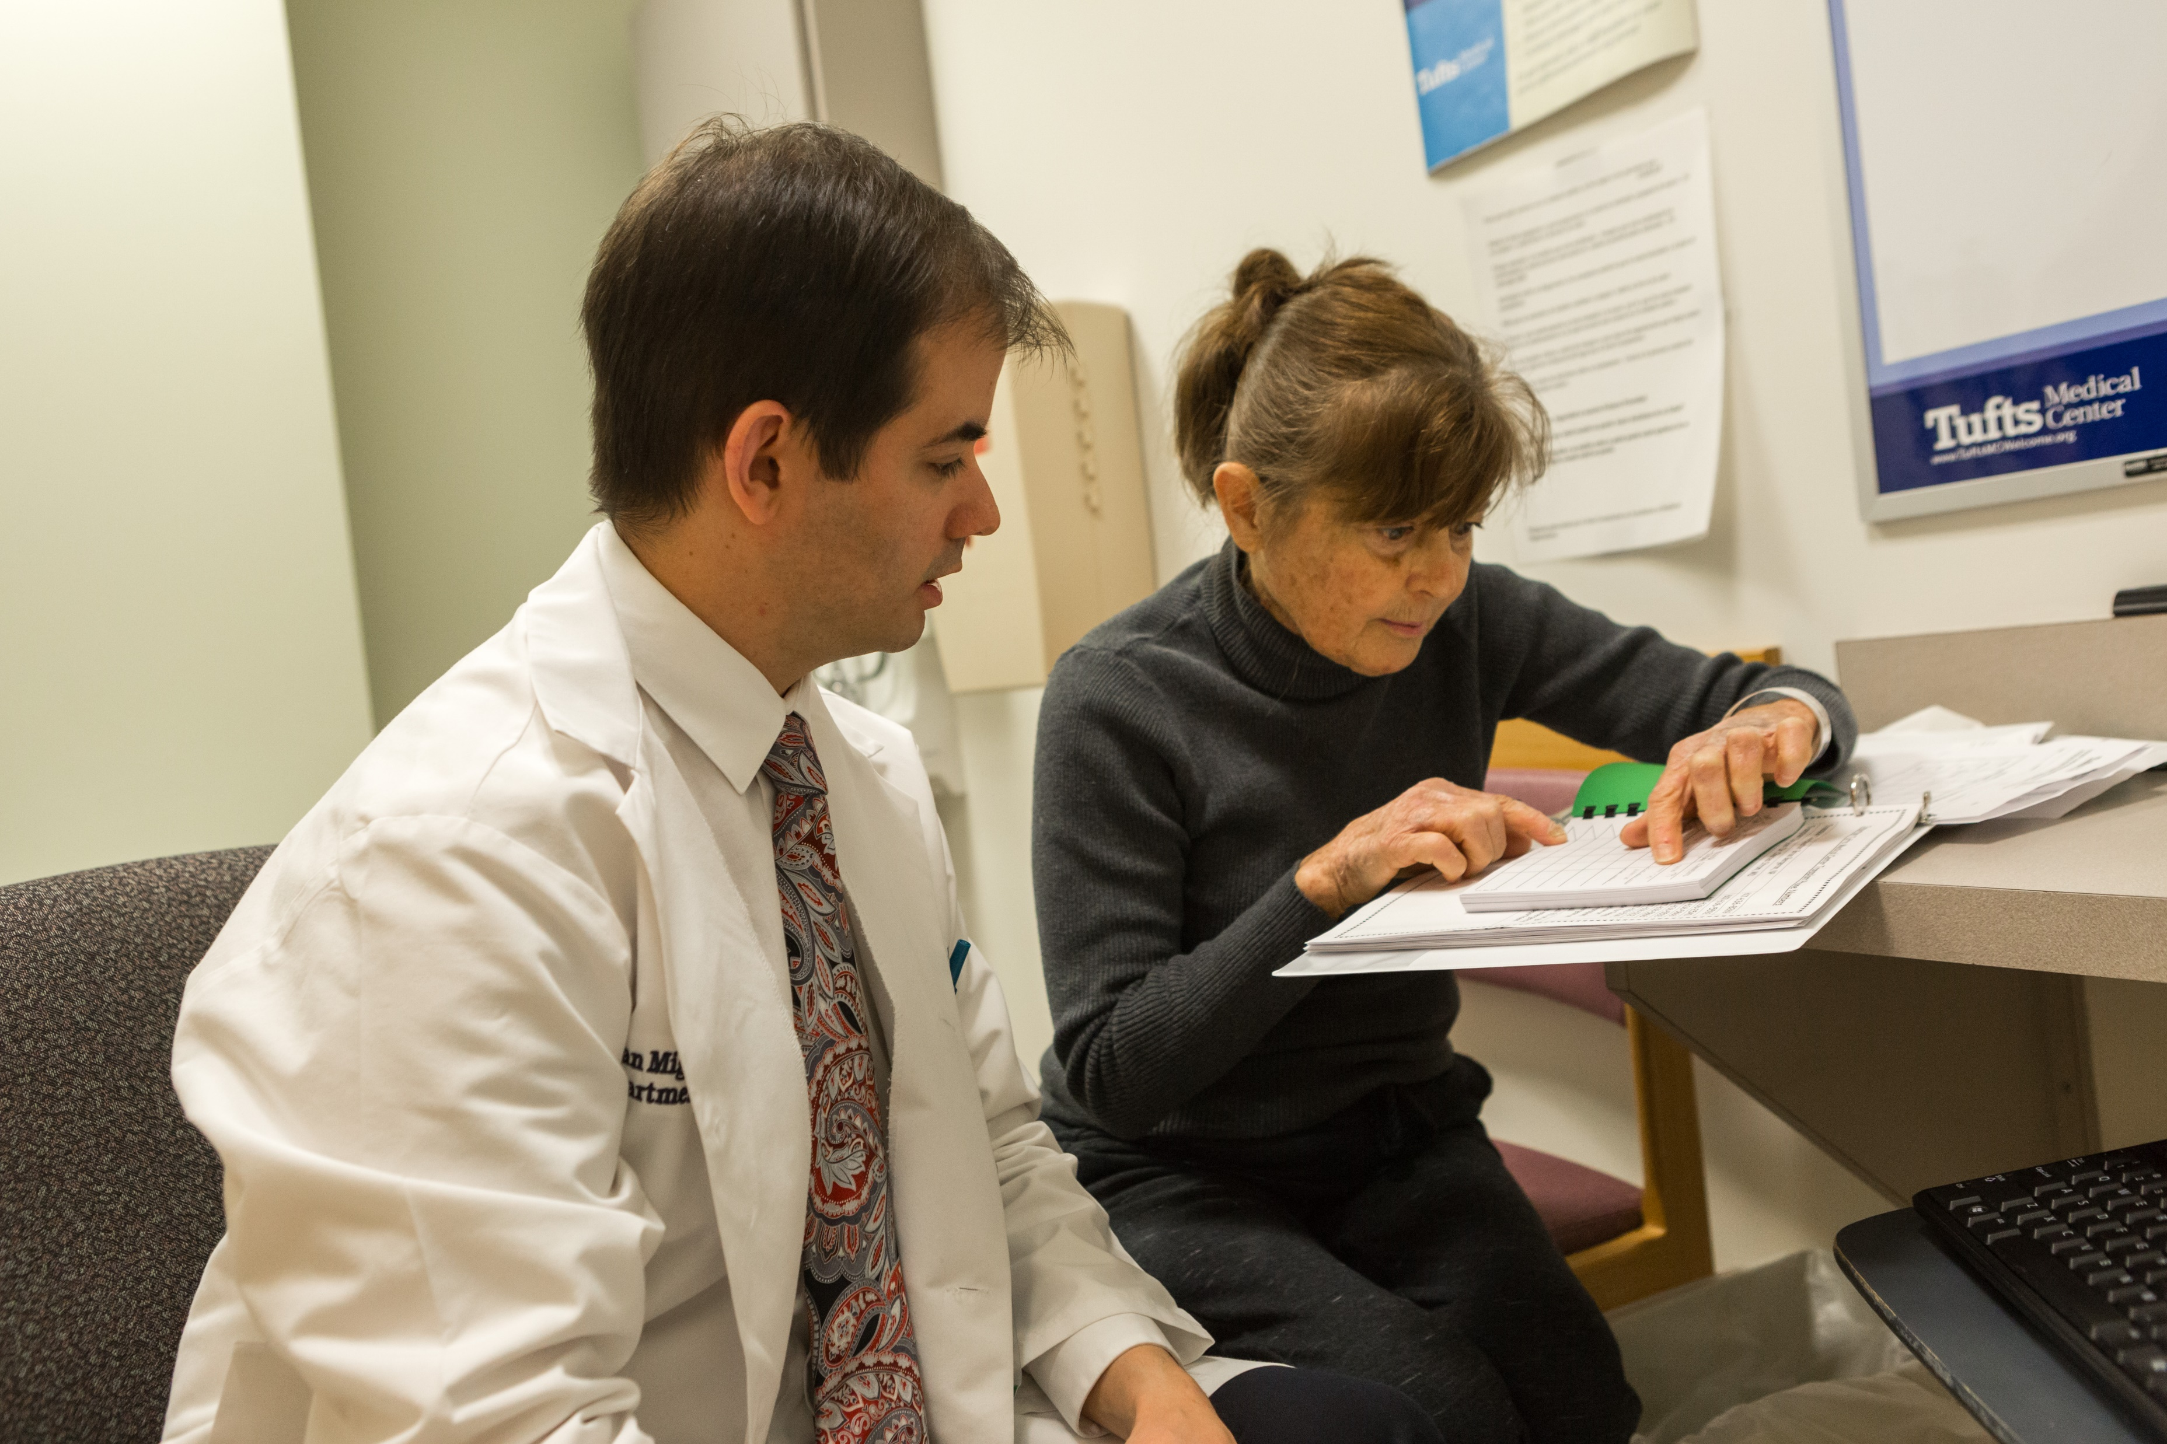
The Clinical Pharmacist

Slide 15
Clinical Problem Solving
Essential Functions
Medication history
Drug list
Medication taking behaviors
Monitor Effectiveness / Toxicity
Medication education/ access

Slide 16
The Scientific Method vs. Monitoring Drug Therapy
H_{O}
0100011

Slide 17
The Scientific Method vs. Monitoring Drug Therapy
H_{O}
History
Exam
Lab
Cough
120/80
4.5 mEq
0100011

Slide 18
Problem Solving: Monitoring Drug Therapy
Problem List
Kidney transplant
Immunosuppression
Infection prevention
Hypertension
Glaucoma
Constipation
Post-operative Medications
tacrolimus 2 mg PO BID
mycophenolate mofetil 500 mg PO BID
prednisone 5 mg PO Qday
sulfa/trimethoprim 400/80 mg PO Qday
valganciclovir 450 mg PO 2 times weekly
amlodipine 5 mg PO Qday
aspirin 81 mg PO Qday
atorvastatin 40 mg PO Qday
metoprolol succinate 25 mg PO Qday
latanoprost 0.005% 1 drop OU QHS
docusate sodium 100 mg PO BID
polyethylene glycol 17 g PO Qday
senna 17.2 mg PO QHS

Slide 19
Problem Solving: Monitoring Drug Therapy
Therapeutic
Toxic
Post-operative Medications
tacrolimus 2 mg PO BID
Subjective
Objective

Slide 20
Problem Solving: Monitoring Drug Therapy
Therapeutic
Toxic
Post-operative Medications
tacrolimus 2 mg PO BID
Urine output
Tremor
Constipation / diarrhea
Subjective
Serum creatinine
Blood concentration
Blood concentration
Objective

Slide 21
Problem Solving: Monitoring Drug Therapy
Therapeutic
Toxic
Post-operative Medications
tacrolimus 2 mg PO BID
Urine output
Tremor
Constipation / diarrhea
Headache
Insomnia
Urine output
Blurry vision
Risk of skin cancer
Subjective
Serum creatinine
Blood concentration
Blood concentration
Complete blood count
Blood glucose
Serum potassium
Blood pressure
Blood lipids
Liver enzymes
Viral infections
Objective

Slide 22
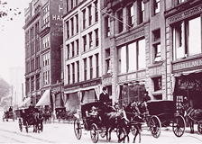
Tufts Medical Center
Boston 1796

Slide 23
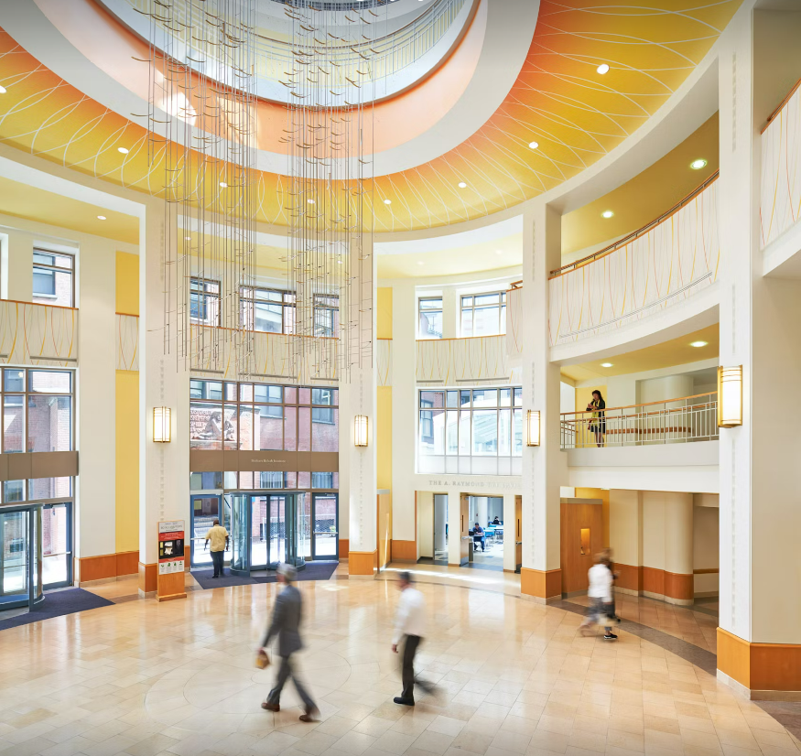
Tufts Medical Center
Beds 400
ICU beds 100
ED visits 46,000 / year
Clinic visits 395,000 / year
Pharmacists 70
Hospital 28
Clinic 24
Residents 9

Slide 24
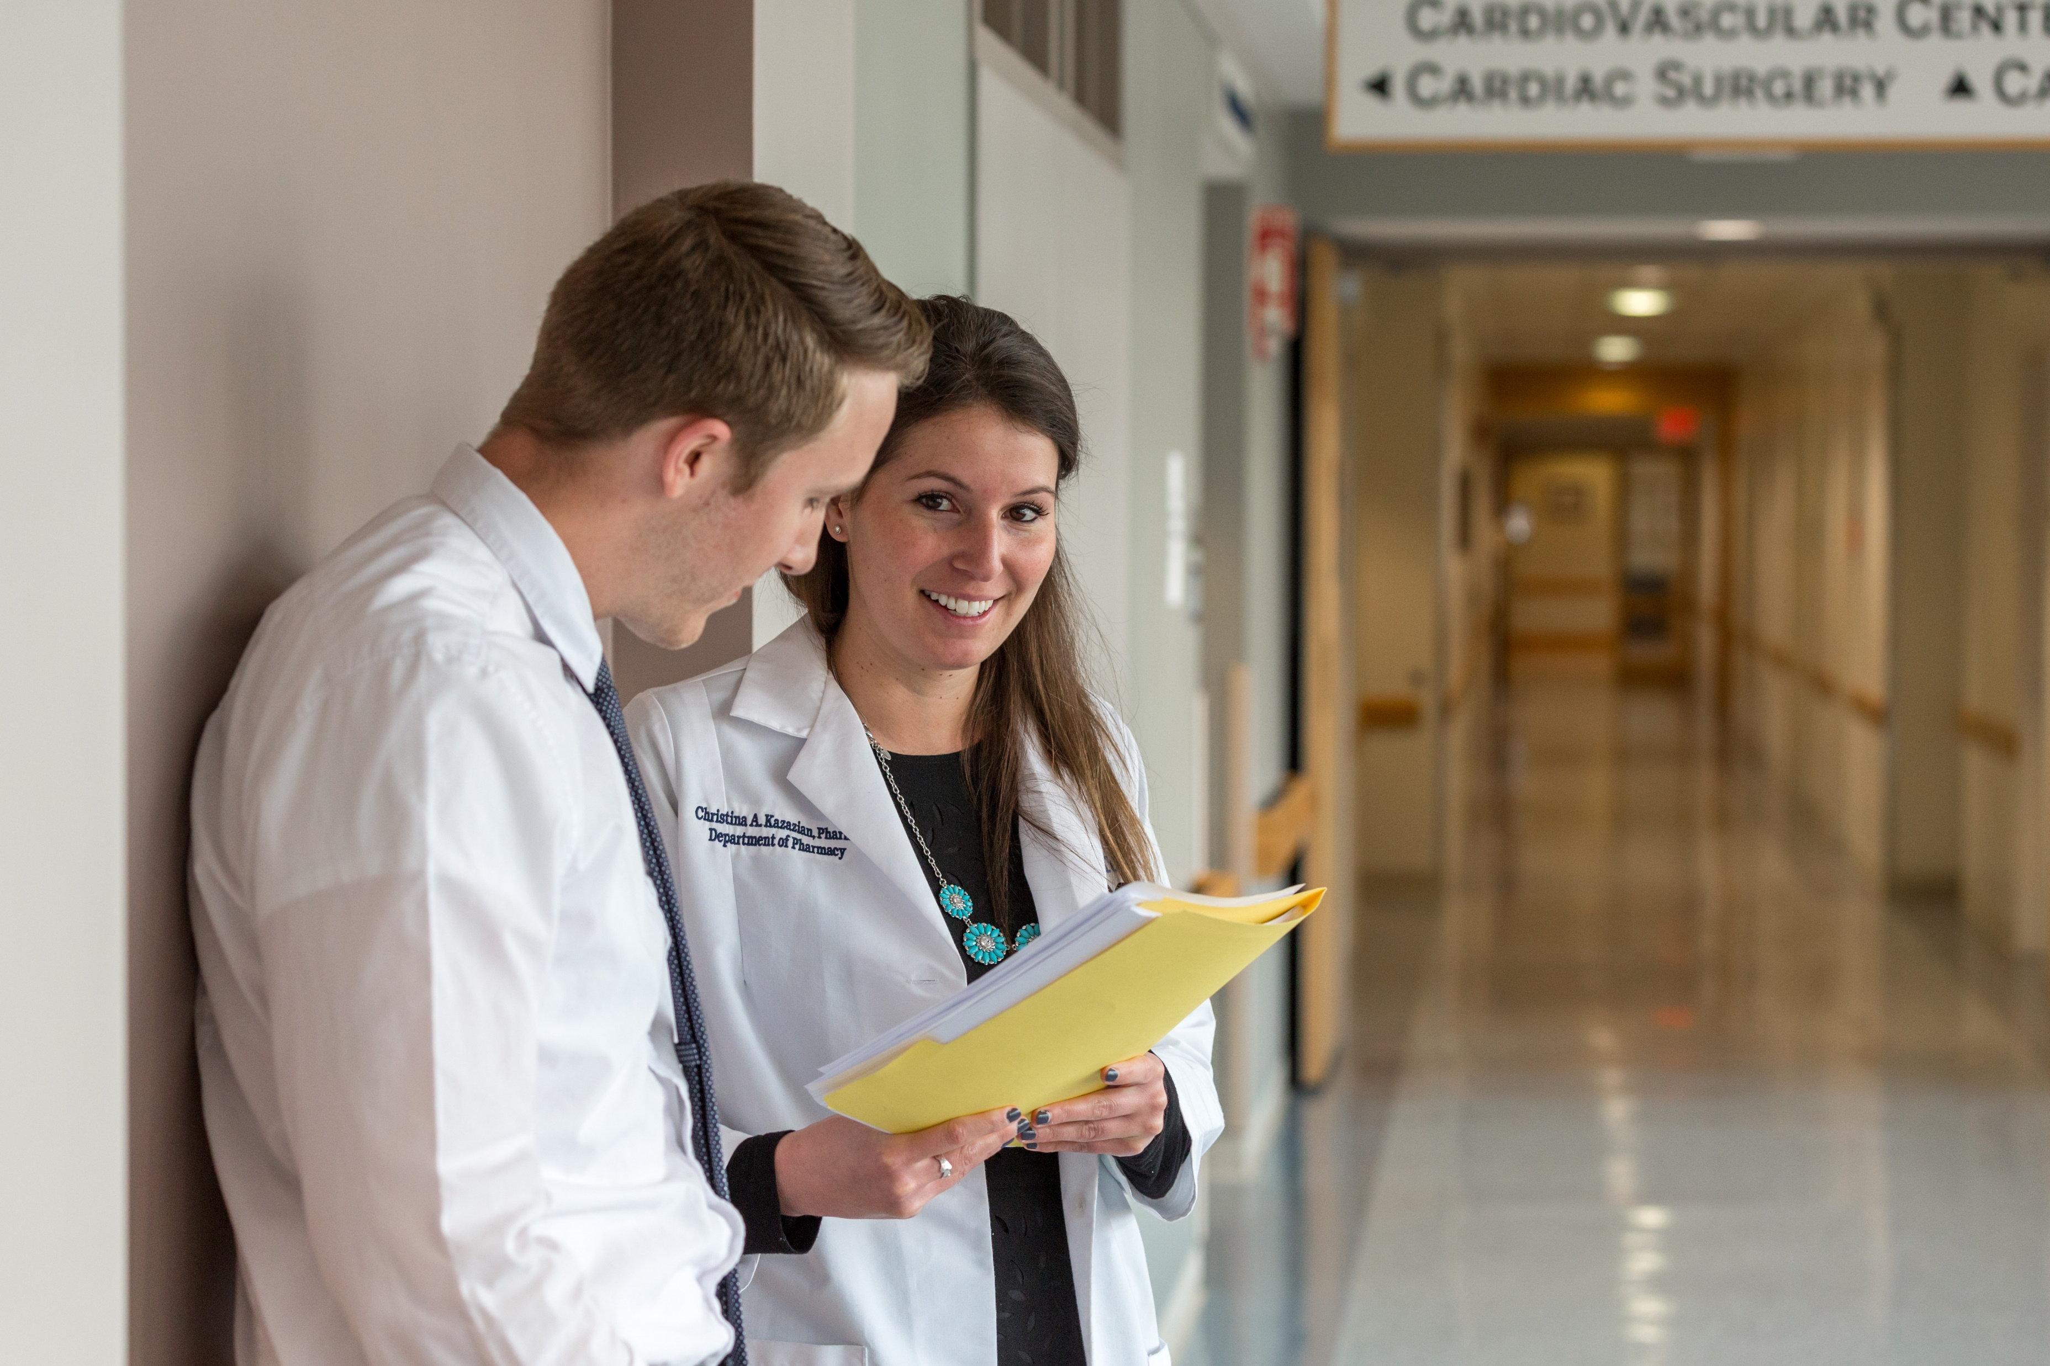
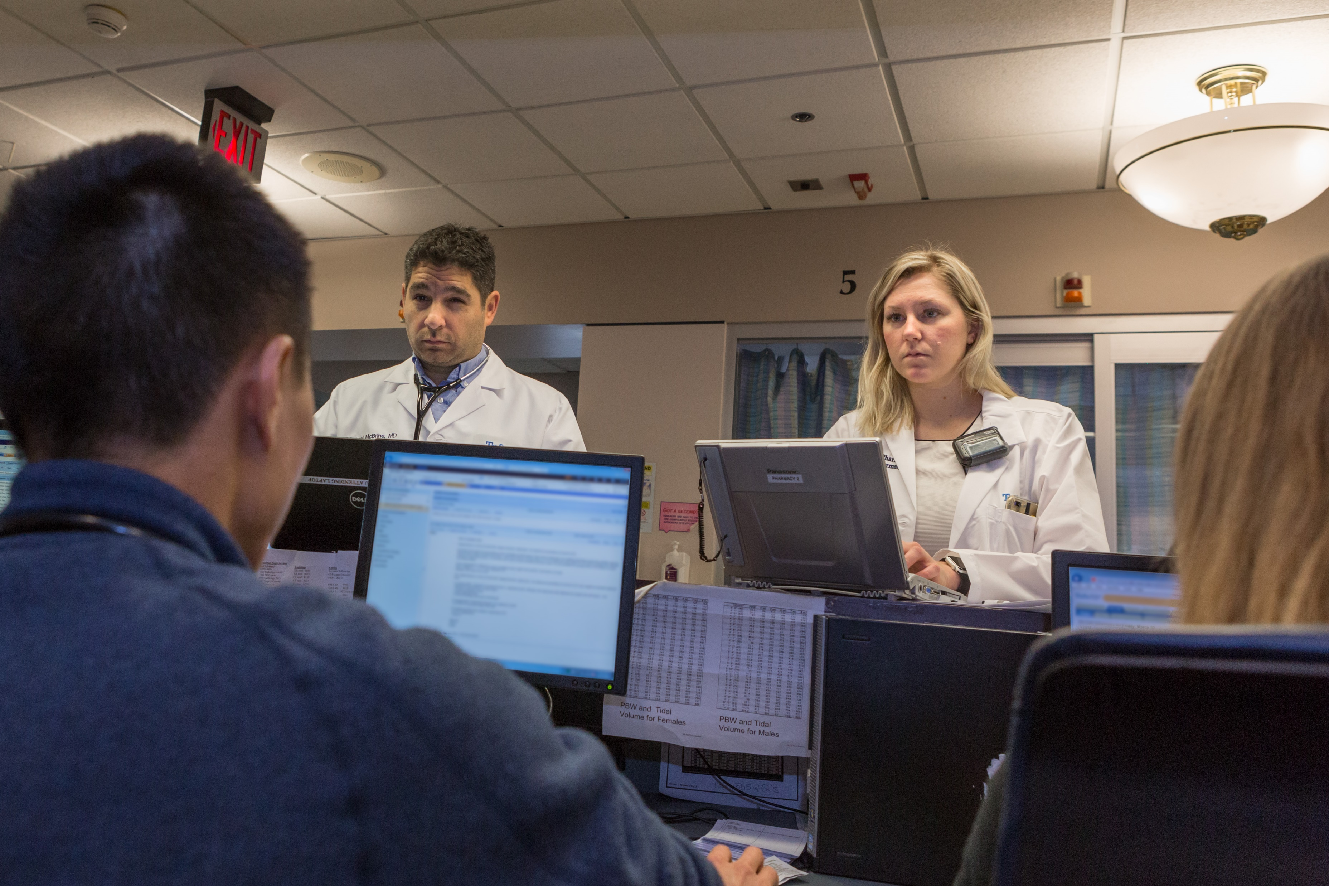
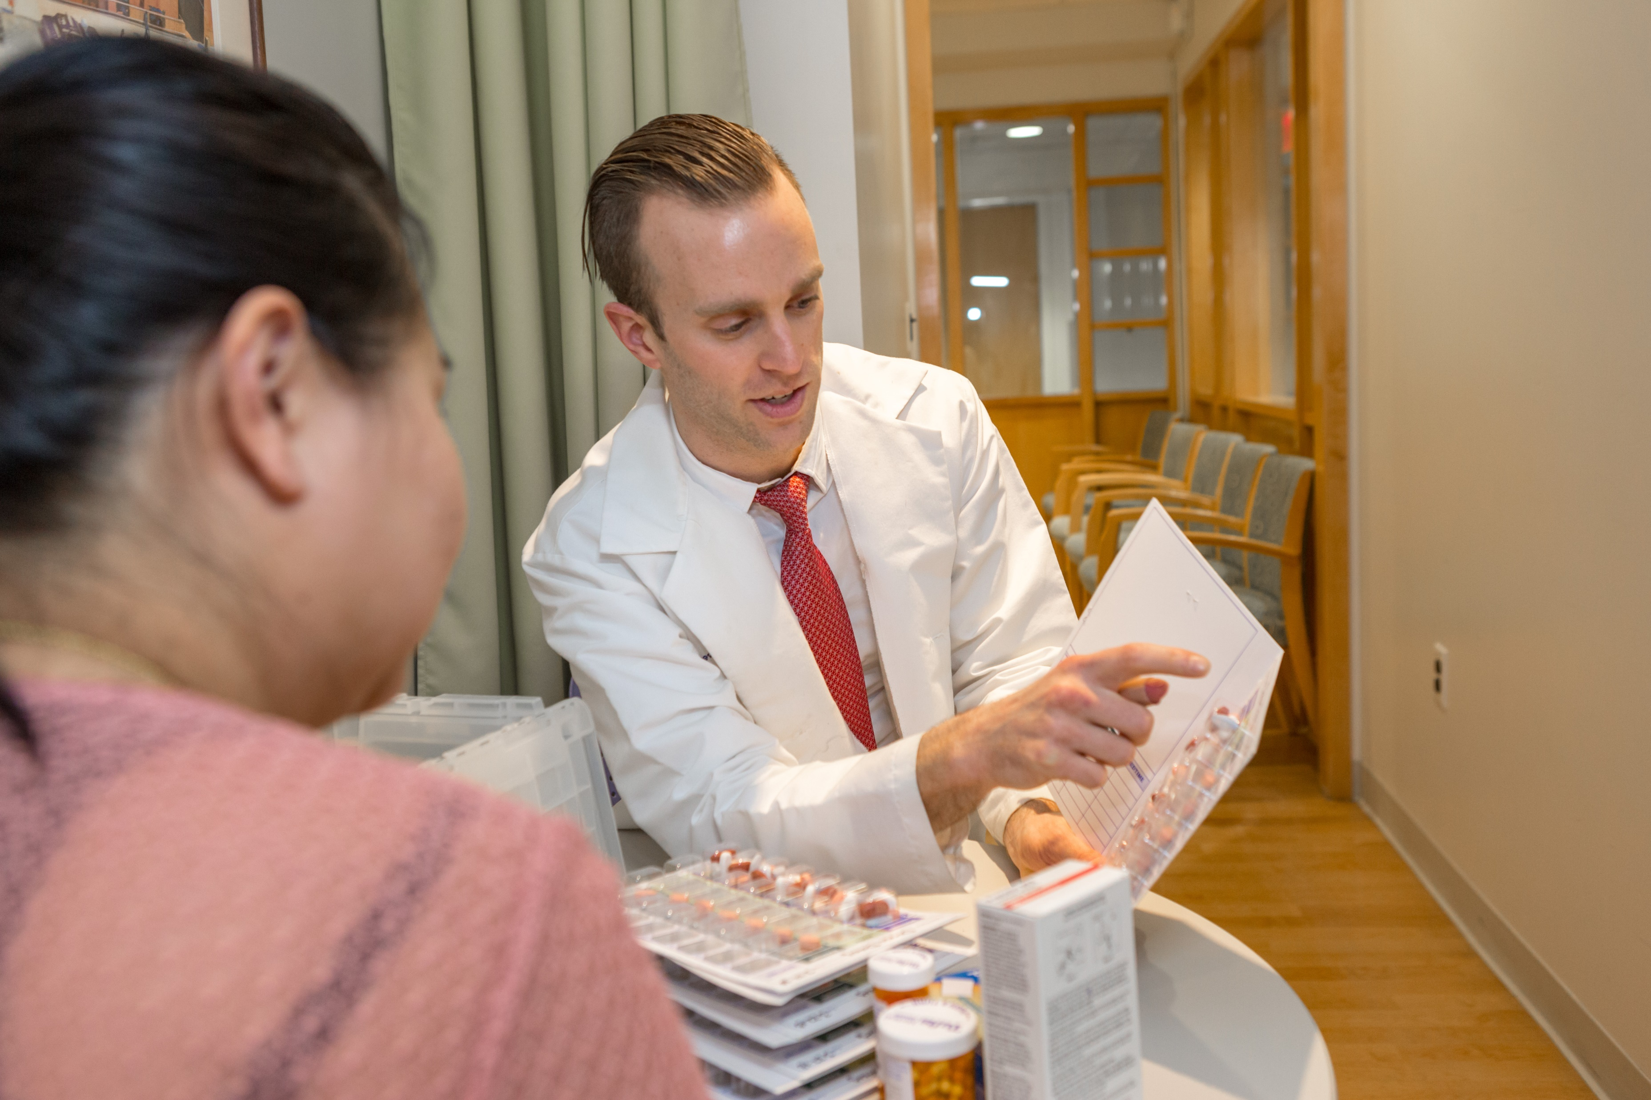
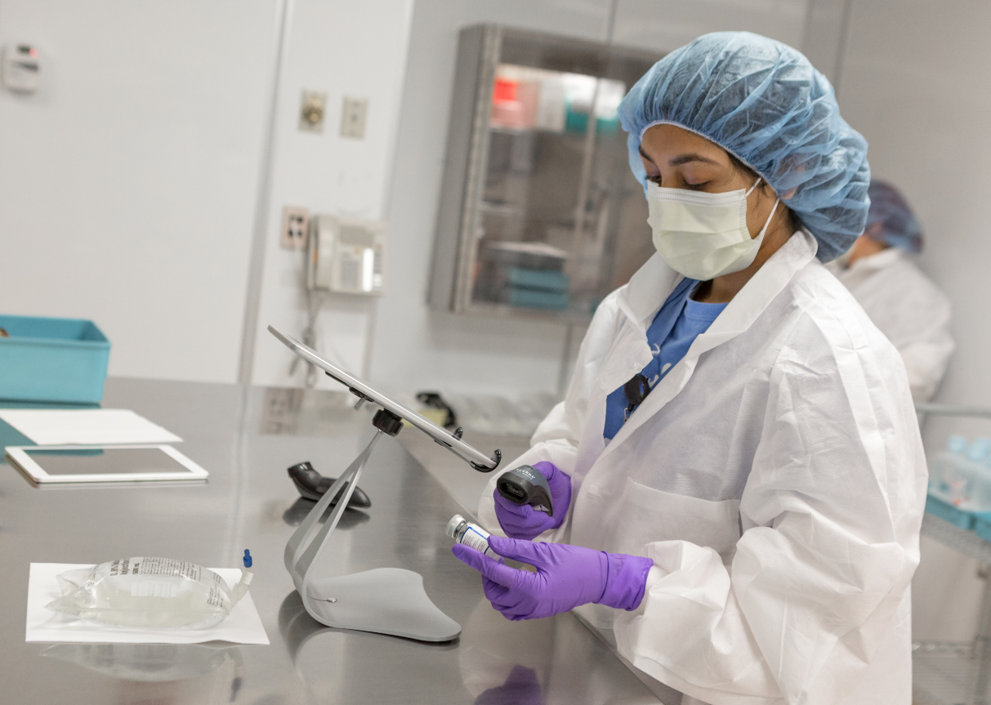
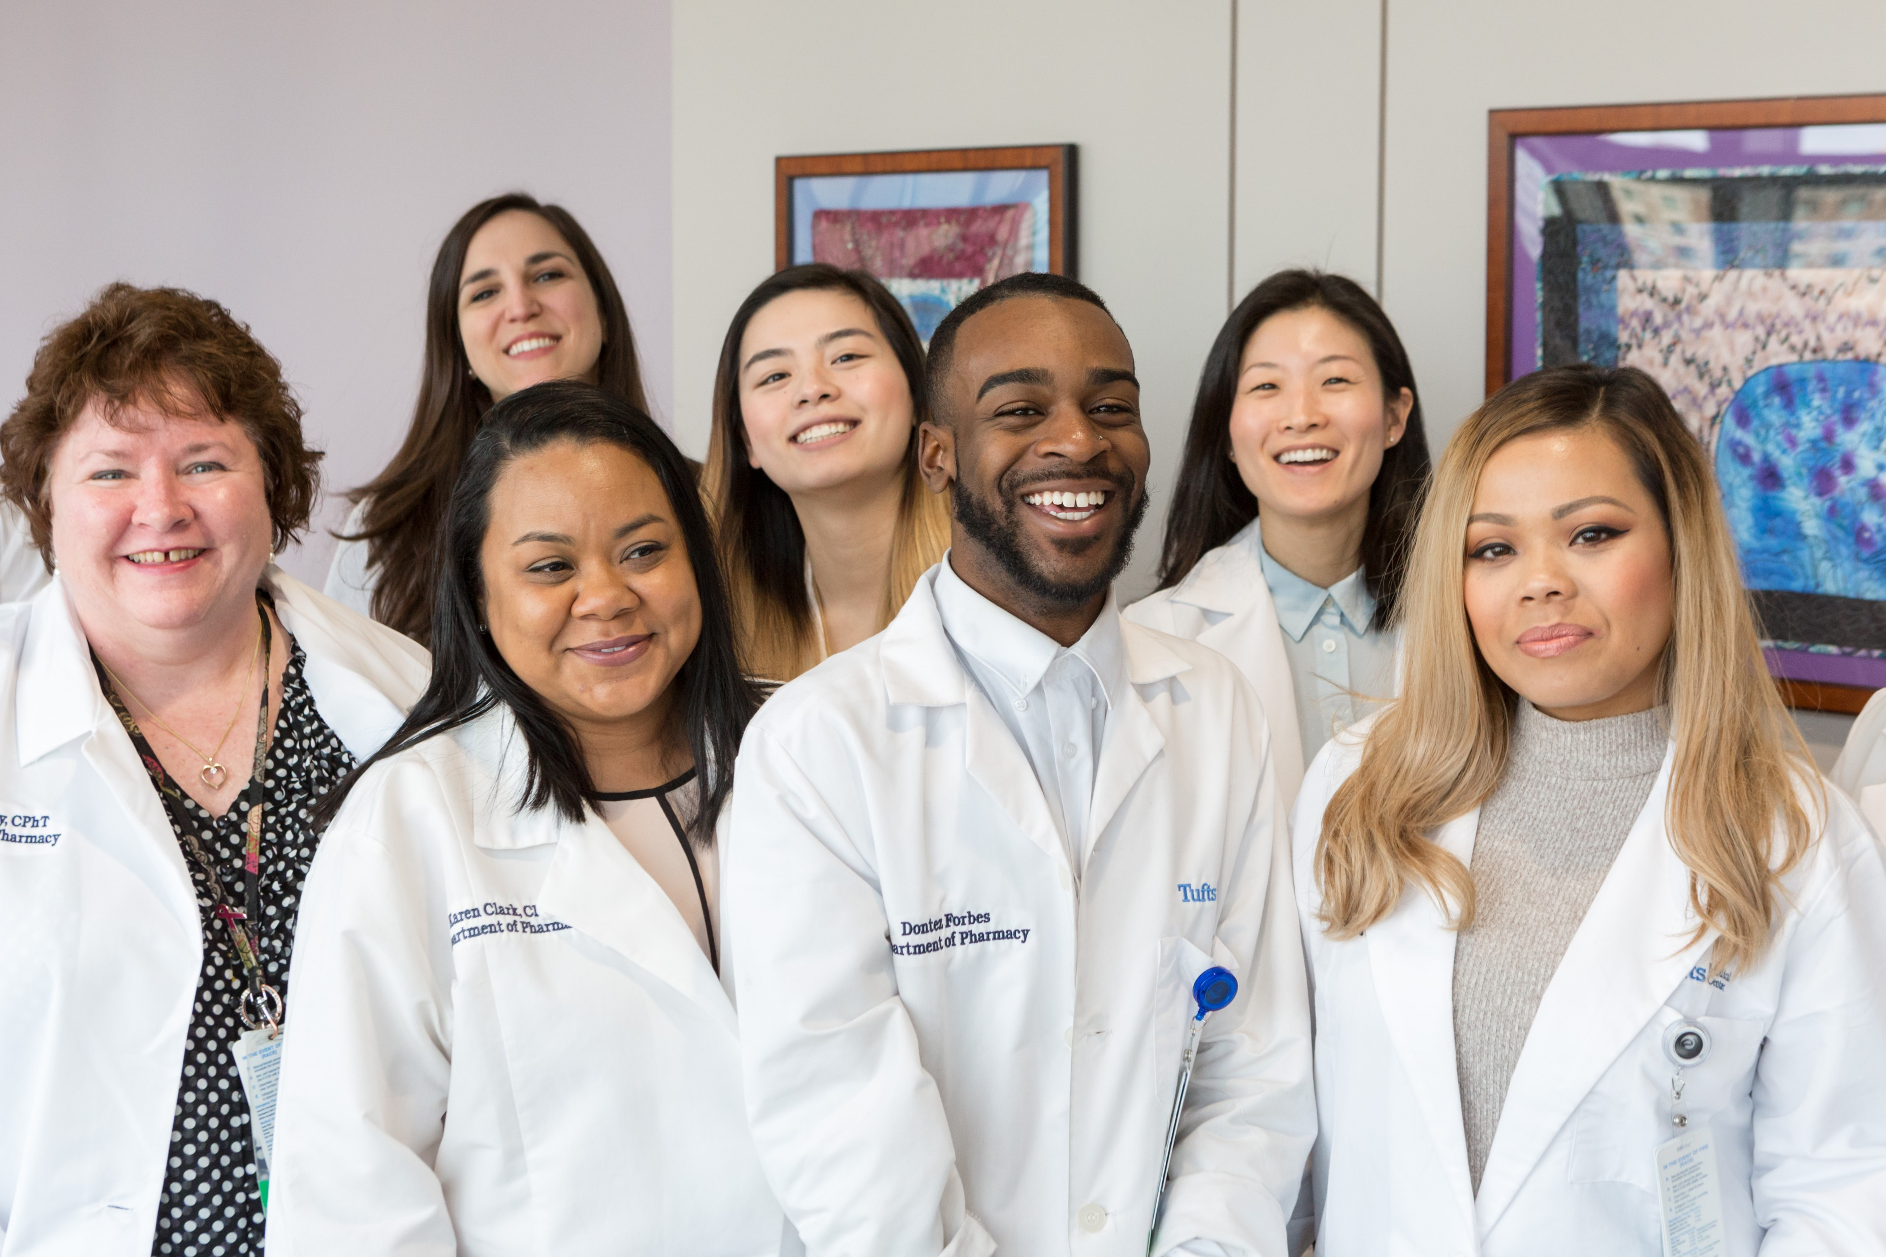
Tufts Medical Center Department of Pharmacy
Medicine
Critical Care
Transplant
Cancer Care
Ambulatory

Slide 25
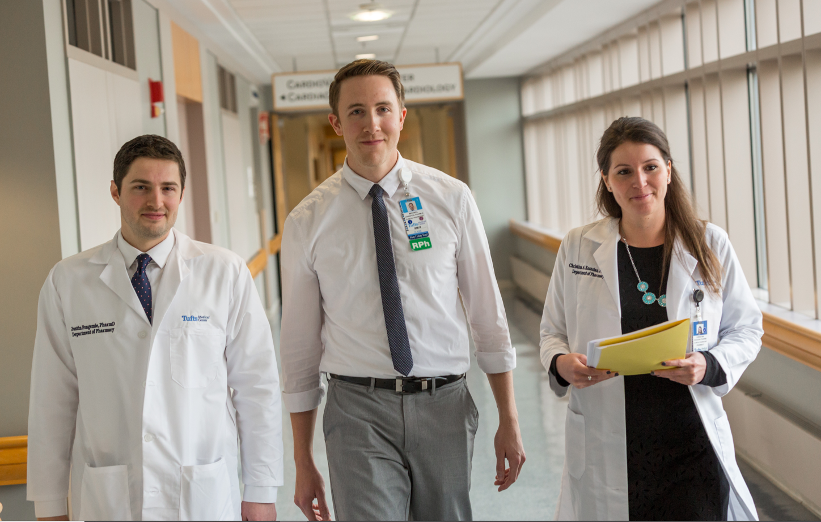
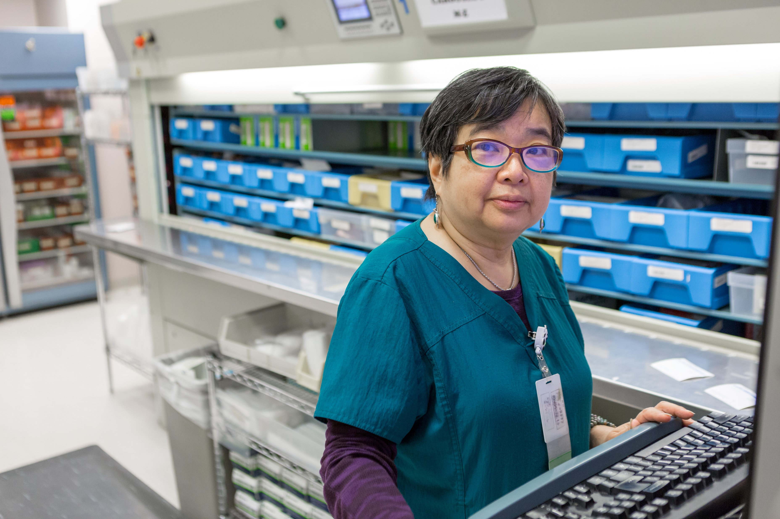
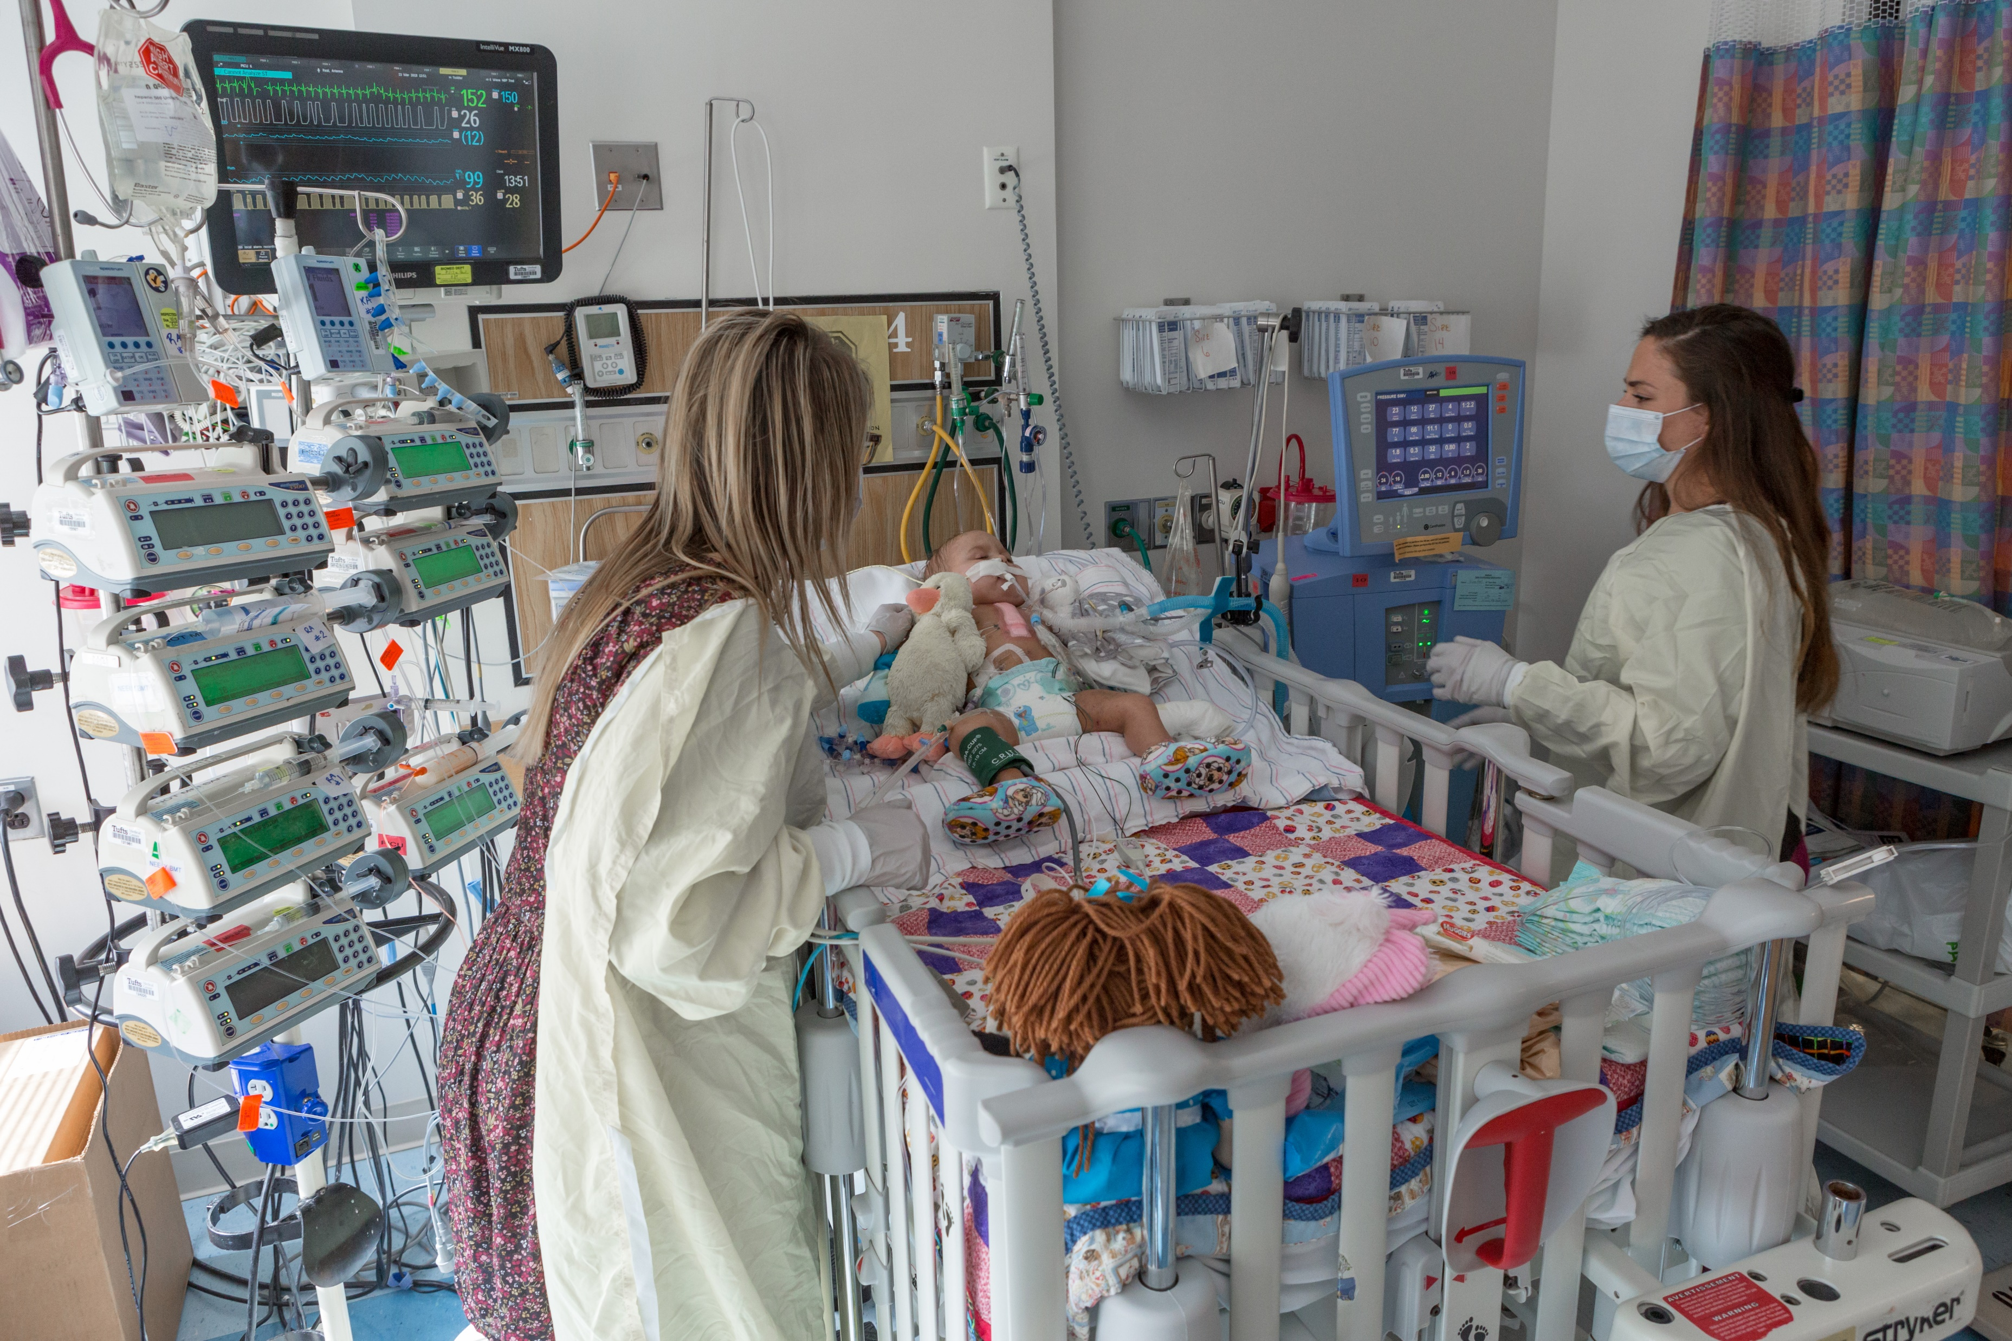
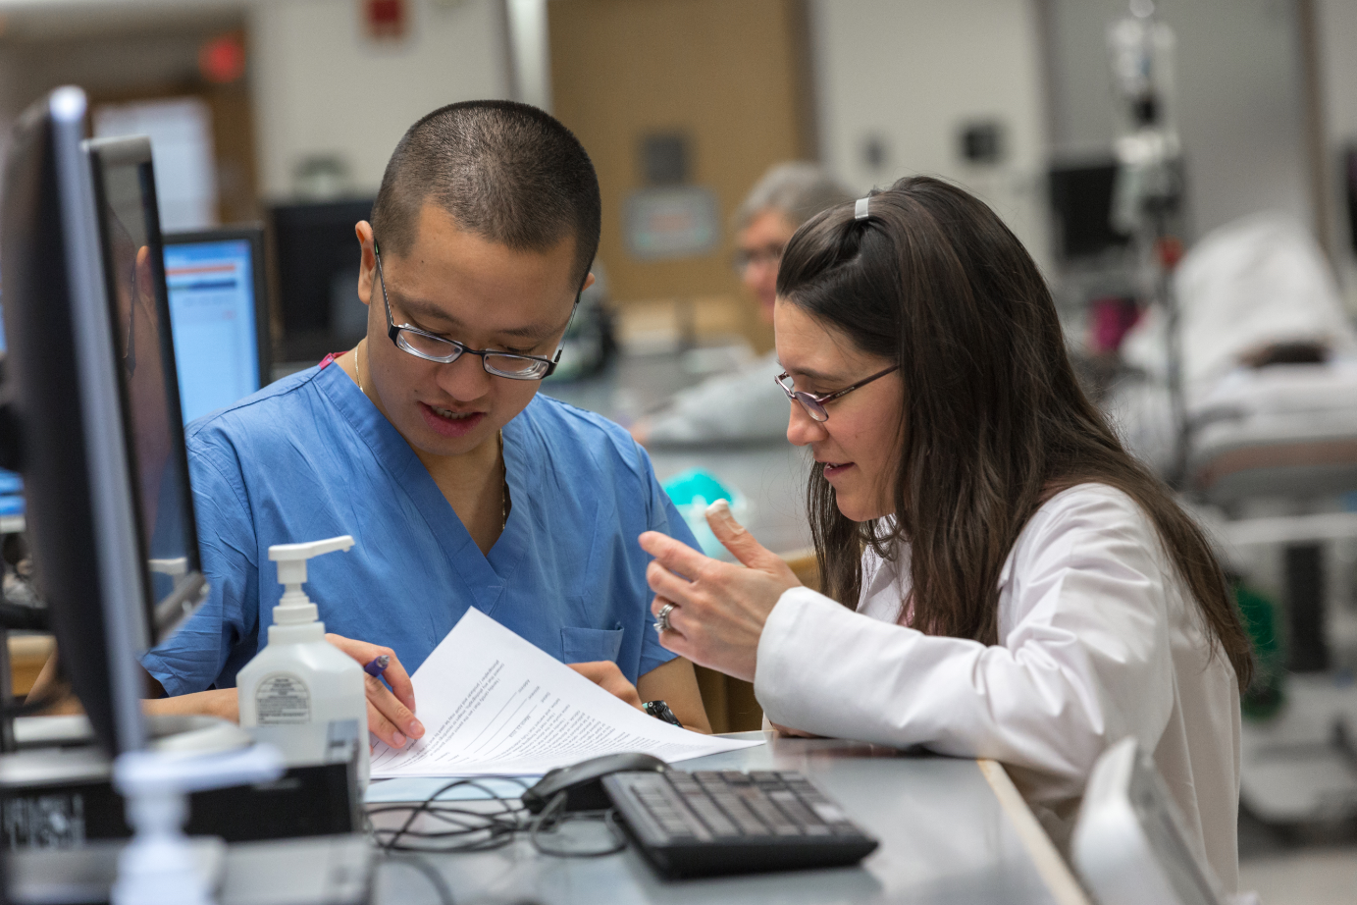
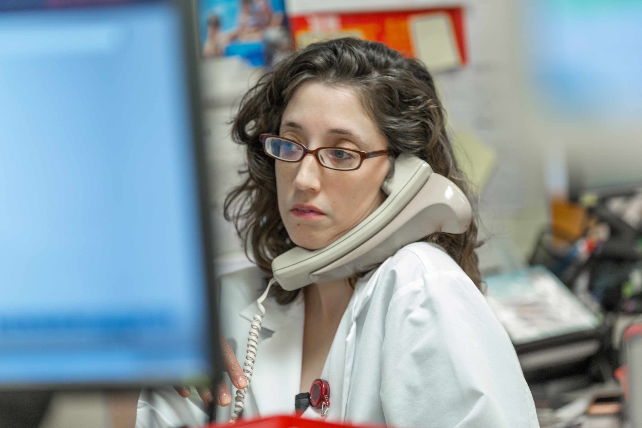
Tufts Medical Center Department of Pharmacy
Integrated Practice
Operations
Clinical Care
Scholarship
Management

Slide 26
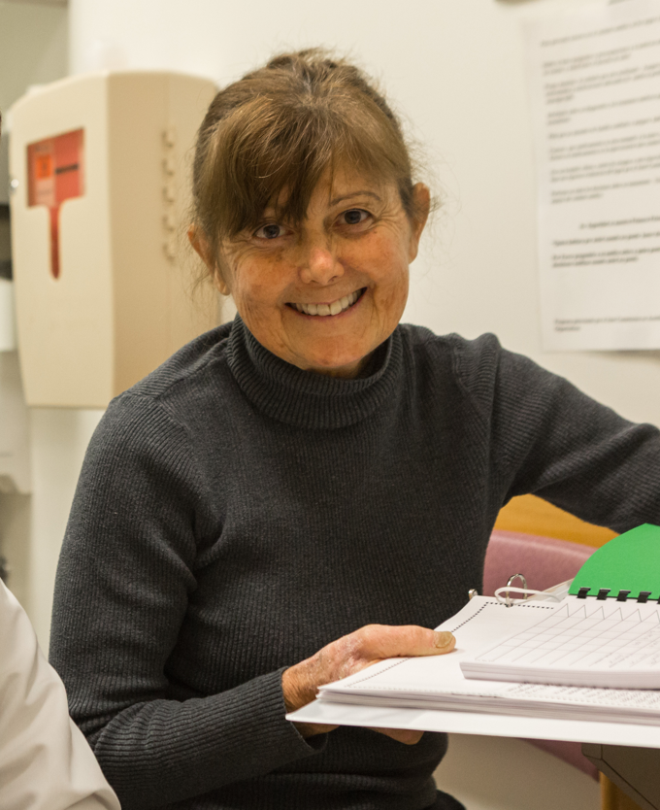
Tufts Medical Center Department of Pharmacy

