Slide 1
Clinical Pharmacy - experience from Czech Republic
Kornélia Chrapková, Hospital Pharmacy , IKEM

Slide 2
1970
Clinical pharmacy pregraduate education-voluntary subject
(2006-became mandatory subject(4th grade)
1981
Clinical pharmacy postgraduate training
2011-2012
Incorporation of clinical pharmacy service as healthcare service into legislation
2012
Legislative requirement for availability of a clinical pharmacist in hospitals with ICU beds
2013
Methodology of clinical pharmacy service (Czech Professional Society of Clinical Pharmacy)
2014
Concept of clinical pharmacy service (Czech Professional Society of Clinical Pharmacy)
2014
Reimbursement of clinical pharmacy service by insurance companies
2021
Reimbursement of ambulatory clinical pharmacy service
Notes:
Clinical Pharmacy started in Czech republic in 1970, firstly it was concipated as volutary subject later in 2006 it has changed to mandatory subject and noew voluntary subject was created in addition to is – Rmedication risk – which tries practically to teach how to indetify risk of mediction in different types of patients and hot to minimize the risk
Clinical Pharmacy specialty training was always considered a core for tge clinical growth of pharmacists into clinical experts into independent clinical experts skilled in individualzaion and optimization of drug schemes in high risk patients
Although there was an education and training available and there were few who acomplished the studies many of them didn ´t continue with clinical Pharmacy practice
The reason could be that there was no interest and demand after clinical pharmacists, there was a lack of enlightment between clinicians and different overal target. Nowdays we hear more and also clinicains when they go abroad they can see many clinical pharmacists working on wards and in hospital settings. And really the pharmacotherapy is more complex andthe focus starts to be the optimization of medication and individualization. Population si aging and this brings a lot of problems, too complex patients with changes in the eliminations , absorptions etc.
Another problem was that even if there was a motivation to practice clinical Pharmacy there was a lack of time and staff for providing the service
In 2011/2012is a year when clinical Pharmacy service was acknowledged as heathcare service and was incorporated into the legislation about healthcare service
2012 –legislative requirement forpresenceof clinical pharmacits in hospital with intensive care units
2013 – methodology of Clinical Pharmacy service – stress the systematic evaluation of medication of patients by clinical pharmacists
2014 –Concept of Clinical Pharmacy Service –summarizing history, major guidelines and position of clinical Pharmacy field)
2014 – again change of legislation when Clinical Pahramcy Service starts to be reimbursed by insurance companies
In 2011 position of clinical pharmacist start to be more stable, acknowledged and the demand of other healthace prefssionals and clinicians sart to incfrease

Slide 3
Implementation of clinical pharmacy service in hospitals
2009 – legislative requirement to ensure medication safety in all healthcare facilities
Requirement of accreditation committees (Joint Commission International-JCI)
- guidelines and requirements focused on safety and quality of patient care → development of Clinical Pharmacy Department
Individual efforts
starting from individual efforts and with clinical pharmacy service on „friendly wards“ → development of Clinical Pharmacy Department
Notes:
The higher demand started due to legislative condition to ensure medication safety in all healthcare facilities
Some hospitals have acquired JCI accreditation where in Medication management and use section is emphasize on medication review for appropriatness and this review is conducted by technician pharmacist or traine professional. You can easily hide clinical pharmacist behind that – or use this guideline as a negotiation tool for creation of Clinical Pharmacy service in order to achieve those requirements. So this helped to create clinical Pharmacy department
On the other hand majority of other clinical Pharmacy departments started from individual efforts and clinical pharmacists on friendly wards till creating clinical Pharmacy service under hospital

Slide 4
Concepts of clinical pharmacy service –staffing levels
Czech Republic |  |  | United States
Type of clinical pharmacy department (CPD) | Type of healthcare facility | Full time equivalent (FTE) of clinical pharmacists | Patient/service type | FTE equivalents per number of patients
CPD – higher type | bigger hospitals(secondary, tertiary), university hospitals, recommended for specialised hospital centres, regional hospitals established by Ministry of Health or by region | Ideally 1 FTE per 50 beds of acute care | All critical care units, extensive burns, tracheostomy, extra corporeal membrane oxygenation | 1 FTE per 10 patients
CPD –basic type | Acute hospital care with number of approx. 200 beds | At least 2 FTE per 200 beds
Notes:
Concepts of Clinical Pharmacy Service was created where requirement for number of pharmacists per beds where defined.
For some hospitals it could be used as negotiation tool but in my opinion it can be a little contraproductive as well. As it´is in everything that one recommendation doesn ´t fit all it´s also with this guideline . Because as there is a diversity on the grade of medical care in hospitals there is also a diversity of the pharmaceutical care. For instance small district general hospital will have not that complex hospitalized patients as will have a teaching hospital or specilised centre and then the demandingness of the pharmaceutical care can differ between hospitals. So in a small hospital it would be ok to have one pharmacist per 50 beds but in bigger hospitals it will not be feasible
You can see the dufference between stafiing in Cuech republic and United states where in United states they have 5 times more clinical pharmacists per beds than we do in Czech republic or that is the recommendation . There are many Clinical Pharmacy departemnts where they haven ´t reached the required or reccomended level
Only for an explanation
CPD of higher type-means that provides comprehensive care for at least 4 different fields of medical specialisation (f.i. Internal medicine, gastroenterology, diabetology etc)
And basic type only for 2 different fields of medical specialisation.

Slide 5
Staffing levels in different countries in Europe
Austria
Notes:
Only fpr a brief overview I have also included situation in other countris. My colleague Gunar Stemer has done this overview 2 years ago where he asked colleagues from different countries whether they have any method created for clinical Pharmacy workforce and about key Pharmacy indicators which are monitored andd annualy reported to Czech Statistical Office. I will be talking about the key Pharmacy indicators later on
In Germany is done individuallly
Ireland deosn´t have any concept and follows concept from US
Sweden/Uppsala laso very individual and have some Pharmacy key indicators

Slide 6
Clinical pharmacy service reimbrused by insurance companies = key performance indicators
low
monitoring of patient
change of clinical state
pharmacotherapy plan
Points 175 = 7.70 Eur
Risk assessment
medium
pharmacotherapy plan
checking of effectiveness
monitoring
high
pharmacotherapy plan
checking of effectiveness
checking of effectiveness
Points 233 = 10.30 Eur
Points 233 = 10.30 Eur
Maximum per patient = 28.30 Eur
No risk identified – LOW risk
Identification of at least ONE risk factor – MEDIUM risk
Identification of at least ONE risk factor + immediate need of drug intervention - HIGH risk patient
Risk factors: polypharmacy, drug with NTI, drug with high interaction potential, renal insufficiency, liver failure, significant changes of laboratory data and/or haematology parameters, patient in intensive care, DM, epilepsy (patient on antiepileptic medication, AF, oncology patient, patient on long-term corticosteroid treatment or on other immunosuppressive drugs, Parkinson disease
Notes:
1 point = 1,08 Kc
Riska assessment is done as the first thing when reviewing patients and we choose whether patient is in a low risk or medium risk or high risk –when there is a need of immediate action of pharmacist
The pharmacist then createds a pharmacotherapy plan- for instance he suggest some change in the dosing or iwthdrawal of medication because of adverse event. or could be a therapeutic drug monitoring and then he is floowing the patient as checking the impact of the change „ checking of effectiveness“ there can be onather problem encountered so he can also write another recomendation estc.
Here is shown how much will be reimbursed by insurance company . But we don ´t limit our job according to how much is paid but if it s needed we follow up the patient a do as much intevrentions as is needed.
Another tool which can help you with negotiation is that some of your service is reimbursed by the insurance company, you can see it under points. Of course the bad news is that no pharmacist can be fully paid by insurance company because you will never achieve som many points. Insurance company pays you and this goes from the budget of the Clinic so the Clinic should know about it. But otherwise pharmacist is funded by Pharmacy and Key Pharmacy indicators can be used for negotiations to show how much work we do a nd that we can do more if we have more pharmacists

Slide 7
Current situation in Czech Republic
Number of CPD in Czech Republic in 2020
5 year-postgraduate study
1 mentor-maximum 3 trainees
number of hospitals –aprox 150
number of CPD in 2020 = 48 (43 with accreditation)
2 different models:
CPD is a part of hospital pharmacy
CPD is outside of a hospital Pharmacy
number of clinical pharmacists in hospitals in 2020
with specialisation= 68
in training = 72
Hospitals
Teaching hospitals
Specialised hospitals
Psychiatric hospitals
Longterm care hospitals
Psychiatric sanatorium
Joint ambulatory care settings
Pharmacy
Uzis 08/2021
Notes:
I am using data from Crech Statistical Office
There is …..hosiptaals in Czech republic
Eccording to the Czech Statistical Office there are about 48 clinical Pharmacy departments ic czech republic?
WE have 2 models of clinical Pharmacy department – where CPD is under hospital and where CPD is out of a hospital. This can be very unpractical and my advice is if you considering and are not decided which direction to go choose just one model. Having 2 different models inCzech republic has created enormous problems a lot of arguments and split the group of clinical pharmacist. Which can be very contraproductive.
The number of clinical pharmacists are slowly increasing
Kolko akreditovaných pracovisk?

Slide 8
Key clinical pharmacy performance indicators in Czech Republic-statistics 2018-2020
Uzis 08/2021
Notes:
Here I would like to show some statistics from Czech statistician office.
I have data only available until 2020
And because there have been changes in the collecting of data I am not using data before the change as it wouldn ´t be accurate
We can see that the highest number of the perfomrmance is assessment of the patient at the beginning that was the highest in 2018
However, pharmacotherapy plan created for patients was highest in 2020. The reason of course could be different wy of recording. I think many clinical Pharmacy departments are stll trying to find the correct way for recording interventions
We also can see that the number of patients with medium risk – who were closesly folllowed up and high risk interventions – when there was necessary an immediate action

Slide 9
Risk factors and pharmacists interventions - 2020
Risk factors
Uzis 08/2021
Notes:
In these two graph I would like only briefly shorw what are the most common risk factors indetified by Czech pharmacists (the most common plypharmacy, NTI, High drug interactions, patient in intensive care, biochemistry changes)
The most commoin interventions of pharmacists where dose adjustement , stopping drug , staring drug and drug counselling, when we discuss some potential drug related problem with clinicians

Slide 10
Clinical Pharmacy in my hospital:
Institute of Clinical and Experimental Medicine
(Transplantology Centrum, Cardiology Centrum, Diabetology Centrum)
315 beds (111 intensive care beds)

Slide 11
2007
First individual efforts, cooperation with „friendly wards“
2010
Establishment of Clinical Pharmacy department (under hospital pharmacy)
Daily presence of clinical pharmacist on wards,
Cooperation with biochemistry department – provision of TDM +interpretation by clinical pharmacist
Demand of clinical pharmacist from other wards
2012
2017
Acquirement of Ministry of Health accreditation in clinical pharmacy field
Clinical pharmacy department - 5 pharmacists (2 with specilisation, 3 in training)
1 Clinic/pharmacist
5 pharmacists(4,4 FTE) per 145 beds + 82 ICU beds
2023
Notes:
So within the following slides I would like to briefly describe our experience and implementaion in clinnical Pharmacy
We have started with toughts about clinical Pharmacy service in 2007, discussed this in a pub with clinicians and made an agreement that we wil start to go to the the wards.
But there was lack of time and lack of knowledge . We didn ´t really know how to start . Noeone trained us and didn ´t really nkow how to start. And we used to go there otut of Pharmacy hours because we didn ´t have time .But we kept fighting and me personally I left to the UK to get more experience in this field. During that time my colleagues were succesful and managed to create clinical Pharmacy department in the hospital Pharmacy. After my retursn I vecame Lead cinical pharmacist whicwas a huge responsibility and I have started on a surgical ward where there wasb ´t a clinical pharmacist before. Surgeons didn ´t really know what to think about me and how to cooperate so it took me aporx 2 years until they started to accept me as clinical pharmacist but also as their equal colleague. The change in the acknowledgement was caused also by showing a proof that we can optimalize therapy when we started to cooperate with biochemistry and on interpretation of drug concentration level. We have created reccomendation which was visible in the HIS and also always personally went to the ward to discuss this . Today we don ´t necesarily go to the wards as but we make sure that the doctor on duty is aware of the suggested dose adjustement etc.
In 2017 we have acquired acrediation in clinical Pharmacy field

Slide 12
Targets of clinical pharmacist
ensure the safety and effectiveness of pharmacotherapy and all processes related to it
comprehensive and systematic optimization of pharmacotherapeutic regimes in all patients
increase the quality of services for the patient
Notes:
We set targets which we would like to achieve by our continous development of service

Slide 13
Analysis of operational events-risks
Patient admission and start of new medication
Medication during patient hospitalization, changes in medication
Discharge of patient
Risk of duplication, Risk of drug interactions, Risk of „incomplete drug history“: AA, missing out drugs, OTCs
Risk of suboptimal dosing (alteration of elimination functions)
Contraindicationsns
Risk of suboptimal dosing
Risk od drug interactions
Risk of adverse effects
Risk of pharmacokinetic and pharmacodynamic changes as an impact of clinical state alteration, age and present comorbidities
Risk of cumulation of drug with a development of toxicity due to decrease renal and renal function
Risk of insufficient education about drug use
Risk of non-adherence
Notes:
In order to achieve the targets we have to make analysis where the potential mistake is happening or where is the risk during patient stay

Slide 14
Analysis of operational events-solution
Patient admission and start of new medication
Medication during patient hospitalization, changes in medication
Discharge of patient
MedRec within 48 hours after admission of patient
Identification of risk patients
Daily medication review on clinical wards
Individualization of medication
Presence on ward rounds
Presence on the centre of prescribing process (spend majority of the time on wards with nurses and doctors)
Advisory service when needed
Education of patients on discharge
Notes:
What help us with med rec is the patient drug record – where we can see what patient was using during the last year
Unfortunately we have got limitaion to see history only 1 year back while clinicans can see much further
I have hghlighted things we still are struggling with such as medrec within 48 hours after admission of patients. We don ´t manage to see all patients. We manage to see 40 % of patients which is very bad
Another thing is that we don´t see in our systém which patient is the most risky patient and now we are working on this changes to make the clinical Pharmacy service better. We also would like to start a porject educational project for patients who are discharged from hospital. Because so far we do conselling of patients in out hospital Pharmacy
However we try as much as we can to be in touch with clinicans we have created with our IT departemtn in our hospitals ystem systém which helps us to identify patients who need TDM or patients who were úprescribed IS, antimicrobials recently etc.

Slide 15
Examples of actvities of clinical pharmacists
Notes:
In the following slides i would like to show some expamlpes which helped us to implement clinical Pharmacy service in our hospital
We have shiwed by this examples what we can do
What is aour resposibility, knowledge and as a consequence thre was demand after clinical pharmacist from defferent wards

Slide 16
What helped us to implement clinical pharmacy service in the hospital
small audits and solving the GAPS
„visibility“ of the clinical pharmacist (presence on the ward, education, seminars, Drug Therapeutic Committee)
IT support
key performance indicators

Slide 17
Therapeutic drug monitoring
Situation before intervention:
incorrect interpretation of measured drug concentrations („traffic light-system“- risk of under/overdosing, risk of increase drug resistance, higher cost), incorrect timing of measuring drug levels, lack of knowledge about PK/PD characteristic of drugs, wrong duration of infusion (red man syndrome), unecessarily frequent drug level checkings (high cost)
Aim: to increase education about TDM(decrease workload of clinicians, rationalise drug level checks)
Intervention:
pharmacist education (interpretation of drug concentration using Pk programme (MWPharm)
education for nurses and clinicians
development of laboratory guideline about
cooperation with nurses, clinician, biochemistry

Slide 18
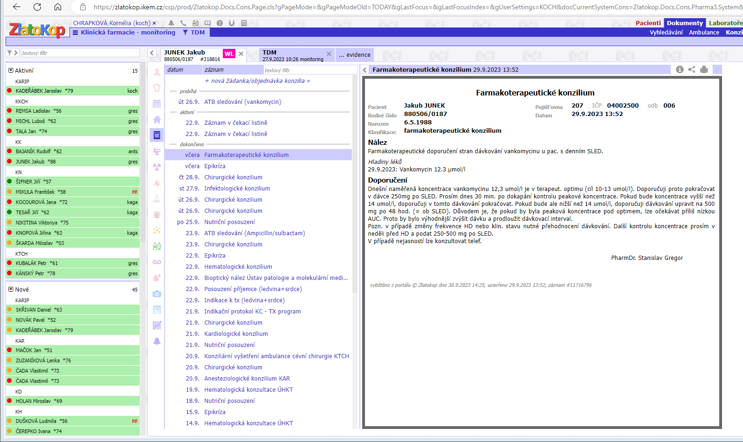
Pharmacist recommendation available in HIS
TDM evidence in HIS
Selection of patients with NTI
Notes:
This is the form which helps us the indwtify patients with the high risk but also enables us to create recomendation for the doctors. The doctor can see it in two different forms.

Slide 19
Antibiotic prophylaxis before surgical procedure
Situation before intervention:
vague guidelines about surgical antibiotic prophylaxis
lack of unified approach
Aim:
to find out level of adherence to international guideline with respect to local epidemiological situation and to optimize antibiotic prophylaxis before surgical procedure
Interventions:
audits before and after interventions (cooperation with microbiologist) -50 procedure in transplant surgery and 50 procedures in cardiosurgery
presentation of the results of audit on wards
new guideline development (multidisciplinary cooperation – microbiologist, clinicians- anaesthesiologist, surgeon, pharmacist)
education

Slide 20
Results of audits BEFORE and AFTER interventions
BEFORE INTERVENTION
There wasn´t 100 % adherence achieved in any key paramater
AFTER INTERVENTION
˃ 75% adherence achieved in all key parameters
INDICATION AP THERAPY INDICATION CHOICE OF DRUG DOSE CORRECT TIMING LONGER PROCED. BLOOD LOSS>1.5L DURATION OF AP

Slide 21
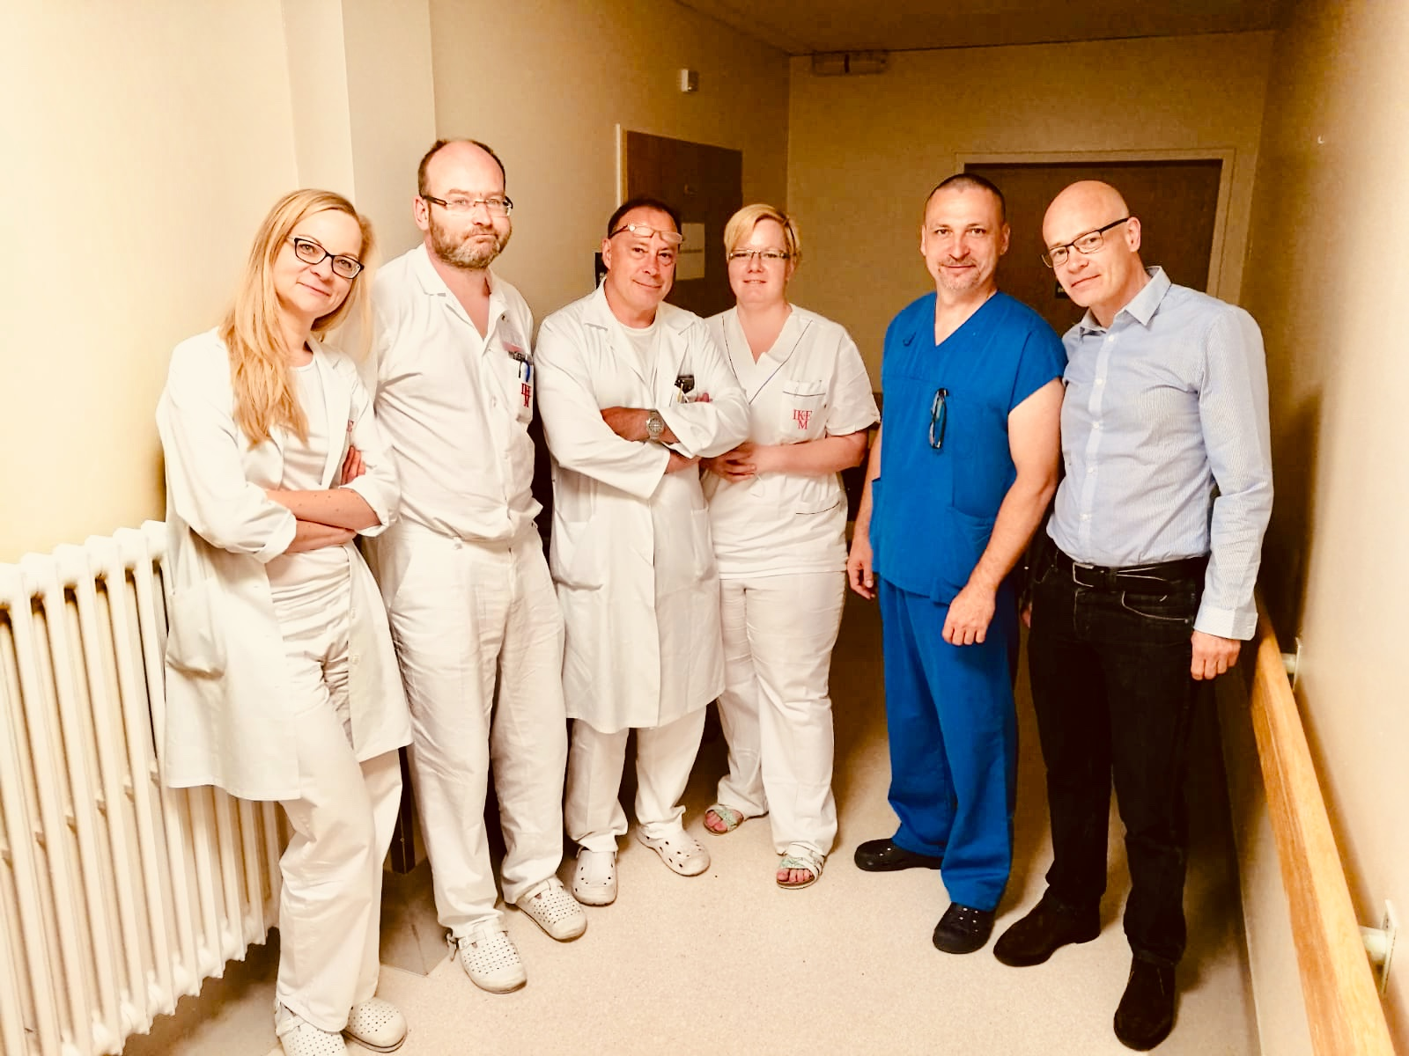
Transplant surgical ward
Abdominal and vascular surgery
Daily presence on the ward (wardrounds, handover etc. as needed)
Role:
Daily medication review- dose adjustment , drug interactions, contraindications (stopping drugs), starting new drugs, TDM (immunosuppressive drugs etc.), thromboprophylaxis, adherence to transplant protocol, prophylaxis of infections etc.
Member of multidisciplinary team – antimicrobial stewarship team, multiorgan transplantation, uterus transplantation (guidelines development, TDM, education, drugs availability),
Education of nurses , clinicians (prophylaxis after splenectomy, thromboprophylaxis, CDI, CMV infections, immunosuppressive drugs, stability, incompatibilities)
Local guidelines development

Slide 22
What we would like to achieve:
Cover every ward in the hospital – recruitment of new staff
Medication review within 48 hours after admission
Risk stratification of patients
Education of patients at the discharge
Development of research

Slide 23
Thank you!

