Slide 1



Clinical Pharmacy in the UK: the importance of research
Dr Penny Lewis MPharm, MRPharmS, PhD, FHEA, PGCertHE
Senior Clinical Lecturer, Division of Pharmacy and NIHR Patient Safety Research Collaboration University of Manchester
Academic Lead Pharmacist for Research, Manchester University NHS Foundation Trust
Deputy Lead for Research Capacity Building, NIHR Greater Manchester Applied Research Collaboration

Slide 2
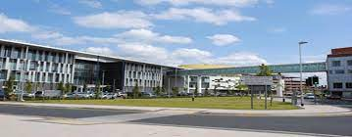



Home

Slide 3
Overview
UK pharmacy education and pharmacy career development
Key roles of UK hospital pharmacists
Importance of research activity for patient care
How to get involved in research
Examples of pharmacist led research projects

Slide 4
Pharmacy education in the UK
Four year university degree (MPharm) followed by one year as trainee pharmacist prior to registration with GPhC (pharmacy regulator)
UK Government policy: the National Health Service should make more appropriate use of pharmacy professionals’ clinical skills, helping patient gets the right care, at the right time in the right place
New GPhC standards for education and training of pharmacists
All pharmacists will be independent prescribers from 2026
Focus on upskilling in consultation and communication skills and clinical decision making

Slide 5

hospital pharmacist daily role
Checking discharges and ordering medications
Reviewing newly admitted patients conducting a medicines reconciliation
Clinically checking drug charts
Medication errors
Optimising medicines
Guideline and formulary adherence
Prescribing (if a qualified independent prescriber)
Responding to medication queries from the MDT
Medication counselling
Training and mentoring junior and student pharmacists
Dispensing medicines

Slide 6
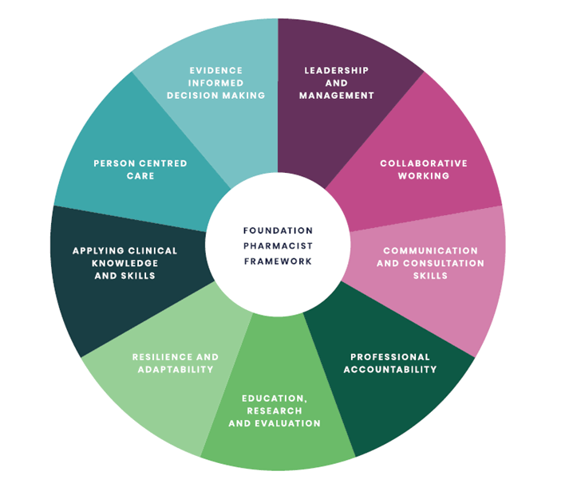
Advanced Hospital Pharmacist practice
Clinical diploma, MSc, DPharm, PhD
Advanced practice
  Running clinics, guideline development, audit
  Medicines information, clinical trials
Consultant pharmacist and credentialling
Foundation Pharmacist Framework
Advanced Pharmacy Practice

Slide 7

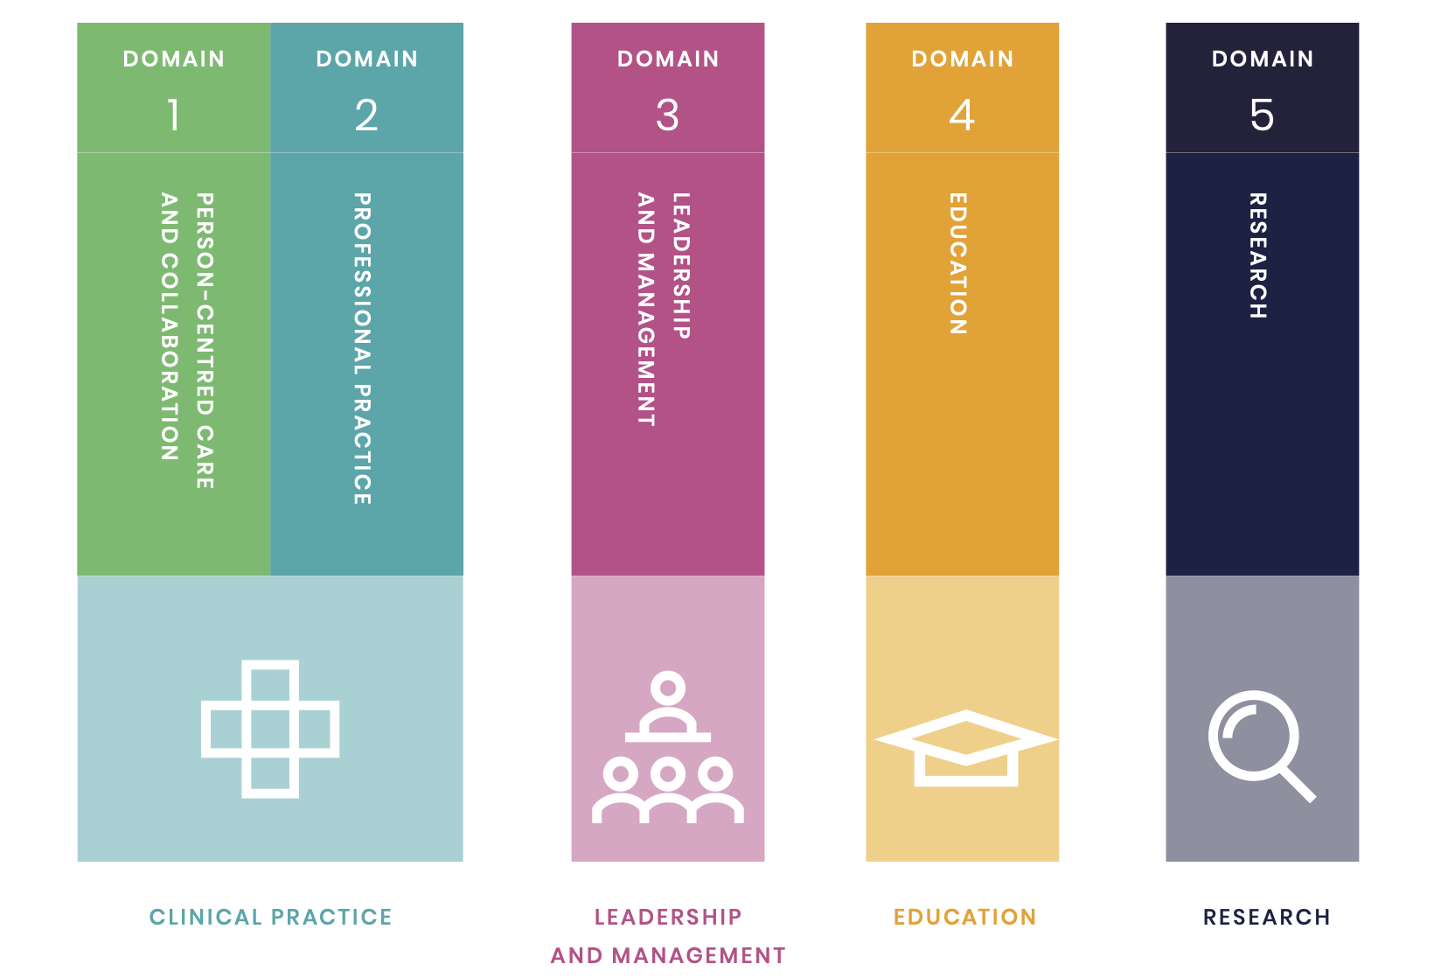
Consultant pharmacist curriculum

Slide 8

Interim NHS People Plan: the future pharmacy workforce
Clinical pharmacists in all sectors will increase their activity in clinical research into new and existing medicines and professional interventions.

Slide 9
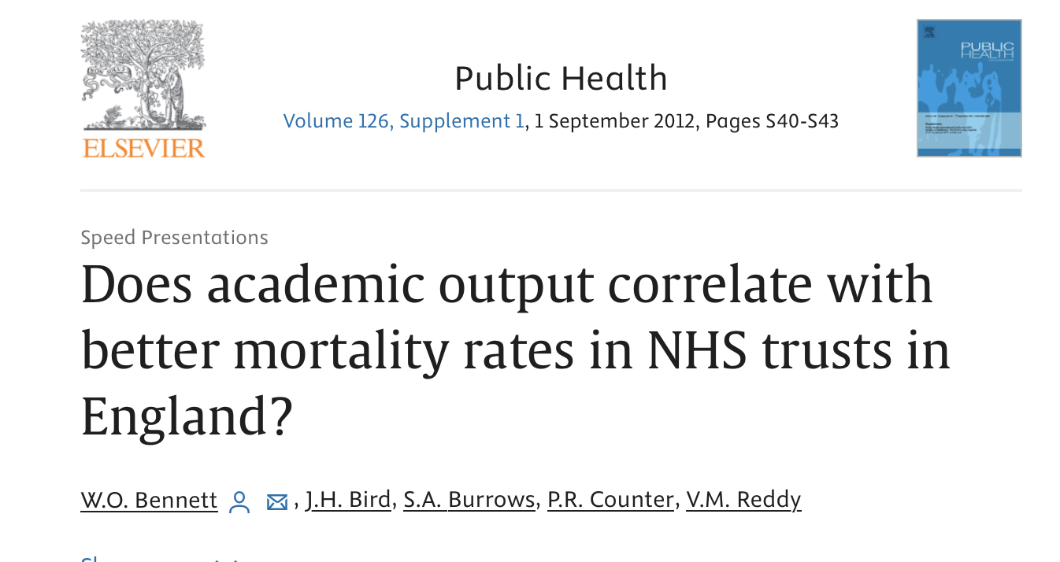
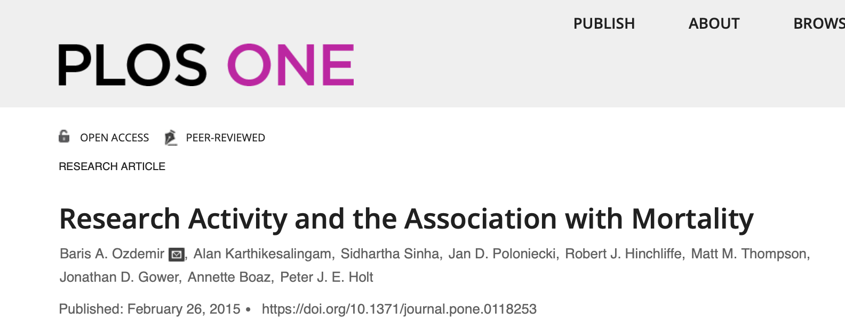
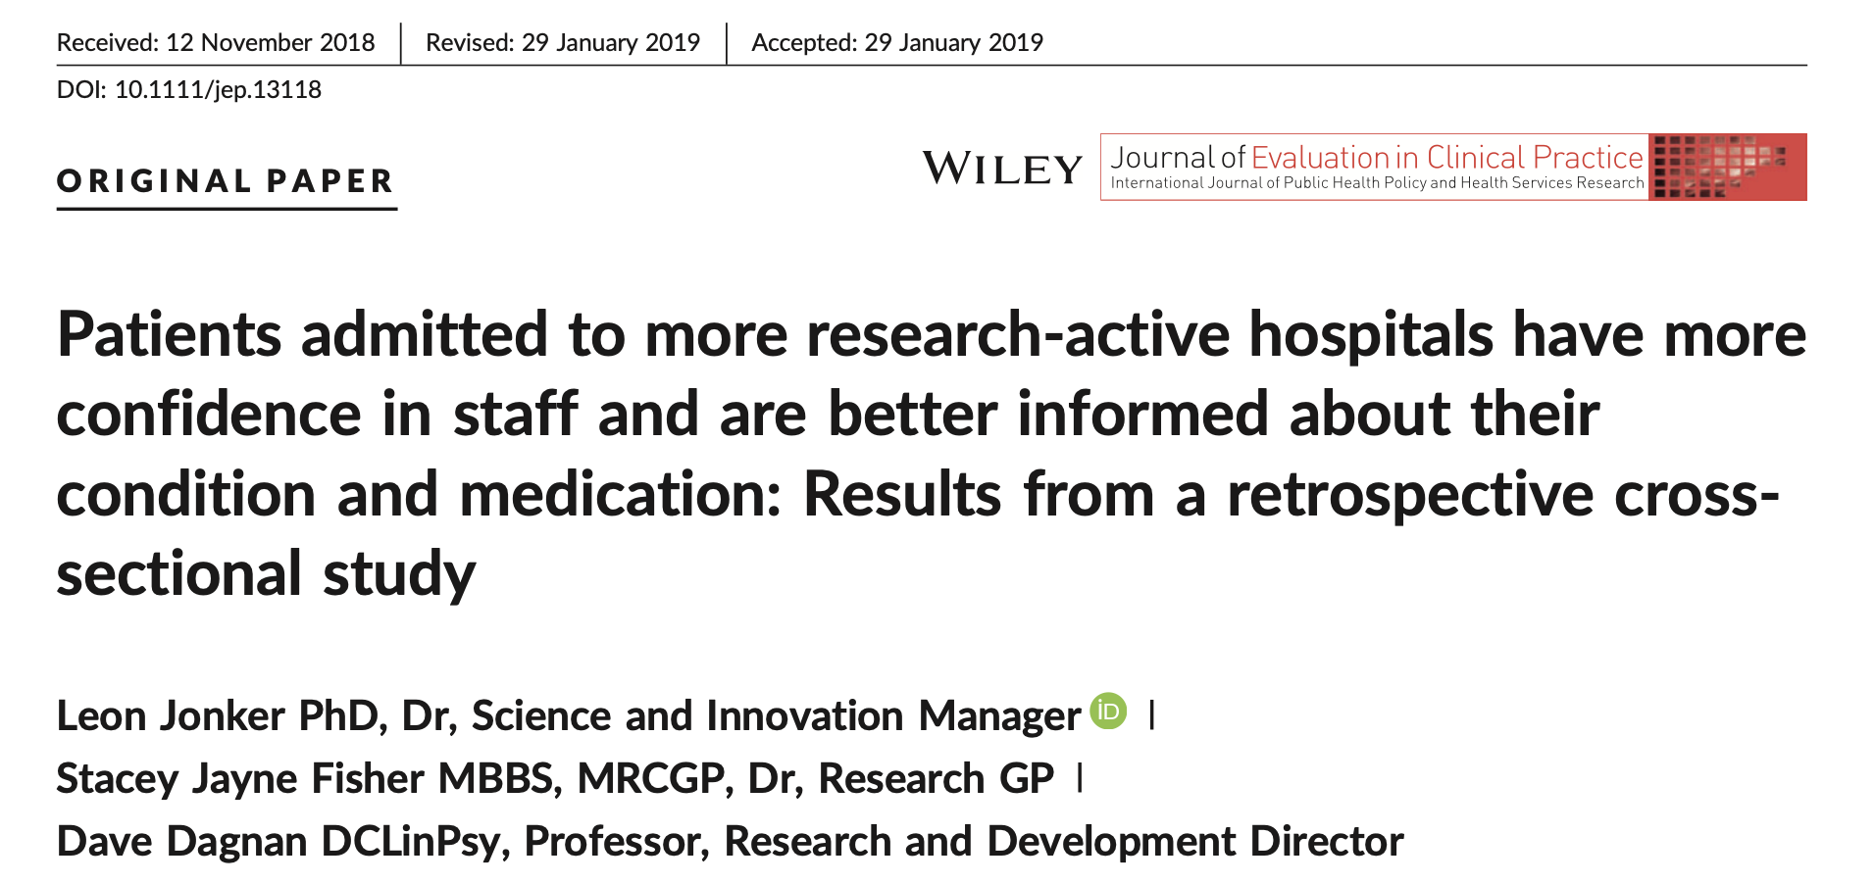
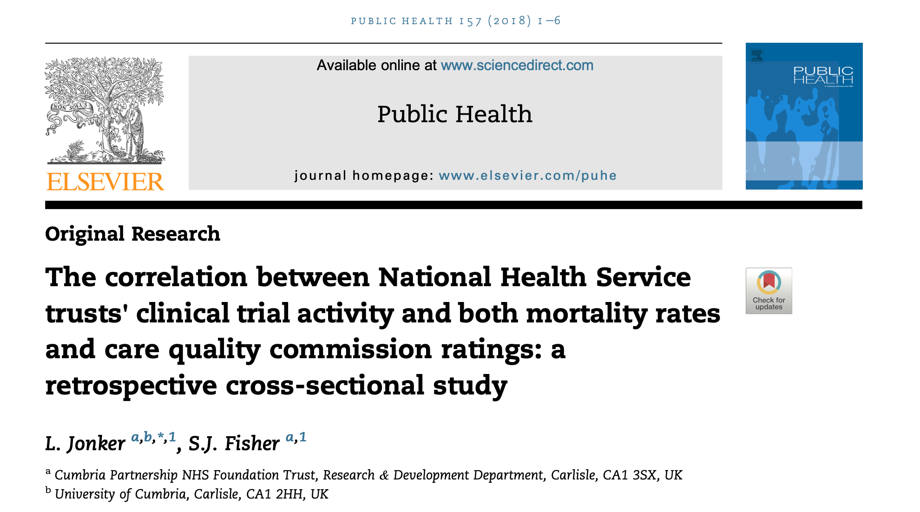
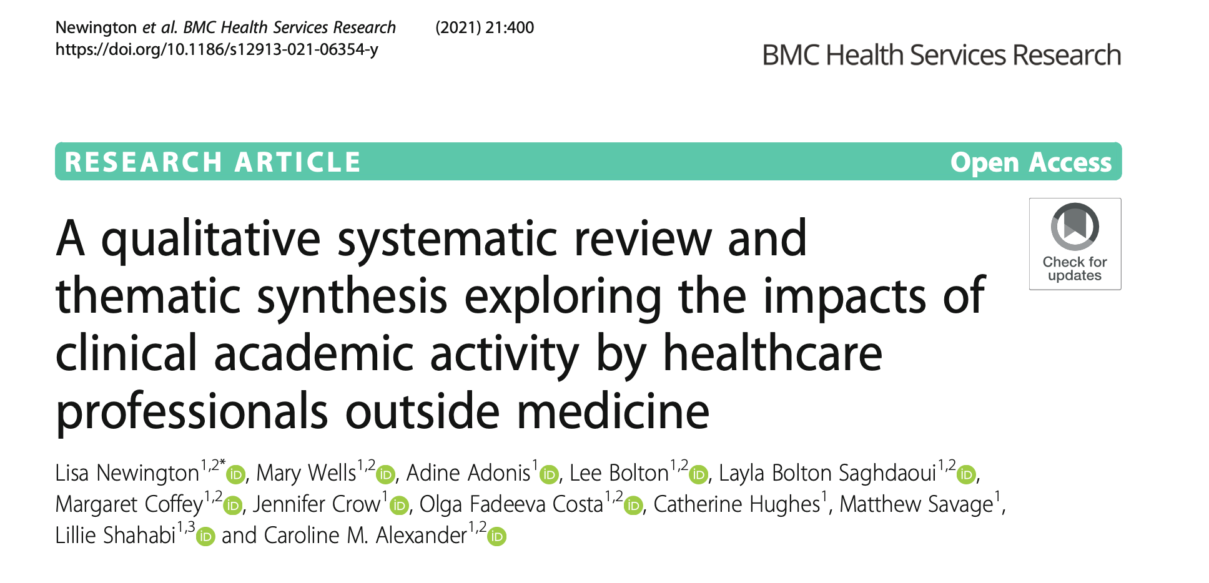
Increased research = decreased deaths
Better quality of information provision to patients, better teamwork, more confidence in treatment, better overall inpatient experience
Staff more likely to recommend hospital as a place to work and reduced staff turnover

Slide 10
Promoting Research activity
Research Awareness
Research implementation
Research delivery
Research Leadership
Keeping up to date – awareness of research in your area – know the guidelines
Searching for research
Design projects/ implementation research to improve practice
Recruit to studies,
Recruit & support research participants
Data collection of existing
Good Clinical Practice
Clinical Academic
Pathway Internship, pre-doc, doctoral, post doc
Professor
Notes:
.

Slide 11
Research myths
Myth | Truth
Research is carried out by academics | Research is conducted by any STAFF
I prefer working with patients | Research involves WORKING WITH PATIENTS and improves the care you give them
Research doesn’t help patients | Research often helps to provide GOLD STANDARD EVIDENCED BASED CARE
Research happens in a laboratory | Research happens in all types of SETTINGs
I don’t have time for research | You can do a small part of a research project which takes less TIME

Slide 12
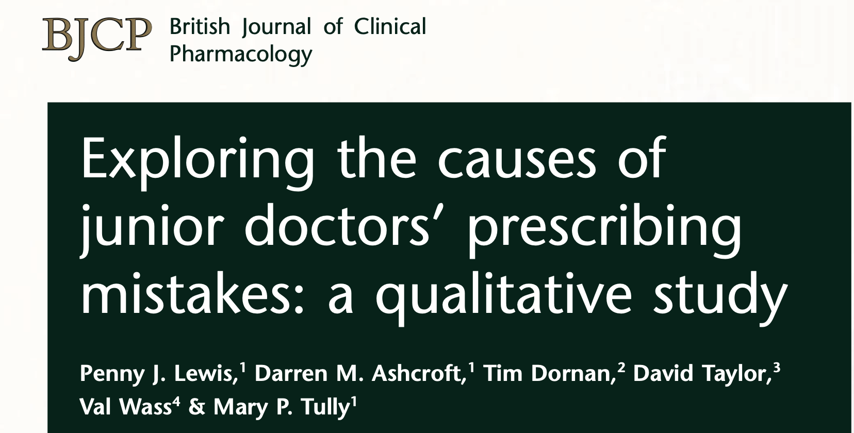
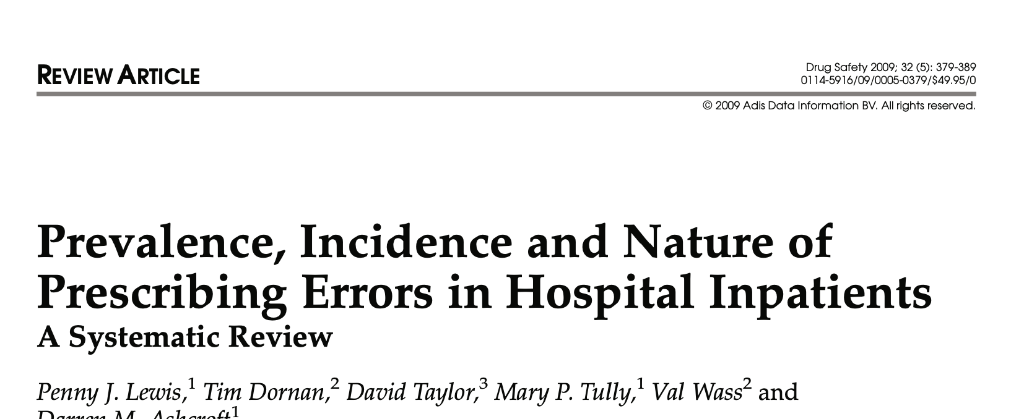
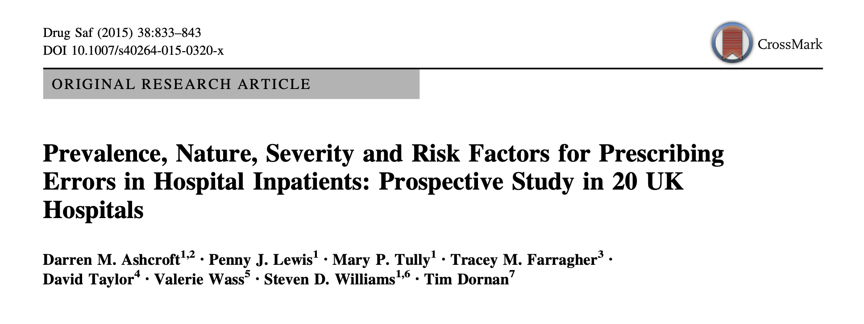
Pharmacists working together to understand prescribing errors:
  Aim:
  Explore the prevalence and causes of prescribing errors made by junior doctors
  Methods:
  Prescription chart review by pharmacists across 20 different hospitals
  Qualitative interviews

Slide 13
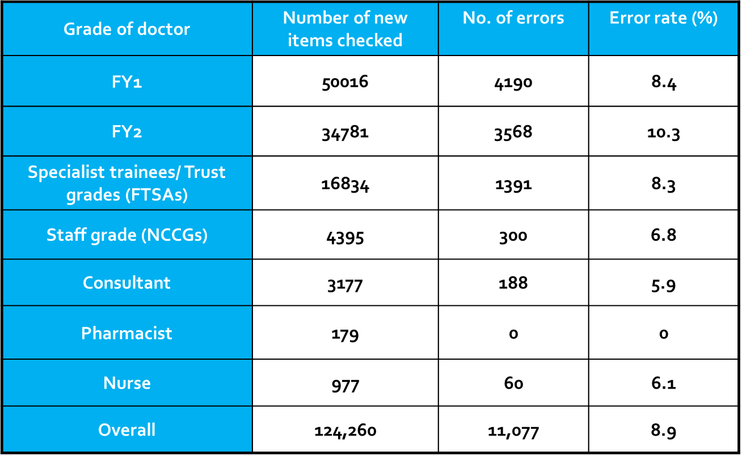
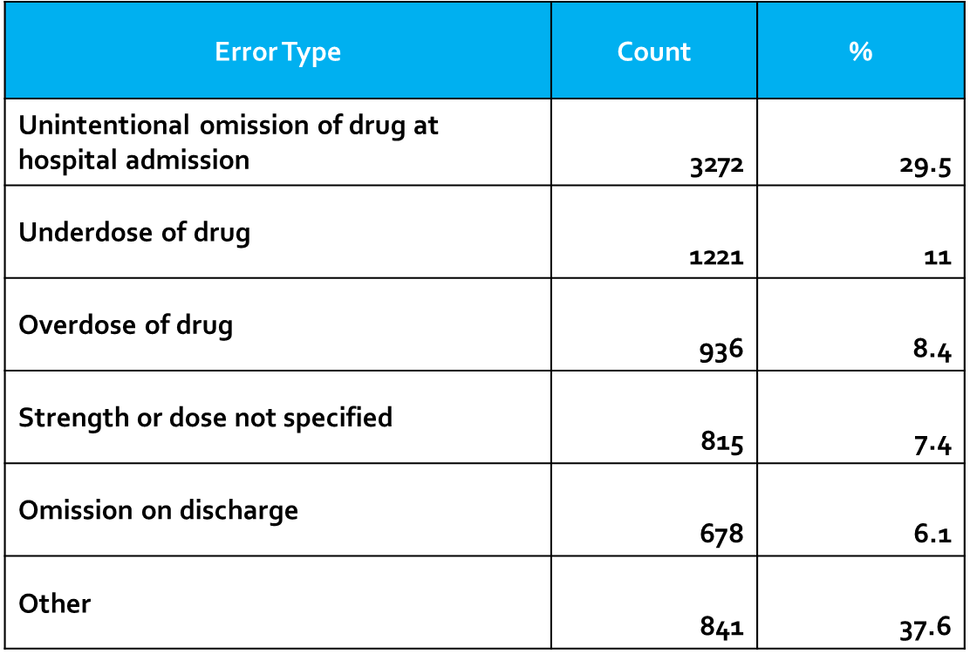
Results: prevalence of prescribing errors
Knowledge-based mistakes | Emphasis on practice and more work placements in undergraduate medical training Introduction of standardised tools to improve communication inter and intra-professionally. Increasing the visibility of pharmacy services
Rule-based mistakes | Systematic approach to prescribing/ checklists Deliberate practice – simulation-based team training Understanding of skills and competencies available in team Improved questioning skills
Results
Ashcroft DM, Lewis PJ, Tully MP, Farragher TM, Taylor D, Wass V et al. Prevalence, Nature, Severity and Risk Factors for Prescribing Errors in Hospital Inpatients: Prospective Study in 20 UK Hospitals. Drug Safety 2015; 38(9):833-843
Lewis PJ, Ashcroft DM, Dornan T, Taylor D, Wass V, Tully MP. Exploring the causes of junior doctors’ prescribing mistakes: a qualitative study. BJCP 2014; 78 (2):310-319

Slide 14
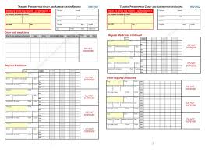

Impact of research
Study led to changes in:
Recommended design of hospital prescription charts
An annual national assessment of prescribing competence of medical students
Employment of extra hospital pharmacists to prevent the 9% of prescriptions with errors from harming patients.

Slide 15

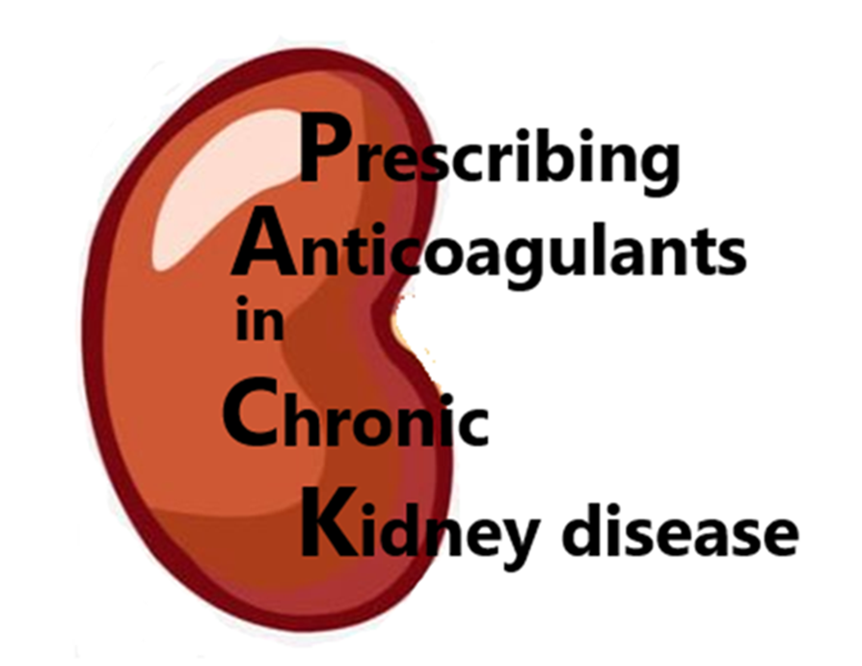

Anticoagulation in advanced Chronic Kidney Disease- Exploring and Guiding Current
Prescribing Practice in the UK

Slide 16
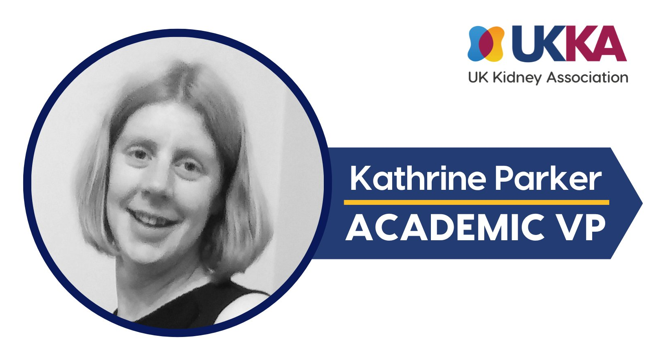
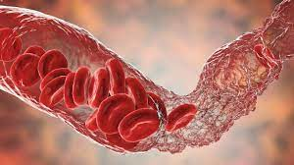
DOACs in kidney transplant paper
Prescribing practice survey and Case vignettes
Delphi consensus
Development of a best practice guideline for use of anticoagulation in advanced CKD
Systematic review
Kathrine Parker- NHS Specialist renal Pharmacist
NIHR integrated clinical academic doctoral fellow
Risk score development for Atrial Fibrillation
Patient focus groups
Co-production patient materials

Slide 17
Summary
Research activity has positive impacts on patient care
All pharmacists can get involved in research in multiple ways
Can use research to demonstrate the impact of pharmacy services

Slide 18

Questions?

